Slide 1
Simplify Fractions
Diving
Use the bar models to help you simplify the fractions.
6
2
9
3
6
2
15
5

Slide 2
Simplify Fractions
Diving
Use the bar models to help you simplify the fractions.
6
3
8
4
4
2
10
5

Slide 3
Use Common Factors to Simplify Fractions
Explain how you would use the common factors of 24 and 30 to express in its simplest form.
24
30
The common factors of 24 and 30 are 1, 2, 3 and 6. Take the highest factor which is 6.
Divide 24 and 30 by 6.
= .
is the simplest form.
24
30
4
5
4
5
Show
Answers
Hide
Answers

Slide 4
Simplify
Simplify these fractions into the simplest form, write the highest common factor with your answer:
(2)
(3)
(5)
(4)
7
12
14
24
7
10
21
30
5
8
25
40
4
7
16
28
(8)
(9)
(12)
3
8
24
64
4
9
36
81
3
11
36
132
Show
Answers
Write some for a partner.
Hide
Answers

Slide 5
Simplify Fractions
Diving
Find the pairs of equivalent fractions.
v
v
v
v
v
$$\frac{\text{4}}{\text{5}}$$
$$\frac{\text{2}}{\text{3}}$$
$$\frac{\text{1}}{\text{6}}$$
$$\frac{\text{3}}{\text{7}}$$
$$\frac{\text{5}}{\text{9}}$$
v
v
v
v
v
$$\frac{\text{4}\text{0}}{\text{72}}$$
$$\frac{\text{6}}{\text{9}}$$
$$\frac{\text{8}}{\text{10}}$$
$$\frac{\text{9}}{\text{21}}$$
$$\frac{\text{5}}{\text{30}}$$

Slide 6
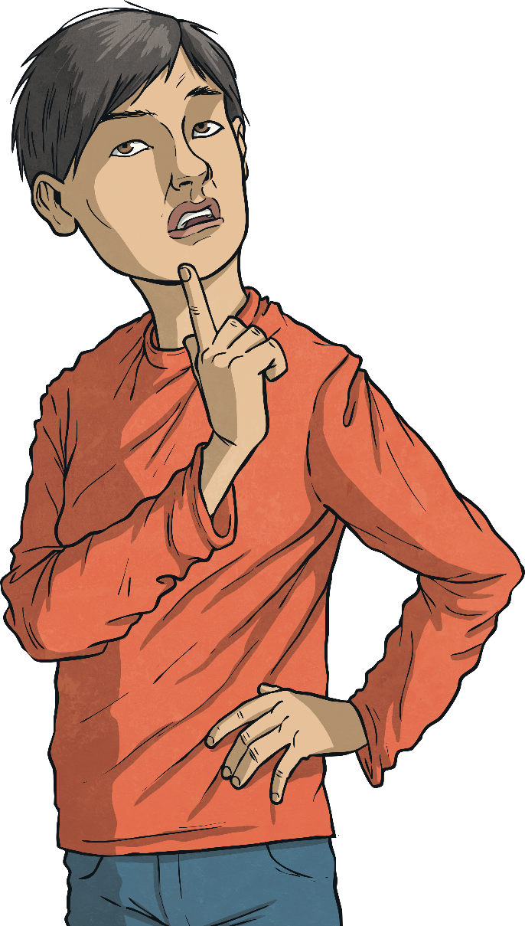
Simplify Fractions
Deeper
Is this statement correct? Explain your answer.
$\frac{\text{35}}{\text{45}}$ in its simplest form is $\frac{\text{14}}{\text{1}\text{8}}$.
This is incorrect.
$\frac{\text{35}}{\text{45}}$ is equivalent to $\frac{\text{14}}{\text{1}\text{8}}$ but to simplify it completely the correct answer is $\frac{\text{7}}{\text{9}}$.

Slide 7
Simplify Fractions
Deeper
Marlon is blowing bubbles in the park.
12 bubbles landed on the grass.
10 bubbles floated away.
8 bubbles popped straight away.
Is this statement correct? Explain your answer.
The fraction of bubbles that floated away is $\frac{\text{10}}{\text{30}}$ in its simplest form.
This is incorrect.
$\frac{\text{10}}{\text{30}}$ in its simplest form is $\frac{\text{1}}{\text{3}}$ .

