Slide 1
Let’s recap…
$=$ one hundredth
$=$ $\frac{\text{1}}{\text{100}}$
$=$ 0.01
1 %
$=$ $\frac{\text{10}}{\text{100}}$
$=$ ten hundredths
$÷$ 10
$=$ $\frac{\text{1}}{\text{10}}$
$=$ one tenth
$=$ 0.1
10 %
percentage
‘out of’
‘one hundred’

Slide 2
Have a think
$\frac{\text{56}}{\text{100}}$
56 %
0 . 56
56
%
c
5 tenths and 6 hundredths
56 hundredths
out of one hundred
0.
$\frac{\text{97}}{\text{100}}$
0 . 97
97 %
$\frac{\text{33}}{\text{100}}$
33 %
0 . 33
c

Slide 3
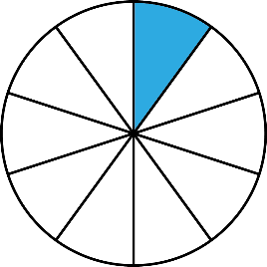
Equivalent FDP
Diving
Complete the table showing the correct equivalences between these fraction, decimal and percentage representations. Show each fraction in its simplest form.
Fraction in its Simplest Form | Decimal | Percentage
0.1
0.1
0.1
0.1
1 2
50%
0.1
0.1
10%
11 20
0.55

Slide 4
Equivalent FDP
Diving
Complete the table showing the correct equivalences between these fraction, decimal and percentage representations. Show each fraction in its simplest form.
Fraction in its Simplest Form | Decimal | Percentage
0.4
40%
0.1
0.01
0.01
13 100
13%
0.01

Slide 5
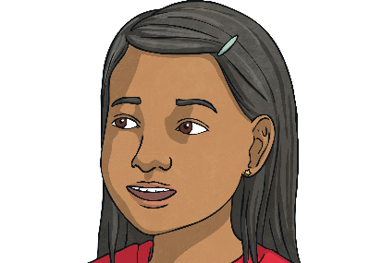
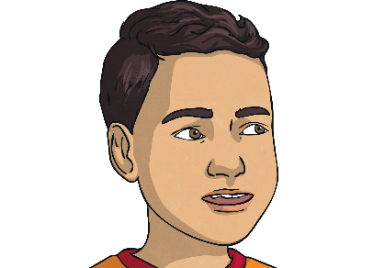
Equivalent FDP
Deeper
Emily and Robert have been asked to give the missing value of the mid-point on this number line as either a fraction, decimal or percentage.
0.4
0.45 = 45% =
45 100
2 5
?
0.5
I think the missing value is 0.3.
I think the missing value should be .
3 5
Is either child correct? How do you know?
Neither child is correct as Robert thinks the missing value is equivalent to 0.6 or 60% and Emily thinks it is equivalent to or 30%.
The missing value is 0.45 or 45% or .
3 10
45 100

