Slide 1
Aim
I can recognise and use subordinating conjunctions.
Success Criteria
I can recognise that subordinating conjunctions are used to create subordinate clauses.
I know that subordinate clauses are used within complex (multi-clause) sentences.
I can use ‘I SAW A WABUB!’ to remember the main subordinating conjunctions.
I can write my own complex (multi-clause) sentences using different subordinating conjunctions.

Slide 2
A clause is a group of words.
Sentences are made up of clauses.
A clause that adds extra information to a sentence is called a subordinate clause.
I found it hard to get to school this morning.
This has 1 clause

Slide 3
I found it hard to get to school this morning.
This has 1 clause
I found it hard to get to school this morning because of a traffic jams.
The subordinate clause adds more information to the sentence. But it wouldn’t make sense on its own.

Slide 4
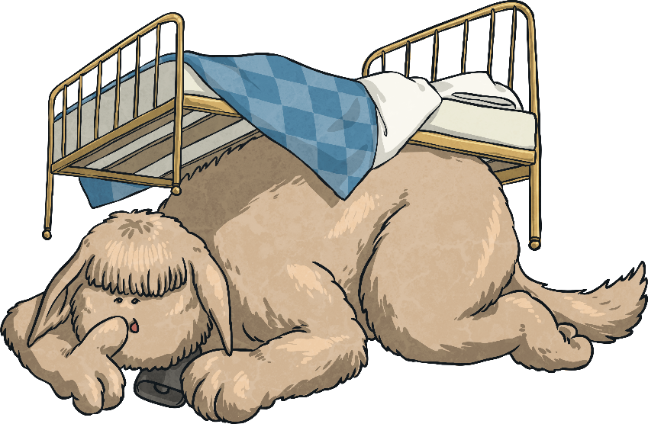
…is an acronym to help you remember the first letters of some of the most important subordinating conjunctions.
I Saw a Wabub…
If
Since
As
When
Although
While
After
Before
Until
Because
I
S
A
W
A
W
A
B
U
B!

Slide 5
So, how do we use subordinating conjunctions?
Next Steps
Subordinating conjunctions are the first words within a subordinate clause. Subordinate clauses do not make sense on their own but, when they are used with a main clause, they create a complex (multi-clause) sentence.
Subordinate clauses will always have a subject and verb within them, e.g.
after she smiled
after Christmas
subordinating conjunction
subject
verb
Here ‘after’ is being used as a preposition.
is a subordinate clause
is not a subordinate clause

Slide 6
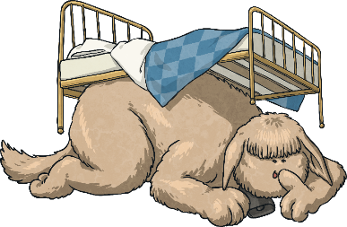
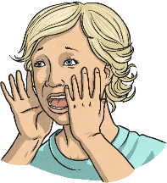
Subordinating conjunctions can also be used as the first word in a sentence. When the subordinate clause comes before the main clause, make sure you remember to use a comma to mark where the subordinate clause ends.
Next Steps
I SAW A WABUB!
When the bell rang, the eager pupils sped into school.

Slide 7
Can you spot the subordinating conjunctions in this piece of text? Where have they been used in these sentences?
I SAW A WABUB!
Subordinating Conjunction Hunt
As he walked closer, Cleo could see the crocodilius in the cave entrance. The beast was hurriedly eating the remains of its last unlucky victim because it was ravenous. Cleo examined its bright red eyes, huge smoking nostrils and razor-sharp teeth while the beast was occupied. Although Cleo was standing quite a distance away, the terrible stench of the gruesome beast was still making him feel nauseous. Cleo took a deep breath before he tiptoed bravely forward. It was time for battle.

Slide 8
Can you spot the subordinating conjunctions in this piece of text? Where have they been used in these sentences?
I SAW A WABUB!
Subordinating Conjunction Hunt
As he walked closer, Cleo could see the crocodilius in the cave entrance. The beast was hurriedly eating the remains of its last unlucky victim because it was ravenous. Cleo examined its bright red eyes, huge smoking nostrils and razor-sharp teeth while the beast was occupied. Although Cleo was standing quite a distance away, the terrible stench of the gruesome beast was still making him feel nauseous. Cleo took a deep breath before he tiptoed bravely forward. It was time for battle.

Slide 9
Now, it’s your turn. Which subordinating conjunction would fit best at the start of this subordinate clause? Is there more than one possibility?
I SAW A WABUB!
Practise Your Skills
I eat lunch, I am going
to an important meeting.

Slide 10
Now, it’s your turn. Which subordinating conjunction would fit best at the start of this subordinate clause? Is there more than one possibility?
I SAW A WABUB!
Practise Your Skills
he was thrown from his saddle,
Henry was wary of riding his horse.

Slide 11
Can you spot the subordinating conjunctions in these sentences?
I SAW A WABUB!
Quick Quiz:
Question 1
a)
b)
c)
Until she tried, Daphne didn’t know that she could whistle.
Heavy snow poured from the skies while the children made a snowman.
Although it was expensive, the couple enjoyed their meal at the award-winning restaurant.
Until she tried, Daphne didn’t know that she could whistle.
Heavy snow poured from the skies while the children made a snowman.
Although it was expensive, the couple enjoyed their meal at the award-winning restaurant.

Slide 12
Complete the sentences below by writing the subordinating conjunctions from the box in the correct places to form complex sentences. Use each conjunction only once.
I SAW A WABUB!
Quick Quiz:
Question 2
a)
b)
c)
The greenhouse got smashed the boys were playing football.
they were in trouble, they had to go inside the house.
they were well-behaved, they could have their ball back next week.

Slide 13
Can you add a subordinate clause to each sentence- remember to start with a conjunction.
If
Since
As
When
Although
While
After
Before
Until
Because
Eliza dreaded going to the mill
Mary screamed
Annie kept working at her machine
Mr Davis was furious

