Slide 1
Thursday 4th March
World Book Day

Slide 2
Who are the masked readers?
Watch the videos and make a guess, further clues to follow.

Slide 3
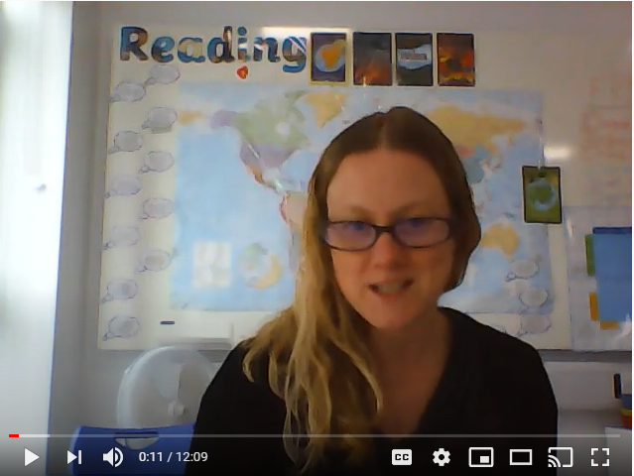
World book day quiz.
https://youtu.be/rhY75IkOhWg

Slide 4
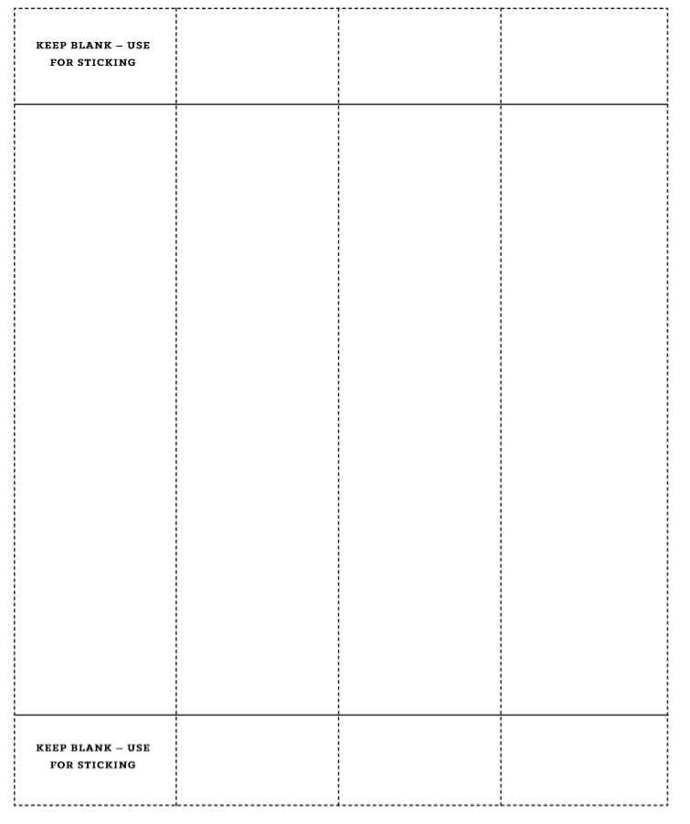
Paper chains showing your favourite book

Slide 6
3. Book in the Window - Like the rainbows displayed in the window to support NHS - draw the front cover of your favourite book and display for others to see.
4. Recipe - create your own recipe linked to the BFG
file://easiserv-2190/users/teachers/work/dbeckwith/Desktop/Roald+Dahl+Dictionary.pdf
5. Draw with Rob - World Book Day bookmarks https://www.youtube.com/watch?time_continue=22&v=WhMoHJuQuLs&feature=emb_logo
6. Make a den and read a book in there - send us a picture!

