Slide 1
Properties and Changes of Materials 2 Lesson 2

Slide 2
How can we separate mixtures?

Slide 3
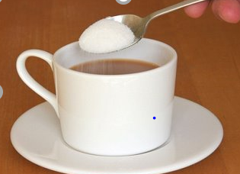
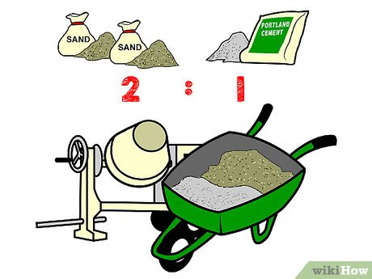
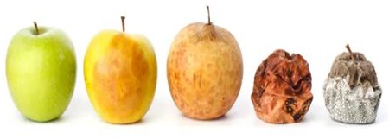
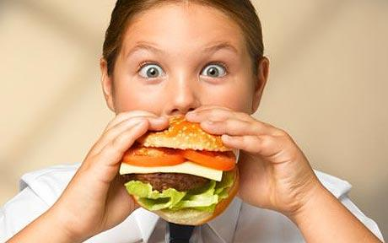
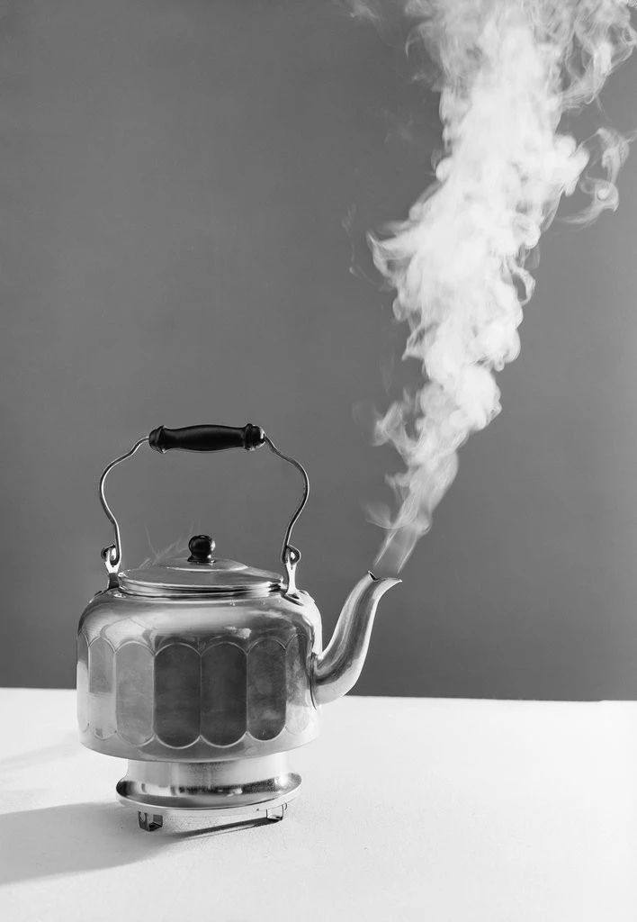
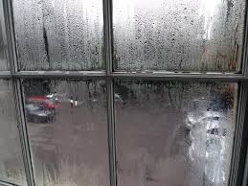
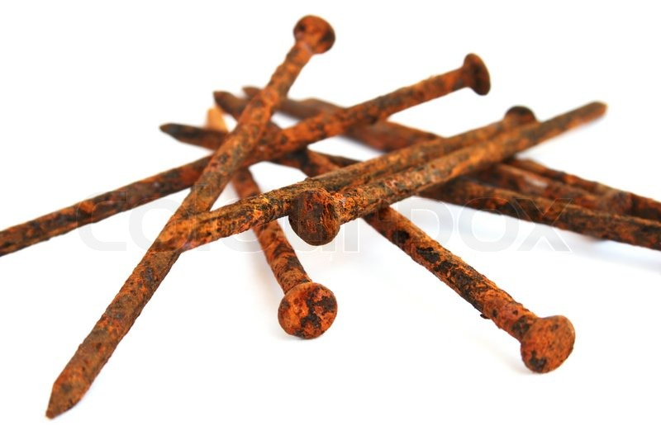
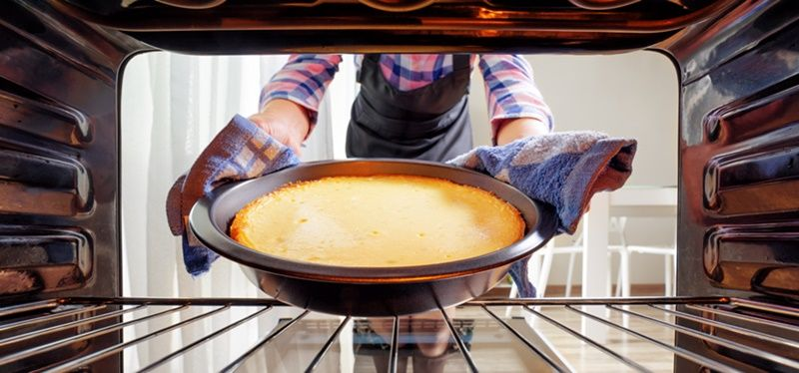
Can you classify these images?

Slide 4
Vocabulary | Definition
separation technique | A method for sorting and separating out the constituent parts of a mixture.
magnetic | Being attracted to a magnet (antonym: non-magnetic).
sieve | Equipment with a mesh for separating out solids of different sizes.
filtration (filtering) | A separation technique for separating out an insoluble solid from a liquid. In the classroom or lab this usually consists of a funnel and a cone of filter paper.
residue | The solid left behind in the filter following filtration.
filtrate | The liquid that passes through the filter during filtration.

Slide 5
More About Irreversible Changes (optional)
https://www.bbc.co.uk/bitesize/topics/zcvv4wx/articles/zw7tv9q

Slide 6
Writing Opportunity
Explain how some of the separation techniques for mixtures that you have used in this lesson work. Show how considering the properties of each component of the mixture is important.

