Slide 1
Why is Ramadan and Eid important?
LO- understand why Muslims fast during daylight hours.
LO- know that Ramadan is a time where Muslims think about others who are less fortunate than themselves.

Slide 2
The 5 pillars of Islam

Slide 3
First task
Complete the worksheet on the 5 pillars.
What each one represents.

Slide 4
What is Ramadan?
https://www.bbc.co.uk/newsround/23286976

Slide 5
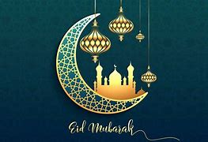
7 things you need to know about Ramadan:
It begins at the first sight of the new moon, of the ninth month of the Islamic year.
Many Muslims fast from dawn until dusk.
Muslims get up at dawn and have a meal called ‘Suhoor’.
They will break their fast at dusk usually with dates and a meal called ‘Iftar’.
Muslims believe that fasting understand the needs of the poor.
It’s a time to grow closer to ‘Allah’ or ‘God’ through prayer, giving to charity and reading the Quran their holy book.
Ramadan lasts for around 30 days and ends with a huge celebration called ‘Eid-al-Fitr’. Muslims attend Eid prayers and have a feast with friends and family.

Slide 6
Eid- Al- Fitr
What is Eid-ul-Adha? - BBC Bitesize

Slide 7
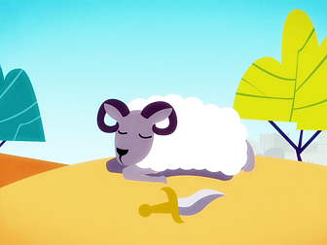
Eid-Al-Fitr
The story of Eid-Al-Fitr
Eid ul-Adha celebrates the time when Ibrahim had a dream which he believed was a message from Allah asking him to sacrifice his son Isma'il as an act of obedience to God. The devil tempted Ibrahim by saying he should disobey Allah and spare his son. As Ibrahim was about to kill his son, Allah stopped him and gave him a lamb to sacrifice instead.
How is it celebrated?
In some countries, Muslims sacrifice a sheep or goat (in Britain the animal is killed at a slaughter house). The meat is shared equally between family, friends and the poor.
Eid usually starts with Muslims going to the Mosque for prayers. They dress in their best clothes and thank Allah for all the blessings they have received. It is a time when they visit family and friends. Muslims will also give money to charity so that poor people can celebrate too.

Slide 8
Hajj
Muslims celebrate Eid ul-Adha on the last day of the Hajj. The Hajj is pilgrimage to Makkah in Saudi Arabia.
All Muslims who are fit and able to travel should make the visit to Makkah at least once in their lives.
During the Hajj the pilgrims perform acts of worship and renew their faith and sense of purpose in the world. They stand before the Ka'bah, a shrine built by Ibrahim, and praise Allah together.
The Ka'bah is the most important monument in Islam. Pilgrims walk around the Ka'bah seven times and many of them try to touch the Black Stone located at the corner.

Slide 9
Activity
Draw 4 pictures that best represents Ramadan and Eid- Al – Fitr.
Write a description under each picture as to why you have drawn that and what it represents.

