Slide 1
Monday 22nd February
Welcome back!

Slide 2
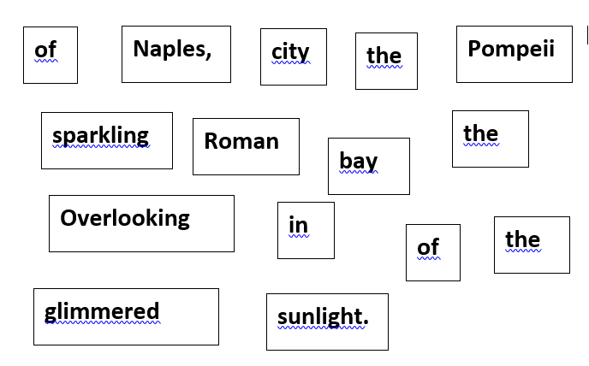
ENGLISH/READING:
Here is a 'chopped up' sentence.
You should be familiar with this as we have done this a number of times in class. Look and read the words carefully and build the sentence. It would really help you if you can write out the words on paper and move them around to build a sentence.
The clue is that the sentence starts with a fronted adverbial for where - remember there is a comma to show the end of the fronted adverbial. Keep reading your sentence to check it makes sense.
Remember you can stroll your sentence as you build to help you - like we do in class.
Now, write down 5 things you know are facts (the truth from the sentence) and 5 inferences (things that might be true from what you have read in the sentence).

Slide 3
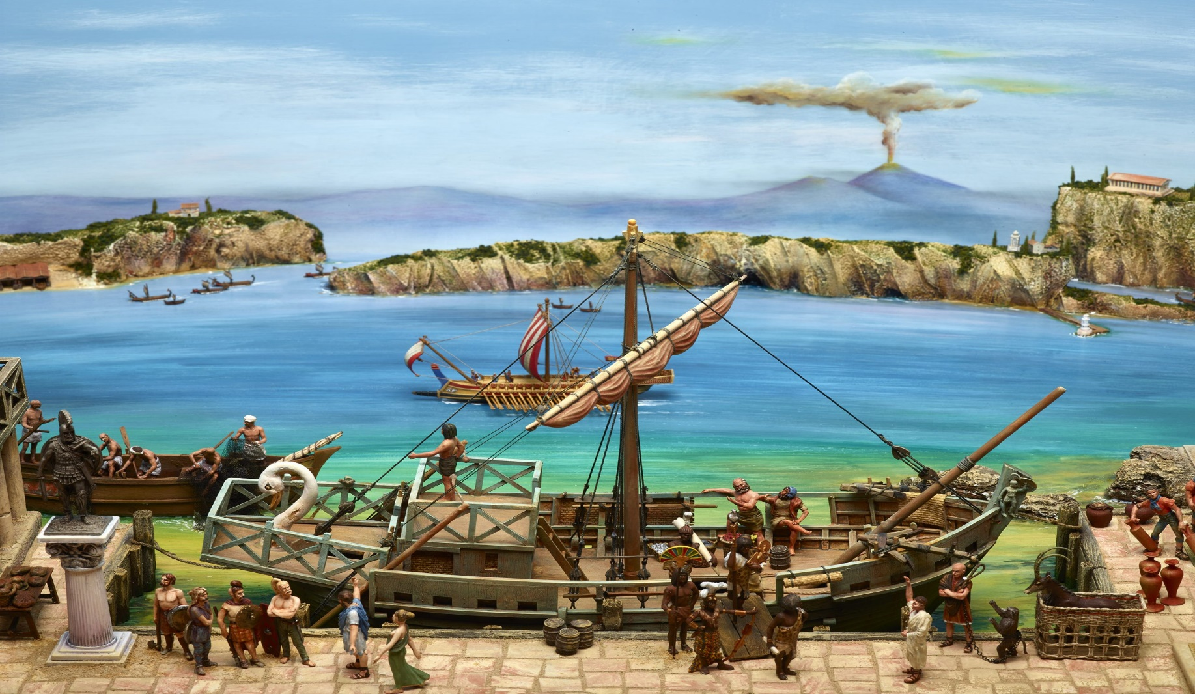
WRITING:
Now you have your sentence from your reading session - there are two adjectives in the sentence used to describe nouns - glimmered and sparkling - can you think of similar adjectives you could use?
Also there is a fronted adverbial at the start of the sentence which describes where the story is set. Can you think of other fronted adverbials for where that would fit? The picture below could help you, you can use words like Near, Next to, By, In front of, In the background..... to help you.
Now use your sentence and write five sentences using different fronted adverbial (remember comma) and different adjectives for glimmering and sparkling for each sentence.

Slide 5
https://vimeo.com/497343674

Slide 6
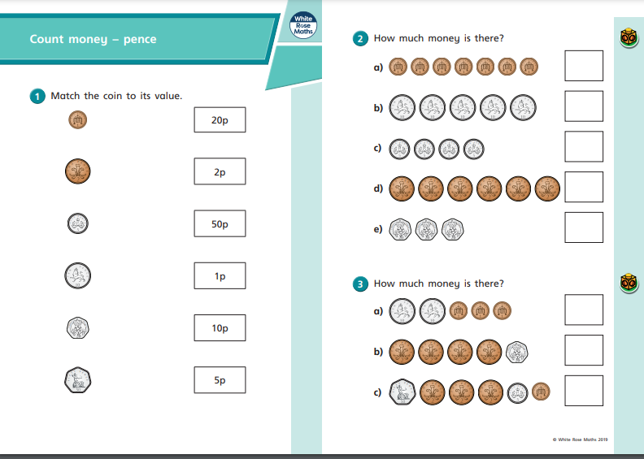
https://resources.whiterosemaths.com/wp-content/uploads/2019/09/Y2-Autumn-Block-3-WO1-Count-money-pence-2019.pdf

Slide 7
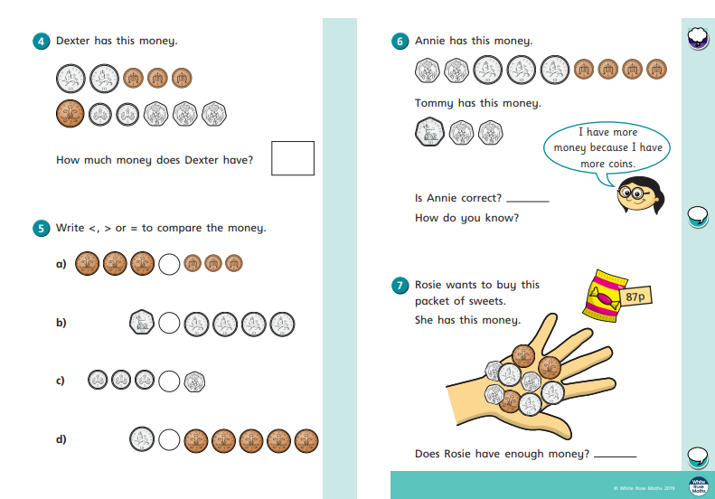

Slide 8
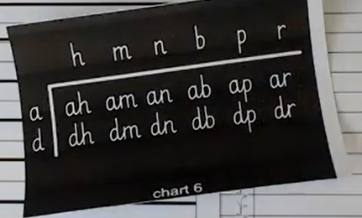

Slide 9
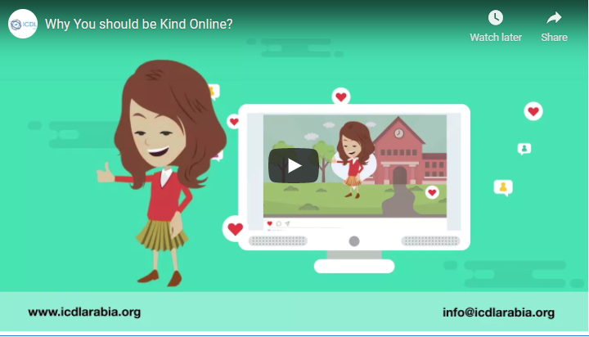
Watch the video about being kind online. Kindness is our value this week so it is important to be kind at home, in school and online.
It is important that you treat your friends the same online as you would if you saw them face to face.
Can you create your own Online Friendship Flower? On each petal can you write a quality of what makes a good friend online?
Try and draw 6 petals. Be as creative as you like and send us a picture to our email address.
https://www.youtube.com/watch?v=qnfWj0unOAw&feature=emb_logo

Slide 11
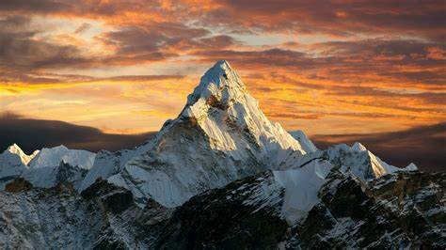
Geography- lesson 1 (final)
Mountains worksheet

