Slide 1
Monday 1.2.21
Remember to mute yourselves!

Slide 2
Can you work out the country from the clues?

Slide 3
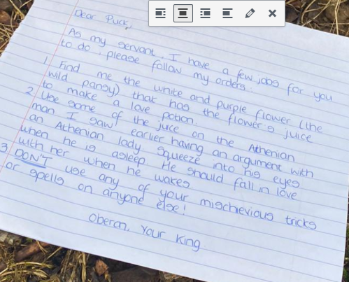
Reading:
Look's like we have had some visitors and it looks like, the play/ story has moved back into the magical forest. Read through the note and try answering the questions below.

Slide 4
Why does Oberon need a purple flower? (Think back to his argument with Titania).
Who do think the Athenian man was, who was having an argument with an Athenian lady?
Look at the last point, number 3, does Puck follow this order? (Think what we know he does)
If someone is Athenian, where are they from? (Look at the spelling and think where we have been for the last couple of weeks).
What do we know about Puck?

Slide 5
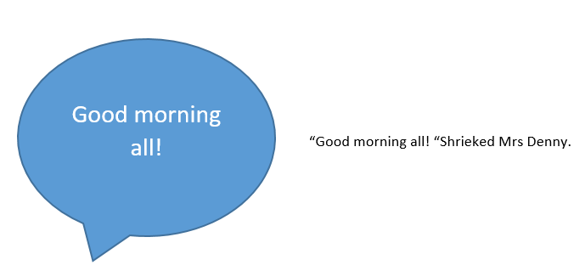
Writing:
Two worlds have collided (come together). The story of the lovers in Athens has moved into the magical forest. And the drama continues...
Please watch the news flash which has occurred in the forest. What has happened now?
Can you change these speech bubbles into direct speech? Direct speech uses:
speech marks to show when someone is talking
a comma or an exclamation mark before you close speech marks
describe how the person said it. Don't just say said - think how they said it.

Slide 7
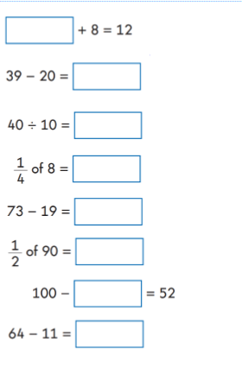
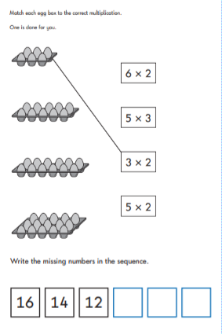

Slide 8
https://vimeo.com/485432791

Slide 11
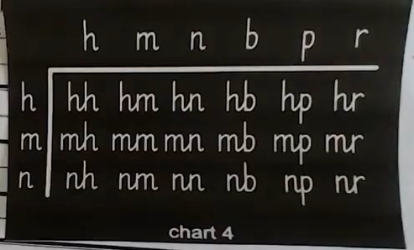
Handwriting

Slide 12
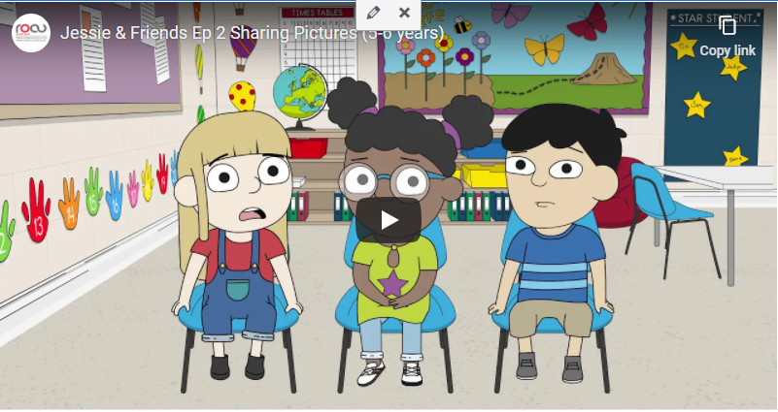
Online safety:
This online safety video is about sharing videos and pictures. Discuss these parts of the story and decide which emoji you would place next to it.
Mo is playing with her friends.
Mo is taking silly pictures with Jessie and Tia.
Mo's picture is shared with people at school.
Miss Humphrey says she will help.
Thinking about Miss Humphrey, who are your trusted adults if something happened online which you needed to talk to someone about?
https://www.youtube.com/watch?v=87eWL0WAnyw&feature=emb_logo

Slide 13
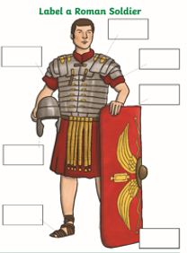

Slide 14
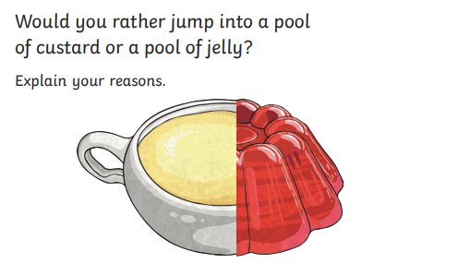
Time to Talk:

Slide 15
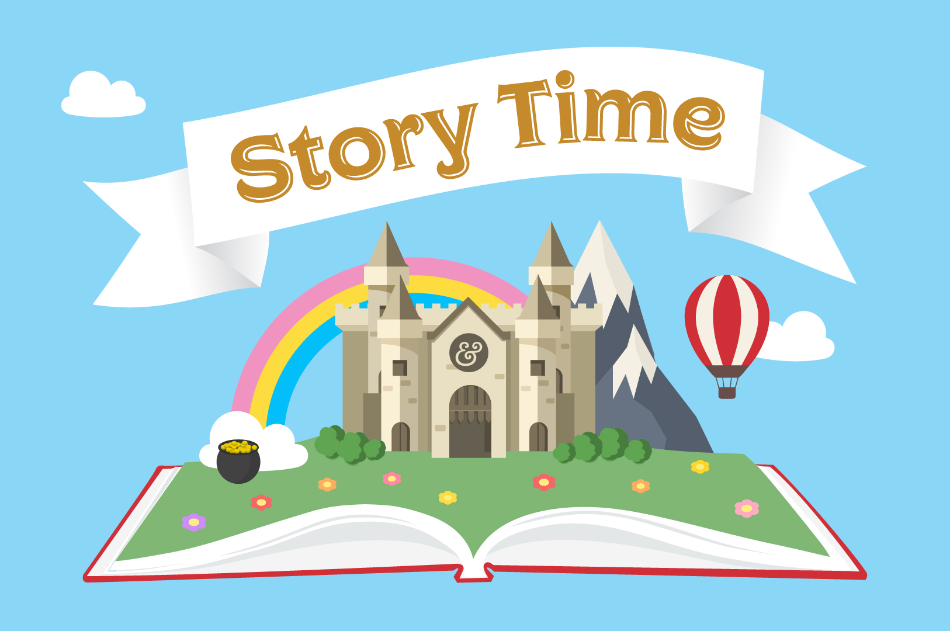
With Miss Bowler!

