Slide 1
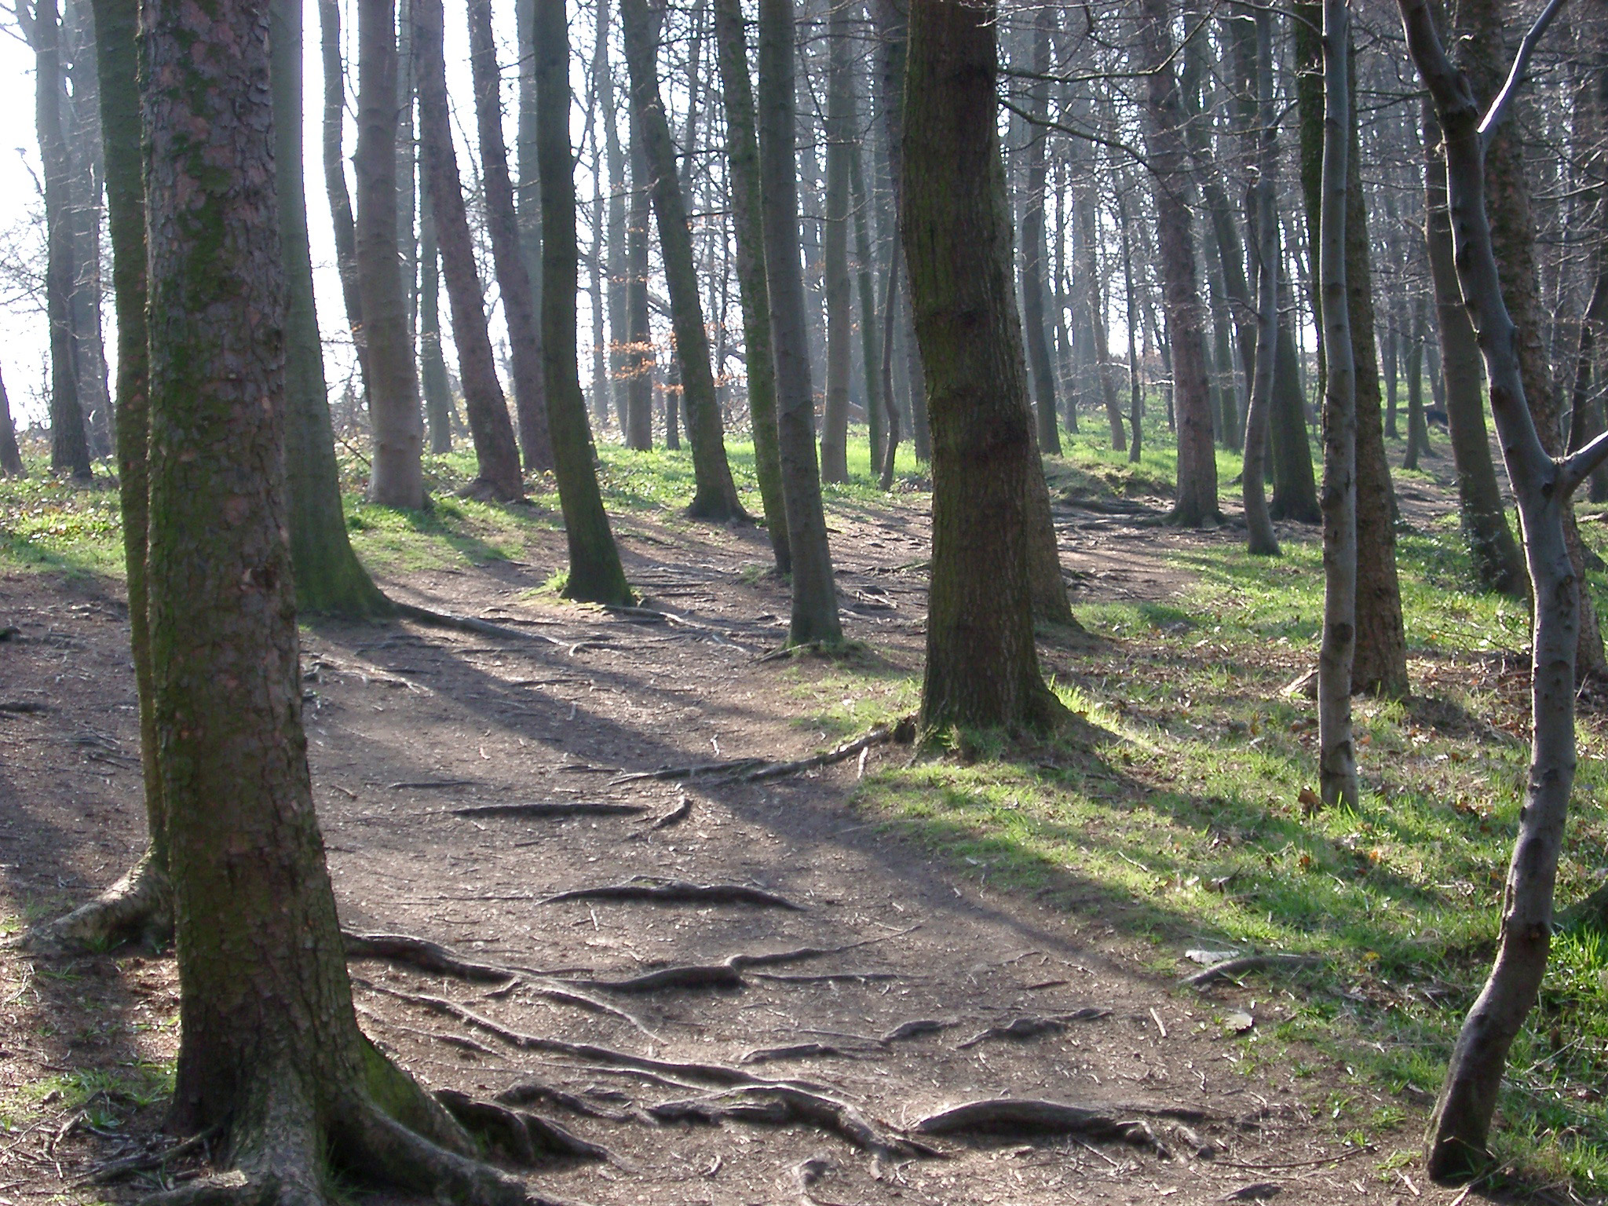
English Lesson 3

Slide 2
Read the next instalment of our new story.
Still Robin dreamed on, dreading how his dream might end. He knew what would happen though. The boy found the hunting horn first and then the bow, which was as big as Robin’s father’s. Then he saw the bones. The boy crouched down, digging away the earth with his hands, his eyes wide with fear. Then the boy was reaching out, reaching down towards him. He was taking him by the back of his head and lifting him. Someone was lifting him, his father perhaps. Robin would wake now and stop it, before it went any further. Enough was enough. He did not want to have to go on. Robin tried not to look at the skull. He looked instead at the boy holding the skull, and saw himself, as he always did. He had always thought the boy in the dream was himself; but now he was not quite so sure. He was older than this boy, a lot older, and he did not have white hair. His hair was black, black as charcoal. He had dreamt this far before and no further. This time he would not wake up in spite of his father calling him and shaking him. This time he would finish, finish and remember and exorcise. The boy dropped the skull back into the earth. It rolled into the bottom of the crater, rolling over and over, until it was still at last, gazing up at the sky and then at him. Now, at last, Robin knew. Those empty staring eyes were his eyes. He was the skull, but he was the boy too. He was both. He was the boy sitting on the rock, the arrowhead in his hand, and he was the skull lying in the earth. He would remember everything now, everything so that he could save himself. He promised himself all that before he woke; and at once he forgot every single thing he had dreamed.

Slide 3
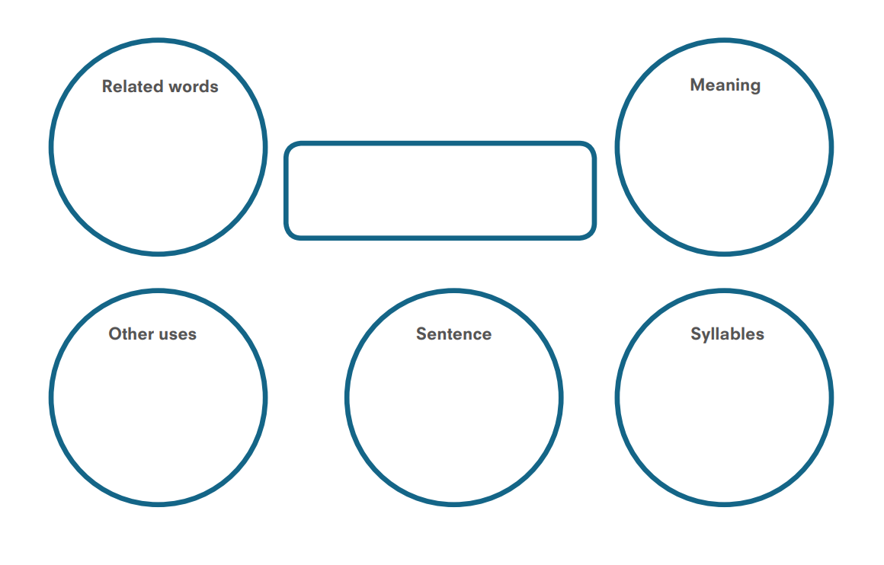
Choose one of the highlighted words from the text to investigate. Find the definition of the other three words too.

Slide 4
Our collection of words:
Can you add a definition to the last four words using the previous activity?
Foretold – predict the future
Stricken – to be affected by an undesirable condition or unpleasant feeling
Debris – scattered pieces of rubbish or remains
Trimmed – decorated with contrasting pieces of material
Crater – a cavity or hole in a surface
Clod – a lump of earth or clay
Dreading –
Crouched –
Charcoal –
Exorcise -

Slide 5
Summary
Can you summarise the story so far?
Remember, to write a good summary we need:
To pick out the key events from the text;
To write them in chronological order;
To pick out key/important words and phrases from the text.

Slide 6
The main characters – what do we know about our two main characters so far? List the things we know.
Character 1
What is s/he like? Describe what you think s/he looks like? Do we know their name?
Character 2
What is s/he like? Describe what you think s/he looks like? Do we know their name?
Don’t worry if you can’t find much for each character, we will add to this as we read on!

Slide 7
The main characters – what do we want to know about our two main characters so far? Write questions for each character – they can be the same question for both.
Character 1
Character 2

