Slide 1
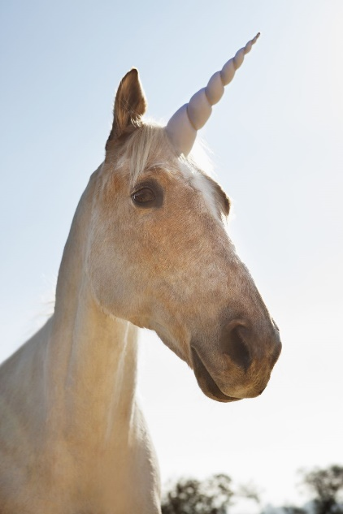
Friday 5.2.21
Fun Friday Fact:
The unicorn is the national animal of Scotland.

Slide 2
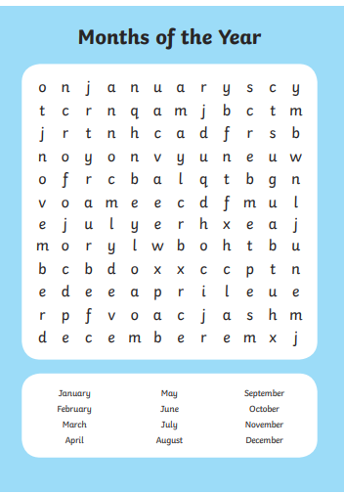

Slide 3
English/Reading:
These two videos show you what happened after Puck made his mistake and how the story/ play ends.
https://www.bbc.co.uk/teach/class-clips-video/english-a-midsummer-nights-dream-7-lifting-the-fog/zvr4rj6
https://www.bbc.co.uk/teach/class-clips-video/english-a-midsummer-nights-dream-8-a-wedding-play/zjm6mfr
Can you answer these questions below:
In Part 7 (the first video), can you write in one sentence what has happened?
What is the main message you learnt in Part 8 (the second video)?
In Part 7, the title is called 'Lifting the fog' - What would you change the title to for this video?
Number these sentences from 1 - 4 to show the order from first to last they happened in the second video (Part 8)
Egeus was angry as he thought Lysander had kidnapped Hermia ____.
The lovers were woken by the sound of the trumpets _____.
Bottom no longer had donkey's ear ____.
Bottom performed in the play for the wedding ____.

Slide 4
Writing:
Imagine the story stopped when Puck made the mistake of putting the flower's juice in the wrong man's eyes (Demetrius).
We would like you to be creative and write your own ending of the play/ story of Midsummer Night's Dream.
It could end on a cliff hanger or there could be a twist at the end. You need to describe what happens to each of the character's and you should write at least half a page to show your ending.
We are looking for:
powerful description.
some of the language you have heard in the story/ play to be used in your ending.
not to end with 'they lived happily ever after' or 'the end.‘
spelling words you should know - check your spellings!
We cannot wait to read your endings. Remember this needs to be at least half a page please!

Slide 5
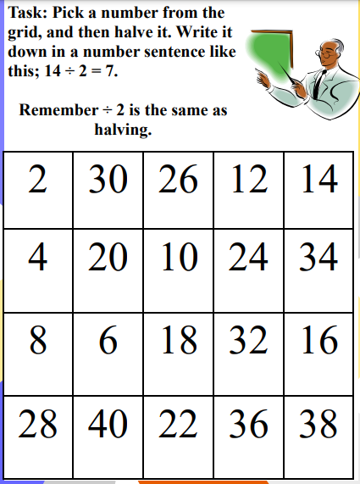

Slide 6
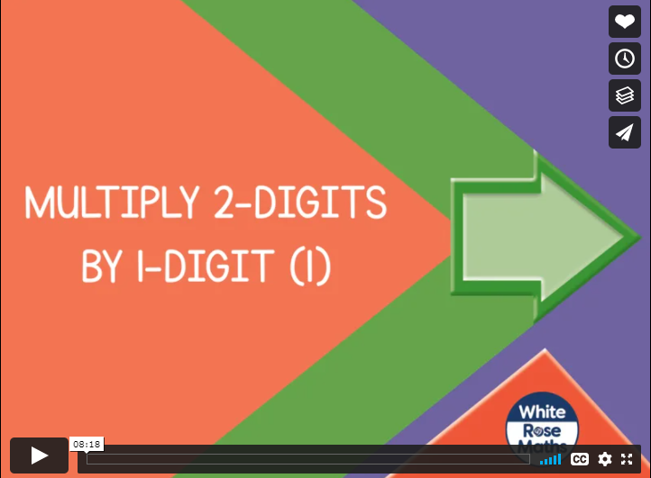
https://vimeo.com/486513593

Slide 7
https://resources.whiterosemaths.com/wp-content/uploads/2019/11/Y3-Spring-Block-1-WO3-Multiply-2-digits-by-1-digit-1-2019.pdf

Slide 10
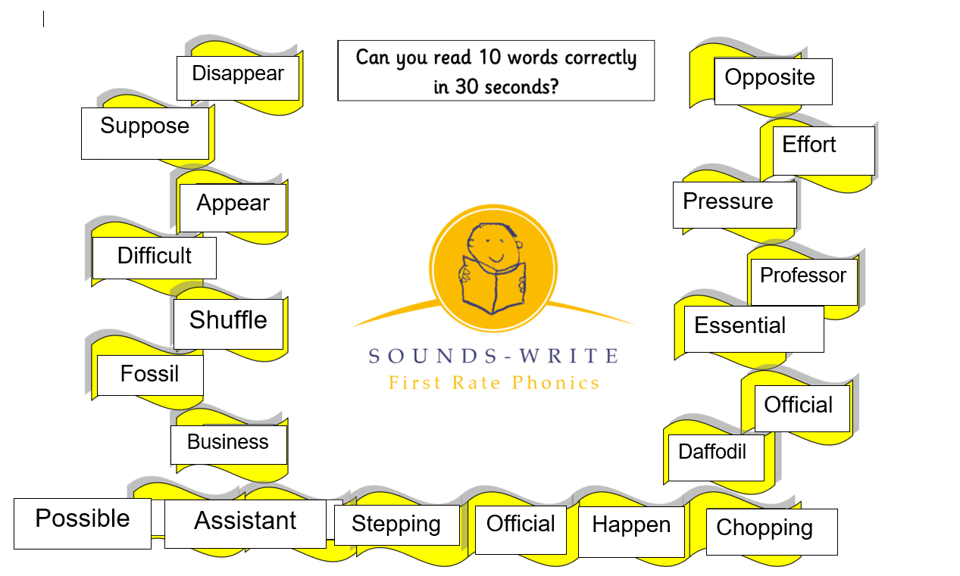

Slide 11
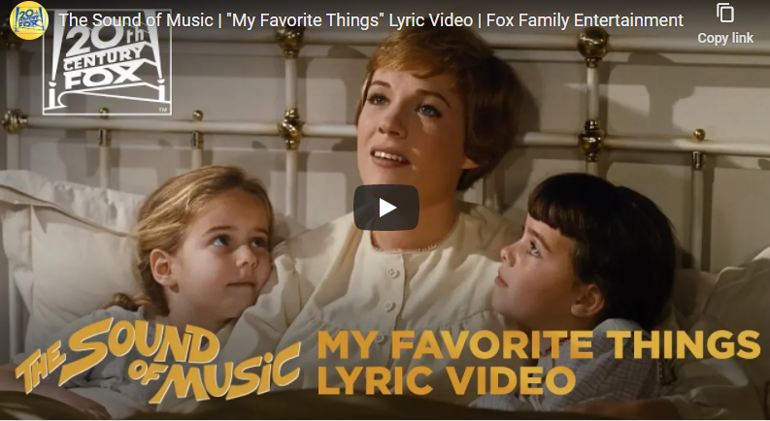
https://www.youtube.com/watch?v=2G6dd7ikrXs

Slide 12
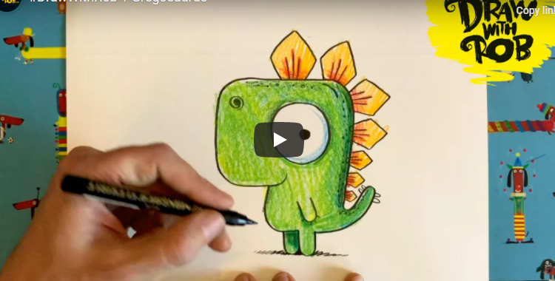

Slide 13
