Slide 1
The battle of Hastings

Slide 2
I want you to think back to the English we did before Christmas, the Anglo-Saxon boy. Can you remember Magnus and his father Harold Godwinson who were trying to befriend the king so that he could take over as king when he died? These history lessons lead on from this
https://www.bbc.co.uk/bitesize/topics/ztyr9j6/articles/z3s9j6f

Slide 3
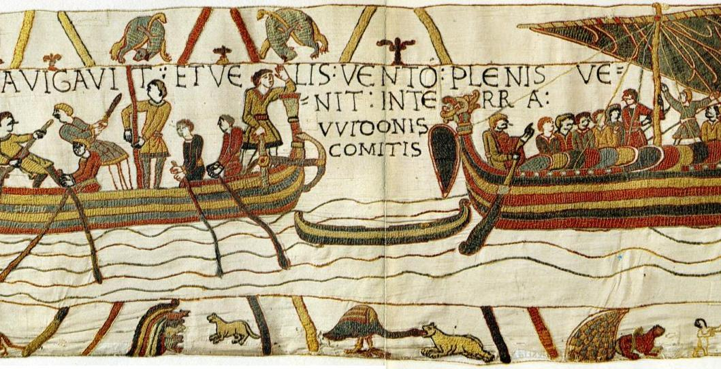
The Battle of Hastings
The Bayeux Tapestry tells the story of the Battle of Hastings.
The tapestry was made around ten years after the battle.
© All rights reserved Northampton Primary Academy Trust 2021

Slide 4
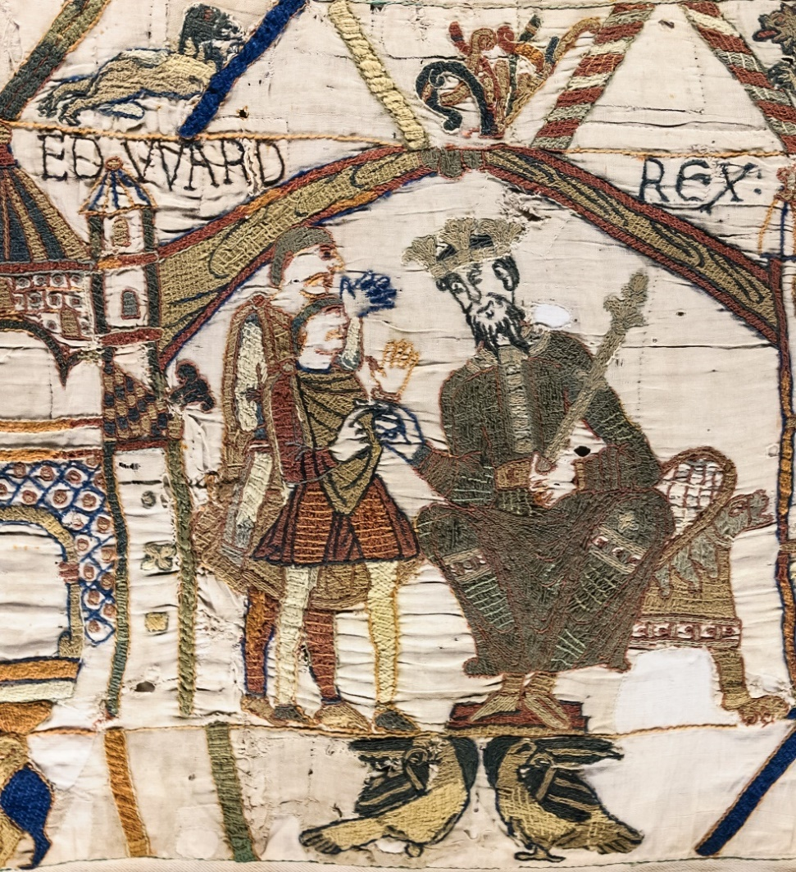
The Passing of the King
In January 1066, the King of England died. His name was Edward the Confessor. The tapestry shows the king handing the crown to his chosen successor – the person he chose to be the next King of England: Harold Godwinson.
© All rights reserved Northampton Primary Academy Trust 2021

Slide 5
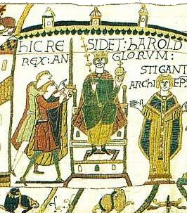
King Harold
Harold was crowned king at Westminster Abbey.
© All rights reserved Northampton Primary Academy Trust 2021

Slide 6
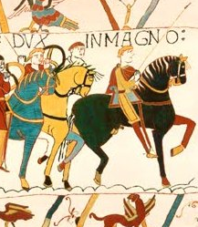
William, Duke of Normandy
William was Duke of Normandy in France. He very much wanted to be King of England and decided on a plan to get his way.
© All rights reserved Northampton Primary Academy Trust 2021

Slide 7
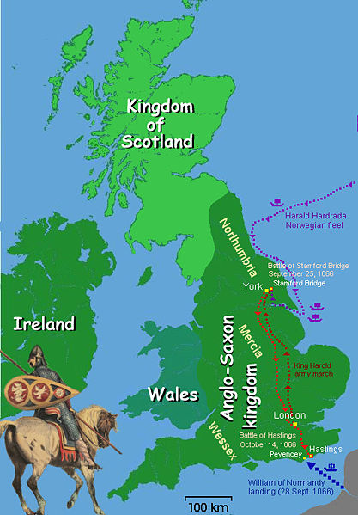
September 1066
Harald Hardrada, the Norwegian king, also wanted the English throne. He tried to invade Northumbria in the north of England. King Harold sent his army to meet them, and the invaders lost the battle at Stamford Bridge in Yorkshire.
© All rights reserved Northampton Primary Academy Trust 2021

Slide 8
William Makes His Move
Two days later, William and his fleet of 700 ships sailed across the English Channel from France.
The Norman invaders set about pillaging and burning the area across from the harbour mouth in order to force Harold to defend his people and country.
It worked. Harold raced down the country and gathered whatever army he could along the way.
© All rights reserved Northampton Primary Academy Trust 2021

Slide 9
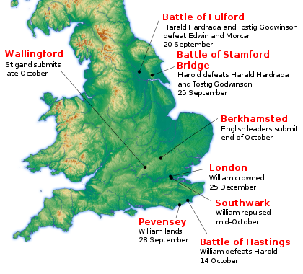
14th October 1066
Harold was on his way to Hastings.
William heard the news and marched out to face Harold.
His army was made up of 15,000 professional soldiers, who were well trained and well equipped.
The English army were tired from their long march. They were poorly paid and many only agreed to fight because they were allowed to keep anything they found as a result of battle. They could keep horses, expensive weapons and armour.
© All rights reserved Northampton Primary Academy Trust 2021

Slide 10
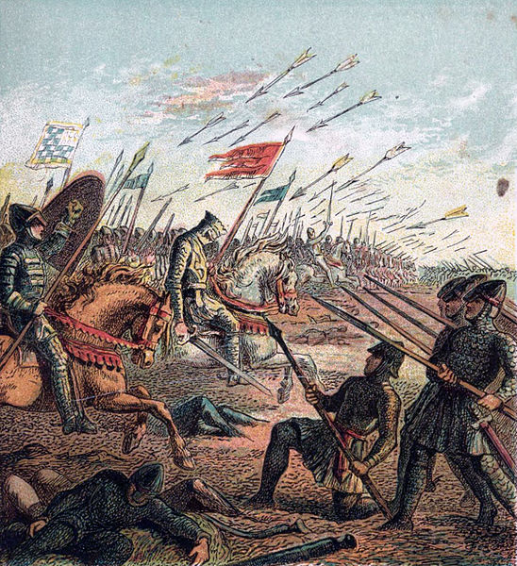
The Battle of Hastings
The Battle of Hastings began. Despite only having 5000 tired soldiers, Harold’s army put up a very good defence. They were at the top a hill and the Normans were at the bottom. The English army formed a shield wall and it was difficult for the Normans to break through it.
However, word went around that Duke William had been killed. This made the English soldiers drop their shield wall.
© All rights reserved Northampton Primary Academy Trust 2021

Slide 11
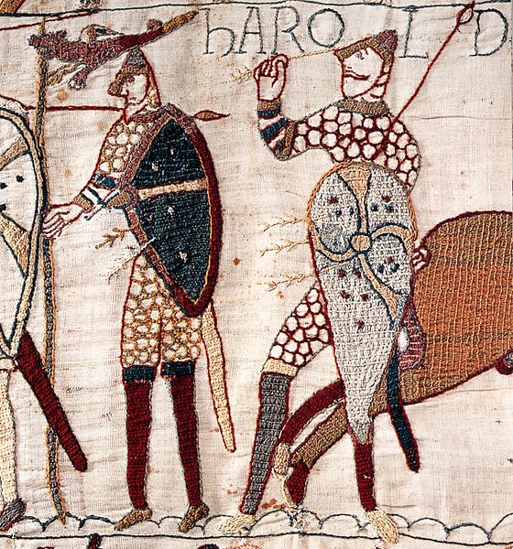
The Duke’s Not Dead!
The story goes that William then took off his helmet and shouted,
“Look at me! I’m alive and with the aid of God I shall gain the victory!”
His army now had more courage and moved in on the English army, mowing them down on their way.
It is thought that Harold was shot in the eye with an arrow. Then, he was trampled into the ground. His army ran away into the night.
© All rights reserved Northampton Primary Academy Trust 2021

Slide 12
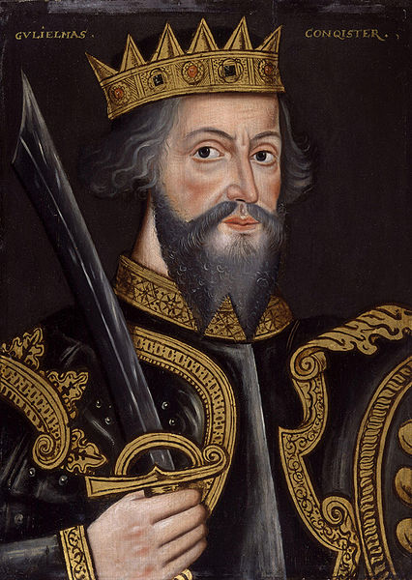
William the Conqueror
William had Harold buried next to the battlefield with a headstone reading
‘Here lies Harold, King of the English’.
Harold’s body now rests at Waltham Abbey.
© All rights reserved Northampton Primary Academy Trust 2021

Slide 13
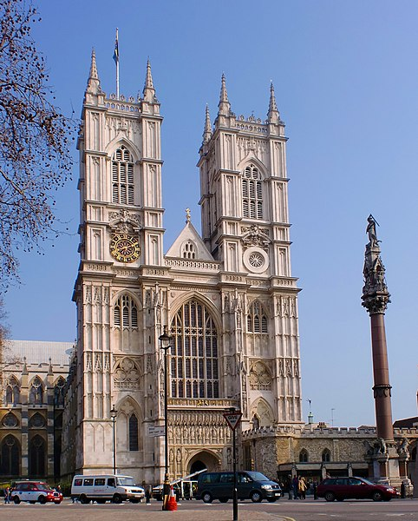
King William
On Christmas Day, 1066, William was crowned King of
England in a ceremony at Westminster Abbey.
© All rights reserved Northampton Primary Academy Trust 2021

Slide 14
Use the template to create a comic strip of the events which happened leading up to the battle of hastings. You will need a brief sentence to go with a picture, I have written an example of how to split it up into the boxes.

Slide 15
The king died in January 1066. | Harold Godwinson became king. William and Harald were not happy and wanted to fight for the title. | The king met Haralds army in the North of England and defeated him. | He marched his tired men to the south of England to meet William.
He met Williams army in Hastings and his army put up a good fight to defend their king. | Harold got shot in the eye with an arrow and died. | His army were leaderless so the war ended. | William was known as ‘William the Conqueror’ and was crowned king on Christmas day.

