Slide 1
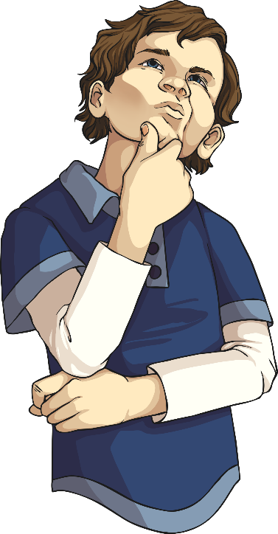
Identifying Parts of the Sentence
To be able to recognise and use active and passive voice, you must be able to identify the parts of the sentence. In the following sentences, identify the subject, action (the verb) and object:
The plane is boarded by the family.
The plane is boarded by the family.
The damage was caused by the storm.
The damage was caused by the storm.
Issac threw a ball at the window.
Issac threw a ball at the window.
The magician pulled a rabbit from the hat.
The magician pulled a rabbit from the hat.
Helen practised her recorder every day.
Helen practised her recorder every day.
The flowers were grown by my nan.
The flowers were grown by my nan.
Did you notice the preposition ‘by’ in some of these sentences?

Slide 2
Active or Passive Voice?
Now, sort these sentences into the correct places in the table below:
The plane is boarded by the family.
The magician pulled a rabbit from the hat.
Issac threw a ball at the window.
Helen practised her recorder every day.
The flowers were grown by my nan.
The damage was caused by the storm.
Active
Passive
The magician pulled a rabbit from the hat.
Issac threw a ball at the window.
Helen practised her recorder every day.
The plane is boarded by the family.
The damage was caused by the storm.
The flowers were grown by my nan.

Slide 3
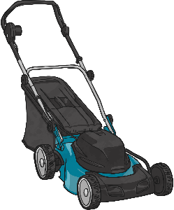
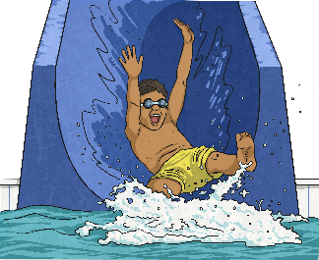
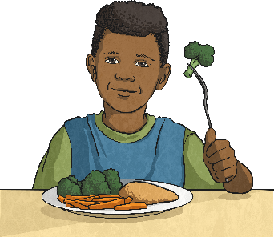
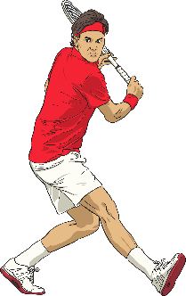
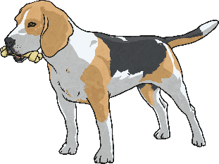
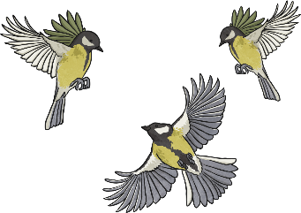
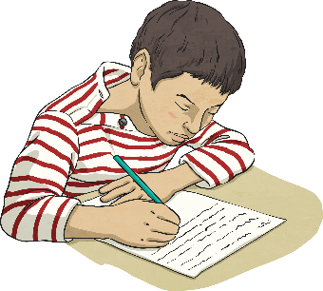
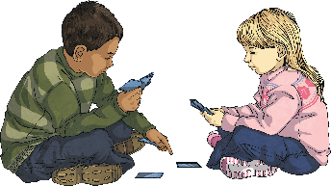
Your Turn – Active Sentences
Choose a square to reveal a picture. Write an active sentence about the picture:
?
?
?
?
?
?
?
?
?
?

Slide 4
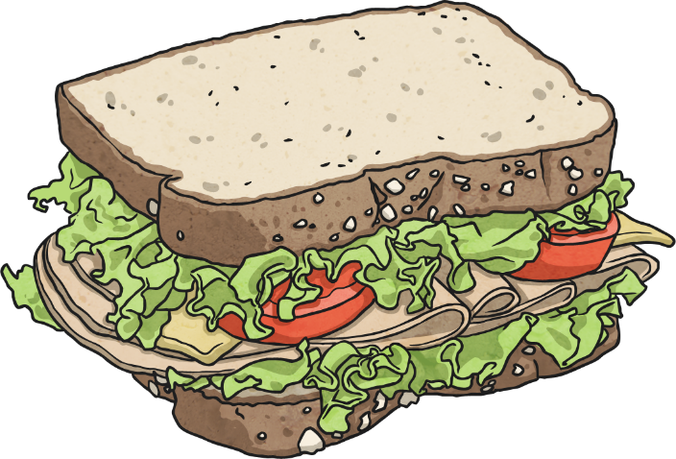
Changing Sentences
It is possible to change a sentence from active to passive voice, or from passive to active voice. It is important that you do not change the tense of the sentence. Have a go at altering these sentences:
On the plain, the lioness chased an antelope.
On the plain, an antelope was chased by the lioness.
Harry ate sandwiches for lunch.
Sandwiches were eaten by Harry for lunch.
The carrots are always eaten by my brother.
My brother always eats the carrots.
Are your new sentences active or passive?

Slide 5
Tricky Passive Sentences
Read these passive sentences. What do you notice about them?
The jewellery was stolen.
The jewellery was stolen.
The bicycle was ridden.
The bicycle was ridden.
The present was opened.
The present was opened.
They all have an action and a subject but none of them have a object. Sometimes the prepositional (by…) phrase can be removed and the sentence will still make sense – you just won’t know who/what performed the verb.

Slide 6
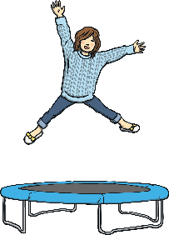
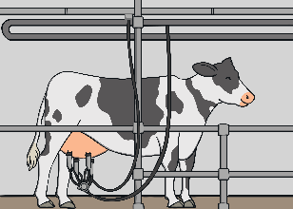
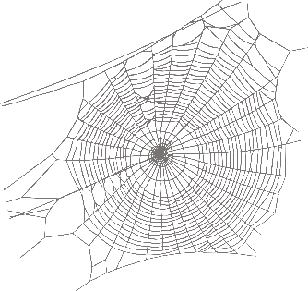
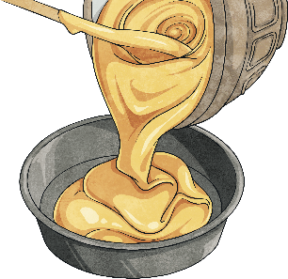
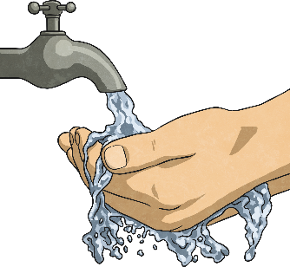
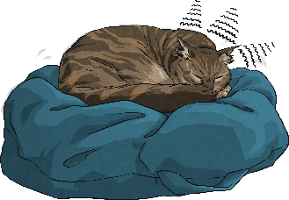
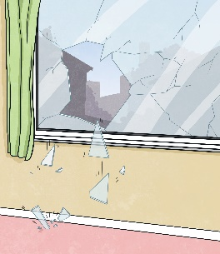
Your Turn – Passive Sentences
Choose a square to reveal a picture. Write a passive sentence about the picture:
?
?
?
?
?
?
?
?
?
?

Slide 7
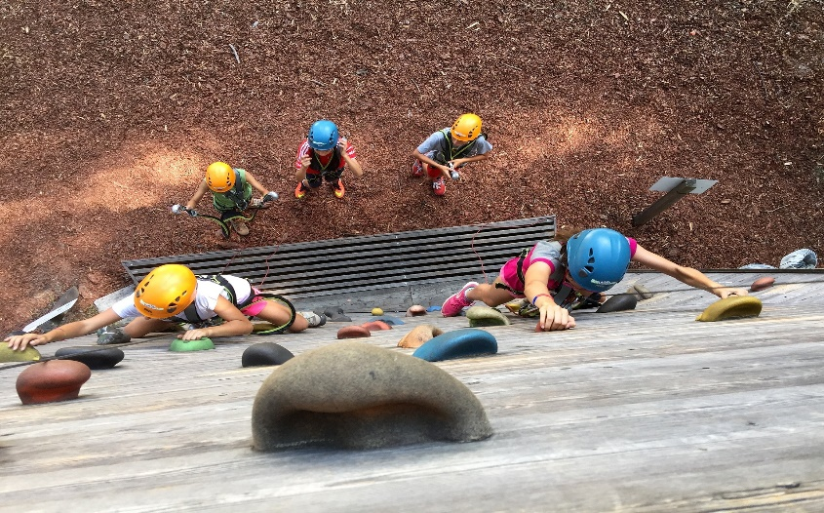
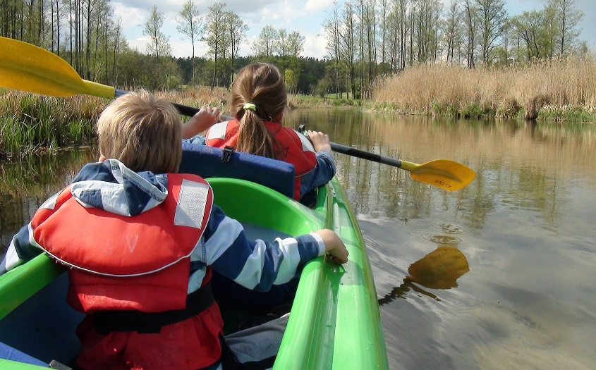
Amazing Active Voice
Can you write descriptions of these photos in the active voice?
The children enjoyed climbing during their school camp.
They spent the day kayaking down the river.

Slide 8
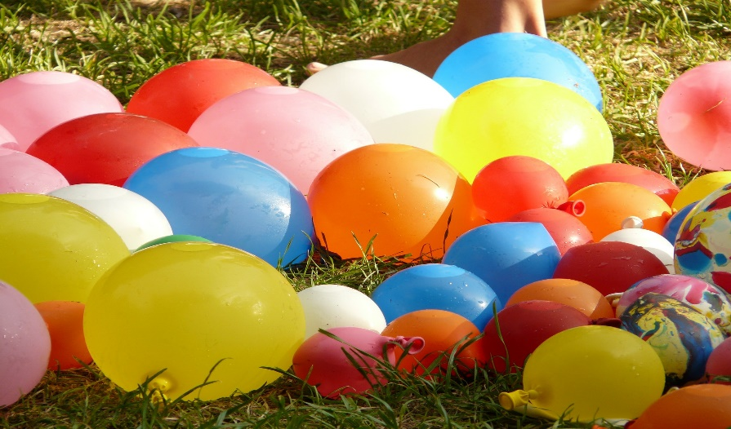
Perfect Passive Voice
Can you write descriptions of these photos in the passive voice?
Tasty cupcakes were baked by my aunt for my birthday party.
The water balloons were blown up by my brother for the water fight.

Slide 9
Quick Quiz 1
Which sentence is written in the passive voice?
Keira played for the netball team.
The tasty meal was cooked by my mum.
The tasty meal was cooked by my mum.
My little brother always wakes up early.
I am lucky to be going on holiday to France with my best friend’s family.

Slide 10
Quick Quiz 2
Underline the objects in these active sentences:
I climbed the tallest tree in the park yesterday.
I climbed the tallest tree in the park yesterday.
The class boarded the coach noisily to go on their trip to London.
The class boarded the coach noisily to go on their trip to London.
We eat our lunch on the field in the summer.
We eat our lunch on the field in the summer.

Slide 11
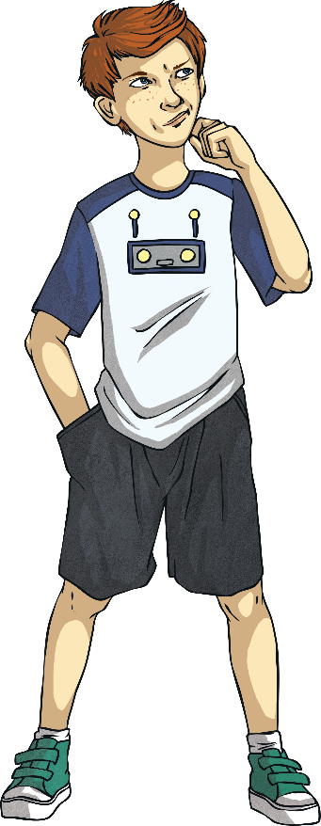
Quick Quiz 3
Rewrite these sentences in the passive voice:
Gina visited the library regularly.
The library was visited by Gina regularly.
My family always eat turkey for Christmas dinner.
Turkey is always eaten by my family for Christmas dinner.
The lazy girl ignored her alarm clock.
The alarm clock was ignored by the lazy girl.

