Slide 1
Wednesday 27.1.21

Slide 2
Reading:
Read Hermia's letter to her father and then answer the questions below:
Dear Father,
When you brought me before the court, I felt confused and embarrassed. I had no idea why you brought me before Theseus, Lysander and Demetrius. You could have talked to me and discussed this before you took the law into your own hands
I love my one true love, Lysander, but you will not allow it. Why can't you respect that I am an adult and allow me to make my own decisions in life. I hate this situation I’m in, it is all your fault.
I remember, once when you loved me and let me be my own person. One thing I would change about the world is that people should have the right to choose who they love. Who cares about the Athenian law! I am afraid that I will be forced to marry someone who I will begin to resent because of you. My biggest question to you is: Why won't you let me choose?
Your heartbroken daughter, Hermia.
Why is Hermia embarrassed?
What situation is Hermia in at the moment?
What is Hermia planning to do?
Which word has a similar meaning to afraid. Choose one of these: anxious, worried, sad
What other word is the similar to heartbroken? Complete the line Your___________________ daughter, Hermia with a similar word.

Slide 3
You are going to make a paper chain of four people: Here is a link below to help you, you only need to watch up until the person lays them out on the table. Please don't decorate them. Once you have cut them out you need to write Lysander on the first one, Hermia on the second, Demetrius on the third and ? on the last one - as we don't know who the fourth lover is yet.
Keep your writing small and try and make your paper chain lovers/ people as big as possible.
Now write as much as you know about each of the characters and who they are. How are they related? What do we know about them from the play? If your people are too small stick them to a bigger sheet of paper and write about each lover underneath.
https://youtu.be/cruIJSHbsqk
Now watch the clip underneath to reveal who the fourth lover is and what they have to do with the play/ story of Midsummer Night's dream.
https://www.bbc.co.uk/teach/class-clips-video/english-a-midsummer-nights-dream-1-welcome-to-athens/zfyyscw
Now you can add anything you have learnt about the Lysander, Hermia and Demetrius and you should be able to name and write about the fourth lover. Now she has been revealed.
Try and write as much as you can about what you have learnt about the four lovers.
KEEP YOUR PAPER CHAINS FOR TOMORROW

Slide 4
6 | 5 | 3 | 7 | 12 | 15 | 24 | 30 | 32 | 44
Doubling
12 | 30 | 14 | 66 | 42 | 28 | 84 | 32 | 10 | 7
Halving

Slide 5
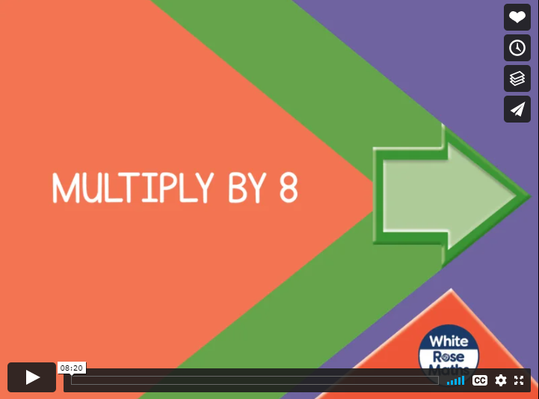

Slide 7
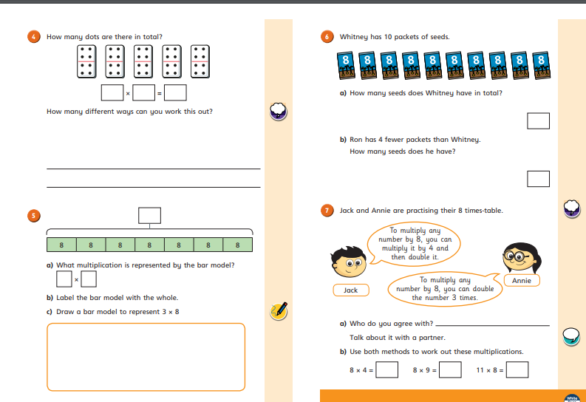

Slide 8
with our very own
Mrs Denny!
https://youtu.be/v2Hn7PM20Hw

Slide 9
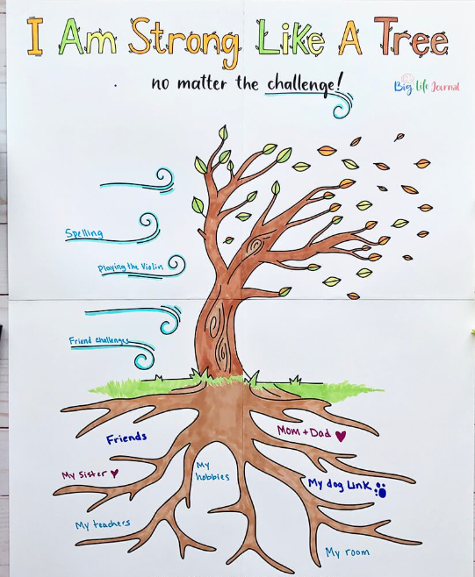
https://youtu.be/Da1jeVEcpg0

Slide 10
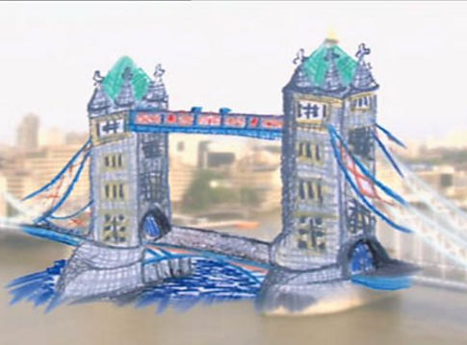
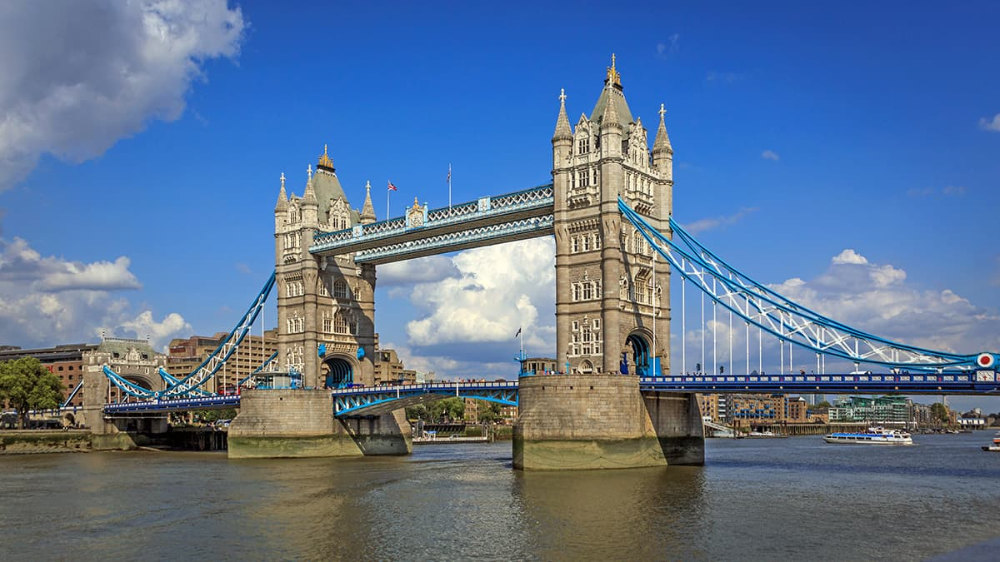
Australian artist Ken Done shows Kirsten O'Brien how he uses his simplified style of drawing and painting to capture the landmarks and places that most inspire his work. Ken Done composes a picture on site, using the landmark of Tower Bridge in London as the focus for his artwork. Using bold strokes and colours with very little detail, children work with the artist to compose their own pictures in his simplistic style.
https://www.bbc.co.uk/bitesize/clips/zdsb9j6

