Slide 1
Properties and Changes of Materials Lesson 2

Slide 2
How can solid materials be compared and sorted?

Slide 3
Solid, liquid or gas? How do you know?

Slide 4
Vocabulary | Definition
transparency | The property of allowing light to pass through.
translucency | The property of allowing light to partially pass through.
hardness | A measurement of how hard something is.
magnetism | Having the force that attracts to a magnet.

Slide 5
Magnetism
The history of magnetism dates back to the ancient Greeks when magnetic iron ore was first discovered near the city of Magnesia in Western Turkey (the term ‘magnet’ comes from the word Magnesia). The Greeks were aware of strange and rare stones which had the power to attract iron. They called these stones lodestones and noticed that a steel needle stroked with one of them also became ‘magnetic’. However, the Greeks' knowledge of science was not advanced enough to help them to explain this natural phenomenon.
The ancient Chinese also began to use lodestones to show where north and south were; they discovered that, when freely suspended, they automatically pointed north-south and so could indicate direction. They did this by floating the needles in bowls of water or suspending them on threads of silk. These were the beginnings of the magnetic compass. The use of the compass eventually spread to Europe and was even used by Christopher Columbus when he crossed the Atlantic Ocean. Magnetic compasses were one of the first pieces of scientific instrument to be used around the world.

Slide 6
William Gilbert (1544 – 1602), an English scientist, was the first person to research the properties of the lodestone and suggested that a perfectly spherical lodestone could spin on its axis, just as the Earth spins on its own axis. This led him to suggest that the Earth itself was like a giant magnet. We now know that the Earth is magnetic because its core is made of molten rock rich in magnetic iron.
It was not until the twentieth century that scientists began to understand magnetism properly and develop technologies based on this understanding. Many common electric appliances rely on the use of magnets; in fact, anything which has an electric motor in it requires the use of magnets – lawnmowers, hoovers, washing machines, even electric toothbrushes. Other important uses include magnets in televisions, headphones, scanning body machines in hospitals, phones, credit cards and data storage in computers.

Slide 7
Investigate the properties of the given materials
transparency
translucency
magnetism
hardness
Writing opportunity - record your findings in your book

Slide 8
Table of Intensity - complete the table below
 | Hardness | Translucency
Intensity

Slide 9
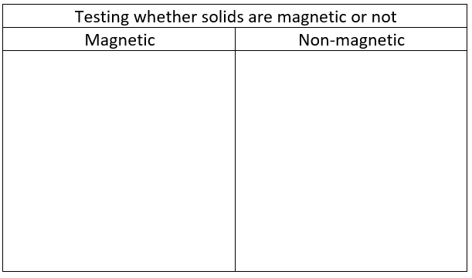
Table of Intensity - complete the table below

