Slide 1
Thursday 28.1.21

Slide 2
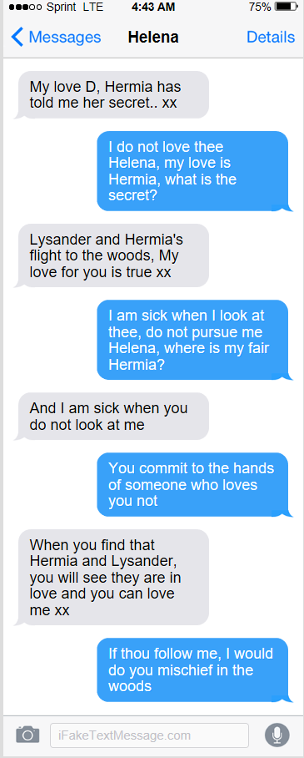
Now answer these questions:
Who is Helena messaging? Who is D?
What is Hermia's secret?
What does D say to show he loves Hermia?
'I am sick when you do not look at me.' What does Helena mean?
'That Hermia' Why is Helena so mean when she says this in her message? Think about what we know about the lovers.

Slide 3
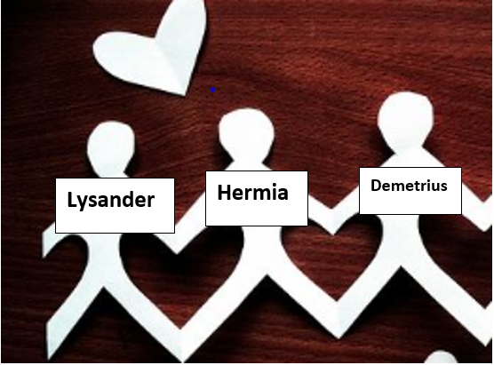
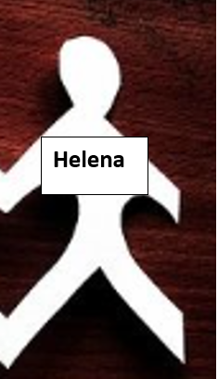
Dear diary,
When I heard Hermia's secret I was feeling....
I love....
I hate...
I remember...
Surely, I deserve to be....
I must...
One lesson I have learnt is....
A .............. Helena
You could do the same by cutting off Helena from the paper chain you made yesterday. Why has she been cut off from the other lovers? Now we know about Helena and learnt about her why is she on her own or separated? How is she feeling?
You are going to write Helena's diary, using the sentence openers and write in as much detail as you can about how she is feeling and use the conjunctions: but, so, if, because.
Challenge yourself to try and use some words and phrases from the play in your writing.

Slide 4
x | 2 | 10 | 4 | 3 | 8 | 5
4
6
2
10
12
3
8

Slide 5
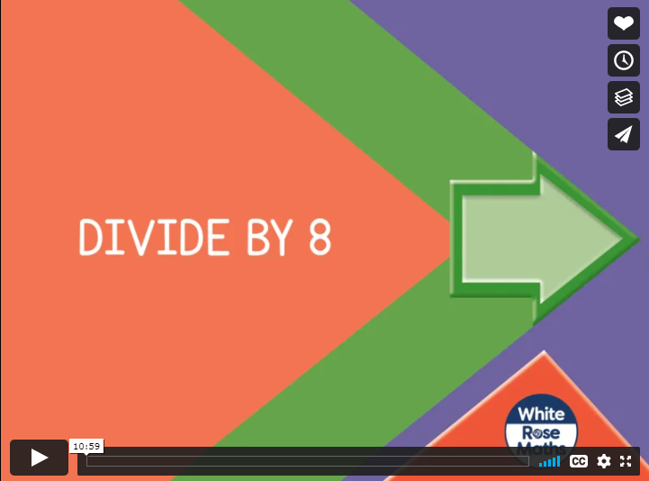
https://vimeo.com/480761847

Slide 6
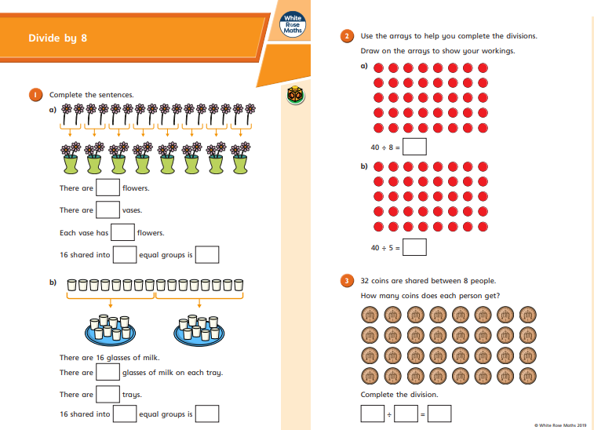
https://resources.whiterosemaths.com/wp-content/uploads/2019/09/Y3-Autumn-Block-3-WO9-Divide-by-8-2019.pdf

Slide 7
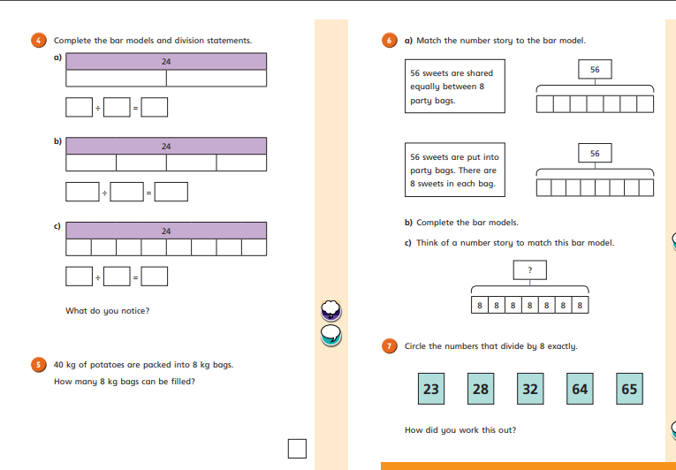

Slide 8
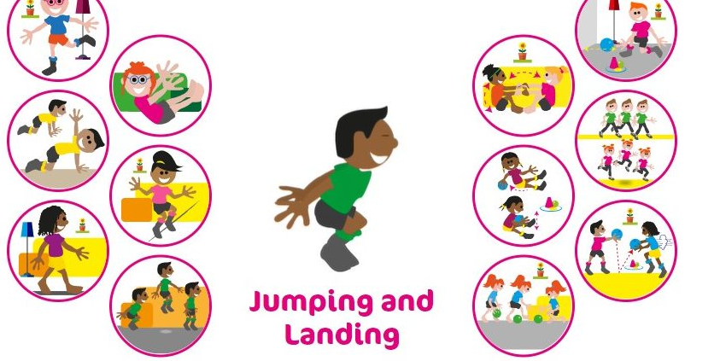

Slide 9
With Miss Bowler!

