Slide 1
Fabulous Friday
Be fabulous!

Slide 2
English/ Reading
Tricksy by nature, pixies particularly delight in tormenting humans. For this reason, they can be found living in suburban and rural areas, and sometimes even in the parks of cities, anywhere people frequent. Ranging between two feet and the height of a human child Pixies (also known as piskies) make their homes in the hollows of logs, lean-tos formed by felled trees and in gardens. Unlike boggarts and brownies, pixies never live inside houses, preferring the outdoors. They sometimes can be spotted alone but are more commonly found in groups of three to five. They desire to dwell in groups placing them in the trooping category within the Invisible World. Due to their prankish behaviour, pixies are remarkable in colouring. Their clothing is usually natural in tone, all the better for hiding themselves as they wait for someone to fall into their next trap. Like many fairies, pixies dislike rude, greedy and cruel people and often single them out to be victims of their pranks. Pixies are particularly known for knotting hair, leading people astray and pinching skin black and blue. Pixies also have a fondness for stealing horses. An excellent sign of pixies presence is small items going missing. Have you ever been under a magnificent oak tree only to get hit on the head with an acorn? It was probably a mischievous pixie.
Vocabulary
Tormenting - annoy
frequent - visit
hollows - empty space inside a tree
desire - string feeling to want something
dwell - live
felled - fallen
trooping - being in groups
astray - to make the wrong choice
presence - being there

Slide 3
Now you have read the text. Answer these questions in full sentences:
Name two places pixies live.
What does a pixie look like?
Which two other types of fairies are discussed in the text?
What makes a pixie naughty?
Would you like to be pixie? Give two reasons why.

Slide 4
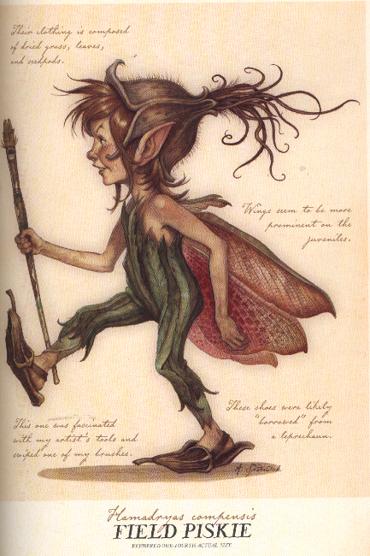
Writing
Here is a picture of what a pixie could look like. Could you draw your own pixie and write about it? Please write in full sentences use these bullet points below to help you.
How does the pixie behave?
What tricks does your pixie play?
What does your pixie look like?
Where would you find a pixie/ where do they live?
What makes a pixie special?
Look forward to reading your pixie descriptions.

Slide 5
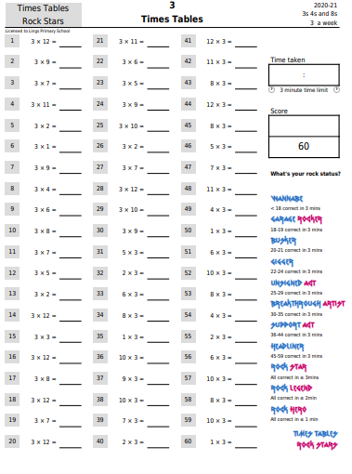

Slide 6
https://vimeo.com/469788481

Slide 7
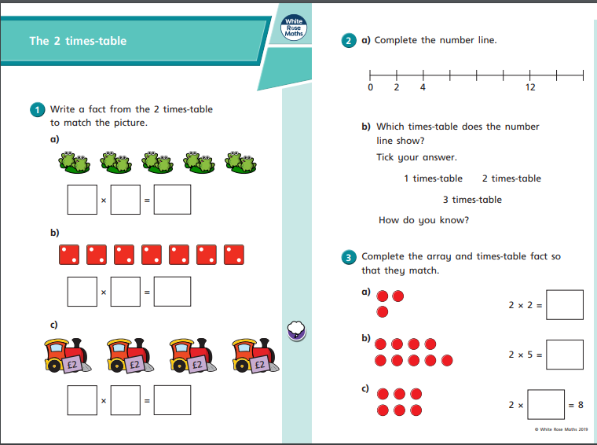
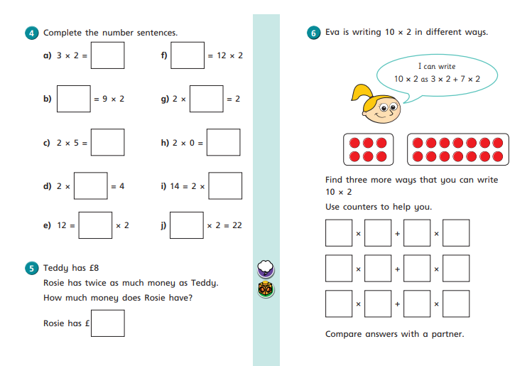
https://resources.whiterosemaths.com/wp-content/uploads/2019/10/Y2-Autumn-Block-4-WO7-The-2-times-table-2019.pdf

Slide 8
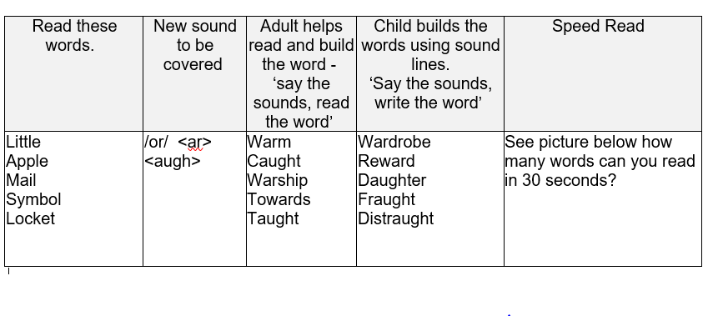

Slide 10
ART: This term we are going to look at landscapes.
Definition:
A landscape is the visible features of an area of land, its landforms, and how they integrate with natural or man-made features.
A landscape includes the physical elements of geophysical defined landforms such as mountains, hills, rivers, lakes, ponds and the sea, living elements of land cover including indigenous vegetation, human elements including different forms of land use, buildings, and structures, and transitory elements such as lighting and weather conditions.
(Wikipedia)

Slide 11
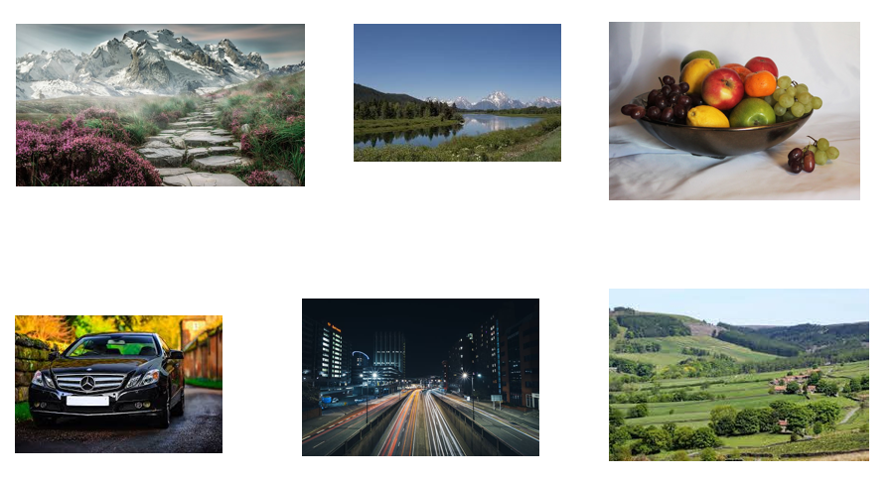
Which of the following pictures are landscapes? How do you know?

