Slide 1
Wonderful Wednesday

Slide 2
New Vocabulary:
Briar – prickly bush Grove – small group of trees Sheen - shine Canopied – covered Woodbine – creeping plant Clamorous – noisy Thyme – herb Honeysuckle – plant with scented flowers Entwist – twisted together
Reading:
Here is a text which may look a bit different to the type of writing you have seen. It is written by William Shakespeare and it is a poem.
Over hill, over dale, Through bush, through briar, Over park, over pale, And now they never meet in grove or green, By fountain clear, or spangled starlight sheen, But they do square, that all their elves for fear Creep into acorn-cups, and hide them there. Quite over canopied with luscious woodbine, Fiery glow worms’ eyes A clamorous owl that nightly hoots, A bank where the wild thyme blows The woodbine and sweet honeysuckle gently entwist

Slide 3
It doesn’t matter if there are words you don’t understand Shakespeare who wrote the text often made up his own words.
You may need to read the text a few times and make sense of the text. Now answer these questions
Where is the poem describing?
What do the elves do when they fear something?
Who could have met in the grove or green?
Name two animals in the poem.
Is it day or night? What words and phrases in the poem tell you that?

Slide 4
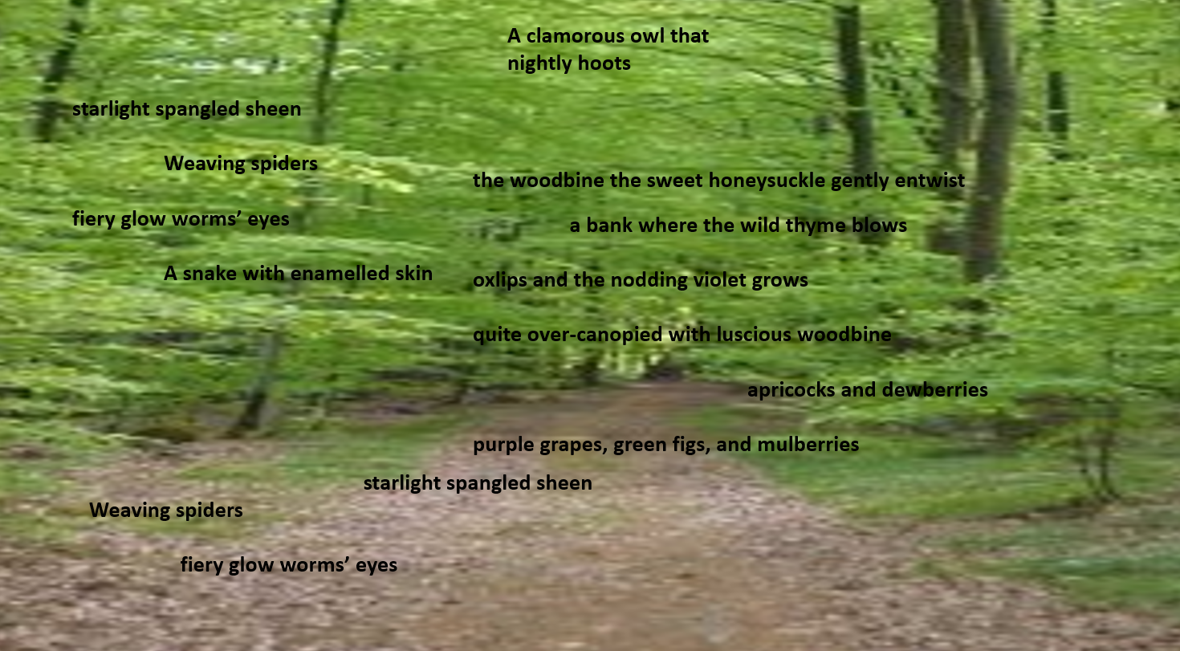
Writing:
Here are some words and phrases Shakespeare used to describe an enchanted and magical forest.
You can use some of these as well as your words and phrases from yesterday to build a poem. E.g. Swaying crunchy branches,
Your poem needs an imaginative title. Try not to tell me it is a forest
Try and use all your senses - What tastes, smells, looks and sounds like in the forest?
You could make your lines in your poem rhyme.

Slide 5
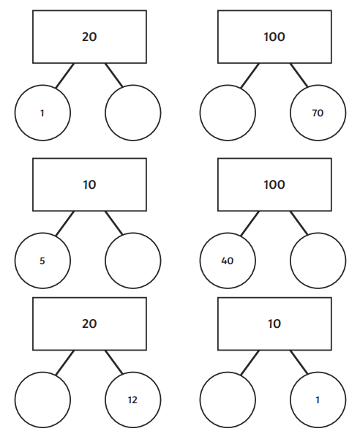

Slide 7
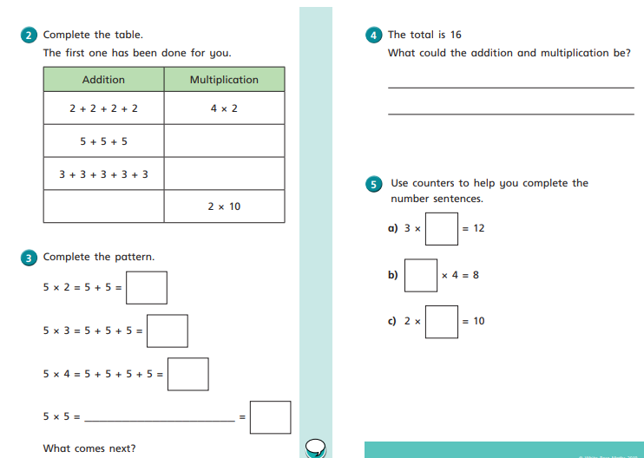

Slide 9
ROCK | HARD/SOFT
Granite
Limestone
Marble
Chalk
Slate
Sandstone

