Slide 1
Who was Walter Tull and what was his involvement in World War One?
Lesson 3

Slide 2
Retrieval Opportunity- Match up the event to the correct date.
1st September 1914
British troops invade Gallipoli
19th January 1915
The first Zeppelin raid
25th April 1915
The 100 day offensive
7th May 1915
The Battle of the Somme
1st July 1916
The First Battle of the Marne
8th August – 11th November 1918
The Lusitania is sunk

Slide 3
Match up the event to the correct date
1st September 1914
British troops invade Gallipoli
19th January 1915
The first Zeppelin raid
25th April 1915
The 100 day offensive
7th May 1915
The Battle of the Somme
1st July 1916
The First Battle of the Marne
8th August – 11th November 1918
The Lusitania is sunk

Slide 4
Vocabulary
Enlist - join the army, navy or air force.
Disband - break up or separate.

Slide 5
Video
https://www.bbc.co.uk/bitesize/clips/smhsbk

Slide 6
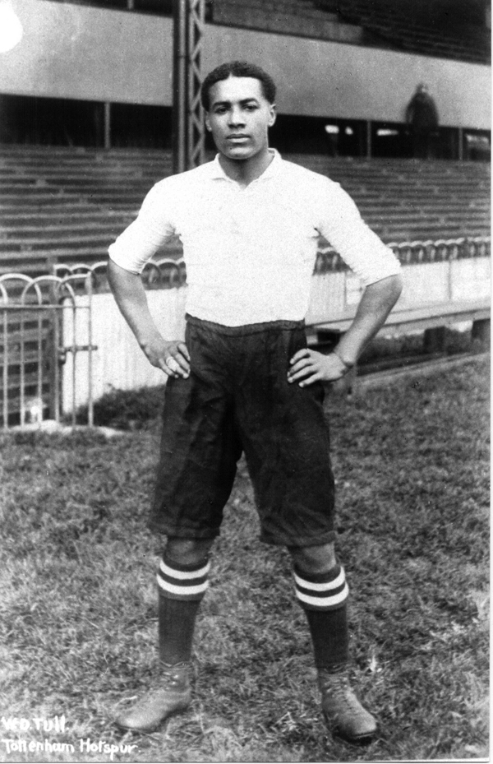
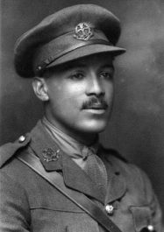
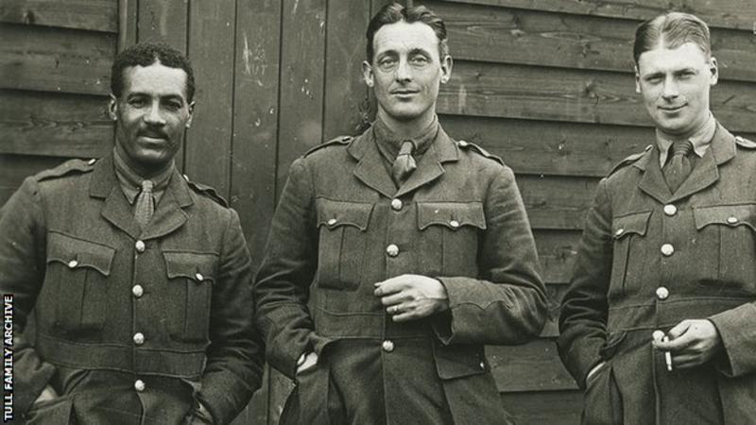
Walter Tull

Slide 7
Who was Walter Tull and what was special about him?
Use the cards about Walter Tull.
Read them carefully to find out information about him.
Decide which is the most important fact about Walter and put that at the top, put the next two important facts below and so on to create a 'diamond' shape.

Slide 8
Writing opportunity
Create a timeline, story map or biography of Walter Tull’s life.

