Slide 3
Aim
I can explain the differences between direct and indirect speech.
Success Criteria
I can identify direct and indirect speech in writing.
I can recognise where inverted commas are needed to punctuate direct speech.
I can change direct speech into indirect speech (and vice-versa).
I can create examples of direct and indirect speech.

Slide 4
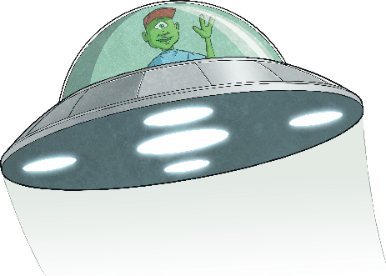
Using Speech within Writing
Within writing, there are two ways to narrate the words spoken by a character. These are called:
direct speech
indirect (or reported) speech
In a direct speech sentence, we would narrate Iggy’s spoken words like this:
“I bid you farewell Earthlings!” shouted Iggy from his spaceship.
If we were writing an indirect speech sentence, we would narrate Iggy’s spoken words like this:
From his spaceship, Iggy bid farewell to the Earthlings.
I bid you farewell Earthlings!

Slide 5
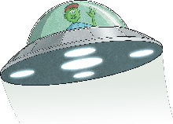
Using Direct Speech
I bid you farewell Earthlings!
Let’s look carefully at the direct speech sentence.
What do you notice?
“I bid you farewell Earthlings!” shouted Iggy from his spaceship.
The exact words of the speaker are enclosed in inverted commas (speech marks).
In direct speech, the exact words of the speaker are quoted with no change to their content or order.
The correct punctuation is used before the inverted commas close.
There is often a reporting clause to explain who said the speech. Sometimes the reporting clause can be extended with an adverb, subordinate clause or prepositional phrase to explain more about how, where or when the speech was said. The reporting clause can appear before or after the spoken words themselves.

Slide 6
Using Indirect Speech
I bid you farewell Earthlings!
Now, let’s take a look at the indirect (reported) speech sentence.
How is it different to the direct speech sentence?
From his spaceship, Iggy bid farewell to the Earthlings.
In indirect speech, no inverted commas (speech marks) are used.
The actual words of the speaker are often changed. The spoken words need to be in the correct tense, extra words may need to be added and pronouns may need to be changed (e.g. I ➔ Iggy).
There are no reporting clauses within indirect (reported) speech. However, an adverb or prepositional phrase to explain more about how, where or when the speech was said can be added if needed.

Slide 7
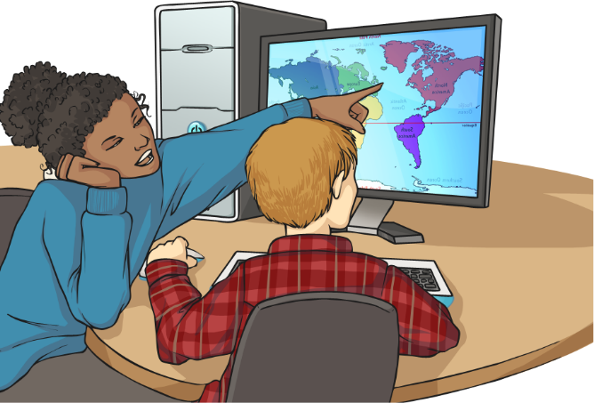
Are Inverted Commas Needed?
Look at these speech sentences. Are they examples of direct or indirect speech?
If they are examples of direct speech, where should we place inverted commas?
Kayla explained that she used to live in New York.
This is an example of indirect speech and does not need inverted commas. The sentence is reporting what Kayla explained.

Slide 8
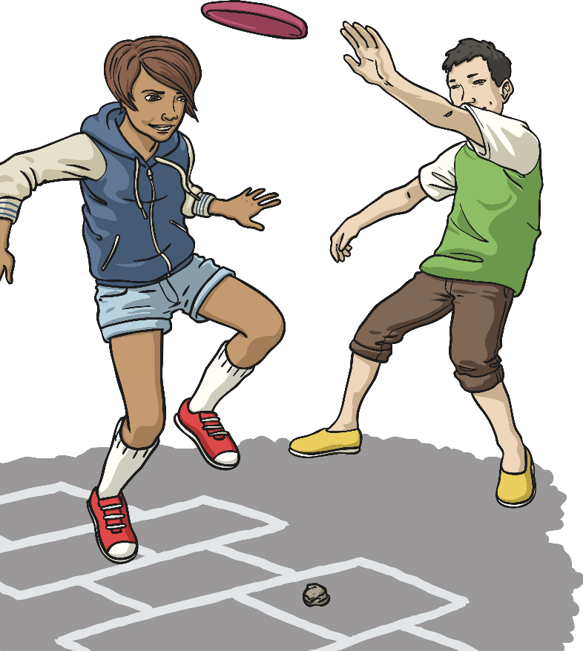
Are Inverted Commas Needed?
Look at these speech sentences. Are they examples of direct or indirect speech?
If they are examples of direct speech, where should we place inverted commas?
Watch out! screamed George as he launched the frisbee.
“
”
This is an example of direct speech and does need inverted commas around the spoken words. Where should they go?

Slide 9
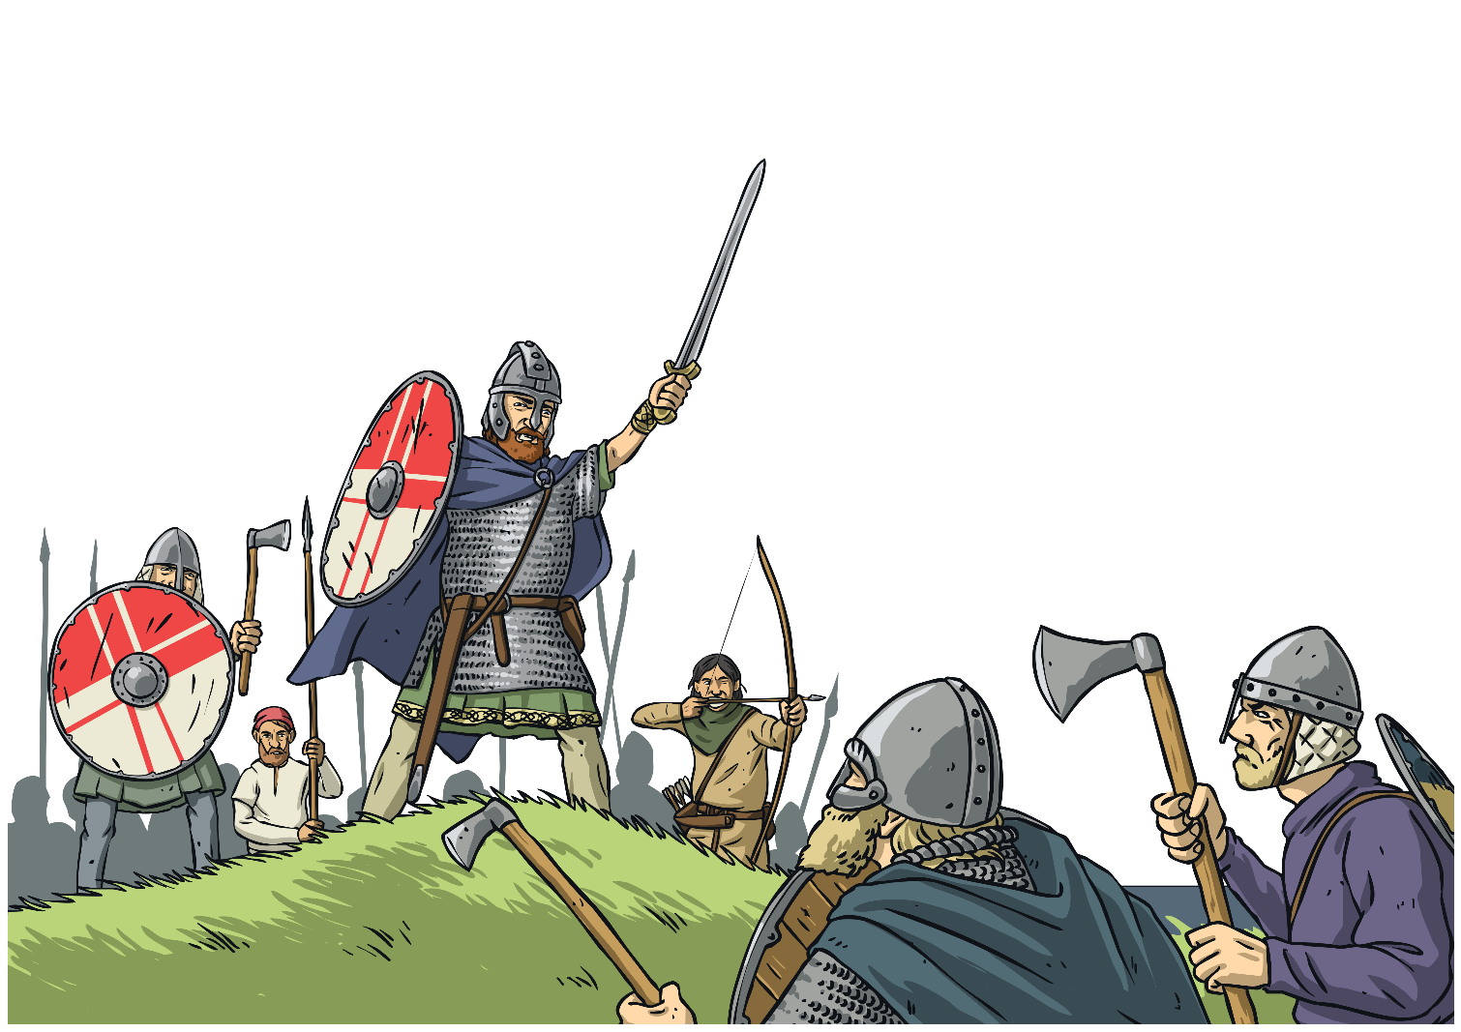
Are Inverted Commas Needed?
Look at these speech sentences. Are they examples of direct or indirect speech?
If they are examples of direct speech, where should we place inverted commas?
Guthrum announced that they should charge towards to the village.
This is an example of indirect speech and does not need inverted commas. The sentence is reporting what Guthrum announced.

Slide 10
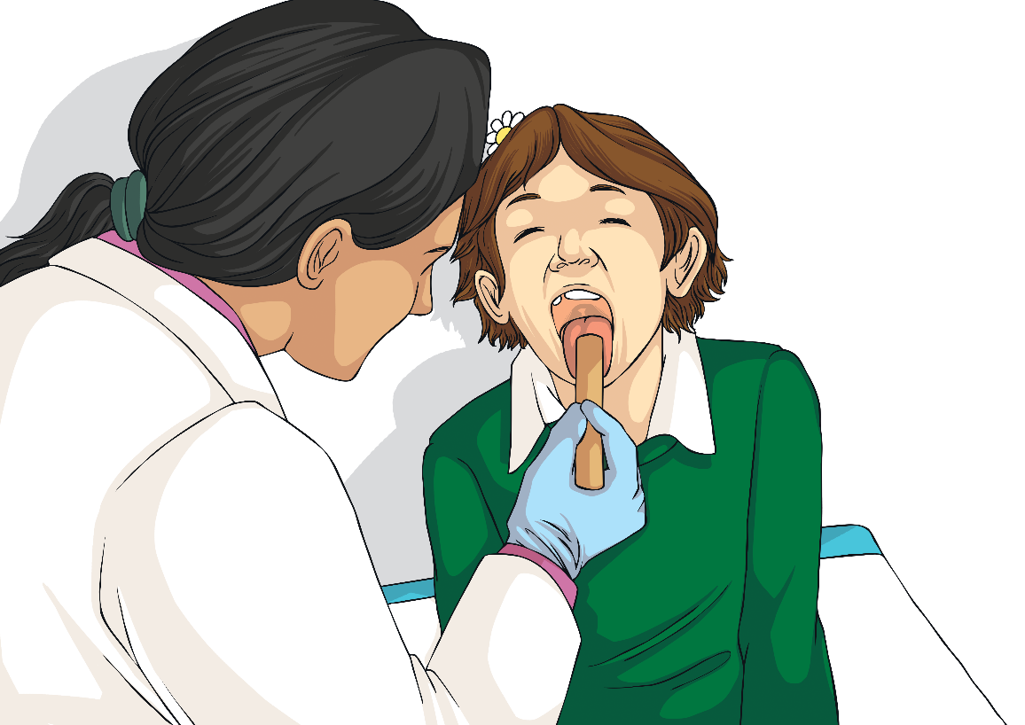
Are Inverted Commas Needed?
Look at these speech sentences. Are they examples of direct or indirect speech?
If they are examples of direct speech, where should we place inverted commas?
The doctor gently said, Open your mouth as wide as possible.
“
”
This is an example of direct speech and does need inverted commas around the spoken words. Where should they go?

Slide 11
Spotting Direct and Indirect Speech
Can you spot an example of direct speech in this newspaper report?
Here is a passage of direct speech. It has inverted commas, other speech punctuation and a reporting clause.
Can you spot an example of indirect speech in this newspaper report?
Here is a passage of indirect speech. It has no inverted commas or reporting clause. It tells the reader what Justin Gatlin promised his supporters.

Slide 12
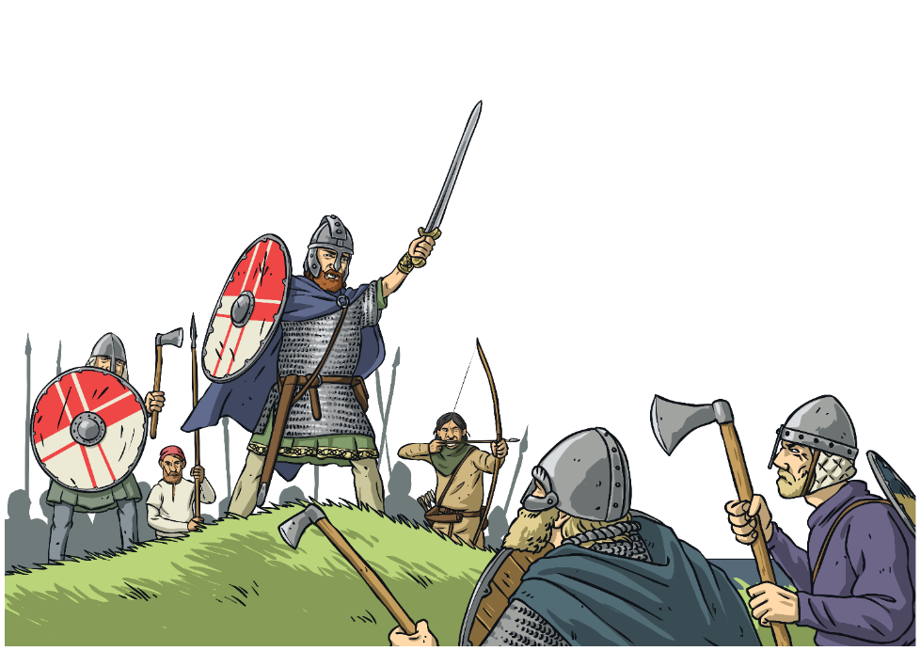
Changing Indirect Speech to Direct Speech
Do you remember this indirect speech sentence from earlier? Could you turn it into a direct speech sentence?
Guthrum announced that they should charge towards to the village.
“We should charge towards the village!” announced Guthrum.
What has changed? Why?

Slide 13
Changing Direct Speech to indirect Speech
Now, can you do the opposite? Could you turn this direct speech sentence from earlier into a line of indirect speech?
The doctor gently said, “Open your mouth as wide as possible.”
The doctor gently told the patient that he should open his mouth as wide as possible.
What has changed? Why?

Slide 14
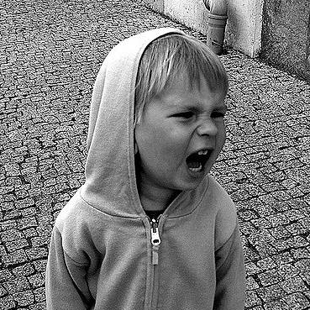
Writing Direct and Indirect Speech Sentences
Look at this photograph. Can you invent both a direct and an indirect speech sentence based upon it?
Example Sentences
Direct Speech
“I want an ice cream!” shouted the angry little boy.
Indirect Speech
The angry little boy shouted that he wanted an ice cream.
Photo courtesy of Mindaugus Danys(@flickr.com) - granted under creative commons licence – attribution

Slide 15
Writing Direct and Indirect Speech Sentences
Look at this photograph. Can you invent both a direct and an indirect speech sentence based upon it?
Example Sentences
Direct Speech
The championship driver shrieked, “We won the race!”
Indirect Speech
The championship driver shrieked that they had won the race.
Photo courtesy of Steven Harrell(@flickr.com) - granted under creative commons licence – attribution

Slide 16
Writing Direct and Indirect Speech Sentences
Look at this photograph. Can you invent both a direct and an indirect speech sentence based upon it?
Example Sentences
Direct Speech
“Say cheese, dad, ” pleaded the girl as she was taking the photograph.
Indirect Speech
As she was taking the photograph, the girl pleaded for her dad to say cheese.
Photo courtesy of Michael Coghlan(@flickr.com) - granted under creative commons licence – attribution

