Slide 1
Microsoft
Word

Slide 2
What is Word?
Word is the Microsoft Office word processing program.
You can type, insert images, pictures and diagrams for a variety of needs.

Slide 3
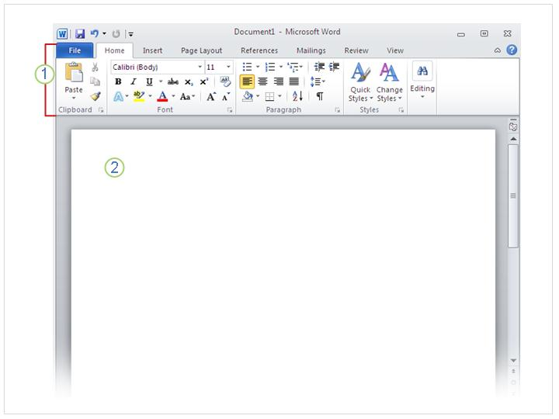
The first time you open Word
The Word ribbon which sits above the document.
A blank document, which looks like a white piece of paper.

Slide 4
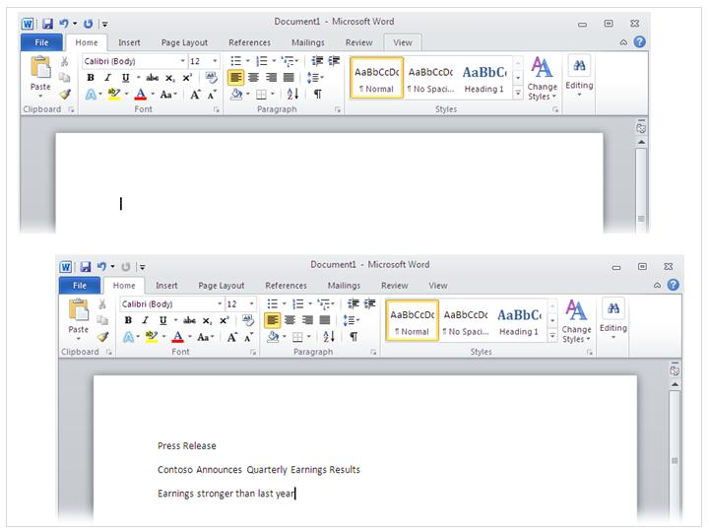
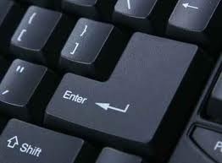
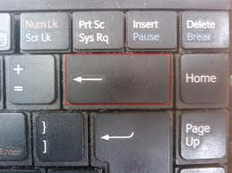
Just start typing…
In the document, look for the cursor, which is a blinking line. This will show you where you can start typing.
If you want to type further down the document, just press the Enter button.
If you make a mistake, press the Backspace key.

Slide 5
The Word ribbon
The Word ribbon contains a lot of pictures called icons.
These icons all perform different functions.
We will look at the main icons in detail.

Slide 6
New Document Icon
Click on New Document to open a new page in Word.

Slide 7
Open Icon
Click on Open to open a document in My Documents. All of your saved documents can be found here.

Slide 8
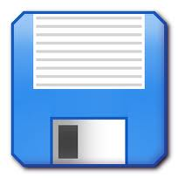
Save Icon
Click on the Save icon to save a document in My Documents.

Slide 9
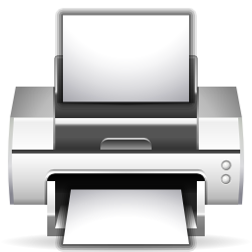
Print Icon
Click on the Print icon to print your document.

Slide 10
Print Preview Icon
Click on the Print Preview icon to check your document as a whole, before you print it.

Slide 11
Spellcheck Icon
Click on the Spellcheck icon to check your document for spellings and grammar.

Slide 12
Changing the text
You can use the Home tab to change the text
3
1
2
Click here to change the size of the letters.
2. Click here to change the colour of the text.
3. Click here to change the style of the text.

Slide 13
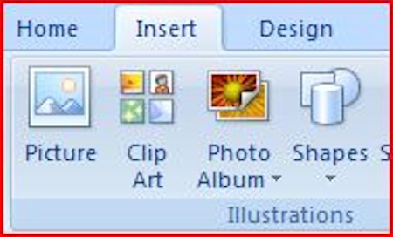
Inserting Clipart
Click on the Insert Tab

Slide 14
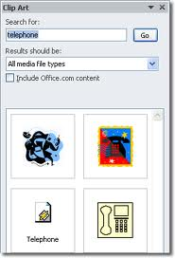
Inserting Clipart
Type in your chosen topic in Search for and click on Go.
When you have chosen your image, double-click the mouse. It will then appear in Word.

Slide 15
Inserting a Picture
Click on the Insert Tab

Slide 16
Inserting a Shape
Click on the Insert Tab

Slide 17
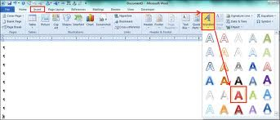
Inserting WordArt
Click on the Insert Tab

Slide 18
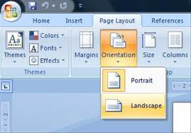
Change the Page Layout
Click on the Page Layout Tab

