Slide 1
TUESDAY 26.1.21

Slide 2
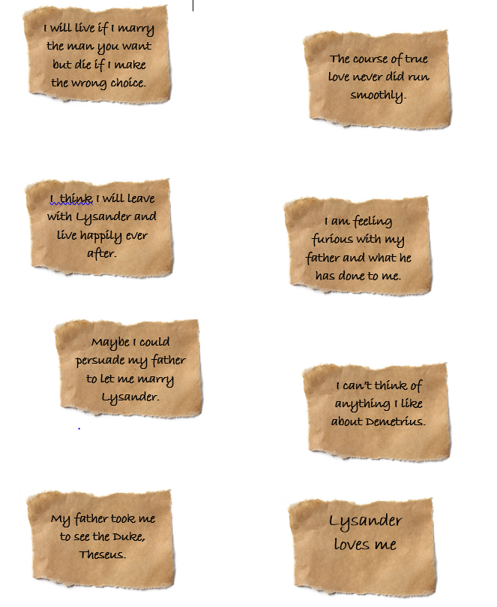
Reading:
Hermia has tried to write a letter to her father but she became so frustrated and angry that she began to tear strips and scrunch paper up. We now know what her father has told her, embarrassed her by taking to court to see the Duke and exchanged messages with Lysander about running away together.
You need to decide which of these strips are facts from the play and which ones are inference - we think they might be true but we don't know if someone says or it is said in the play. You could cut them out and label fact or inference or you could create a table with Facts and Inference and write them out. Think carefully.

Slide 3
Writing You are going to complete this letter to Egeus, Hermia’s father, which has been written by Hermia. You are given the sentence openers and you need to complete the sentences in as much detail as possible. Please try adding conjunctions such as, because, but, if, so to really show how you as Hermia is feeling and why. Avoid using one or two words in a sentence. These sentence openers are just starters, you need to give as much information as possible. Challenge: we will be really impressed if you can use some of the language you have seen last week and this week from the play.
Dear Father, When you brought me before the court, I felt….. I love….. I hate… I remember once… One thing I would change about the world is… I am afraid that… I will learn to… My biggest question to you is…
Your daughter, Hermia.

Slide 4
https://vimeo.com/480759672

Slide 6
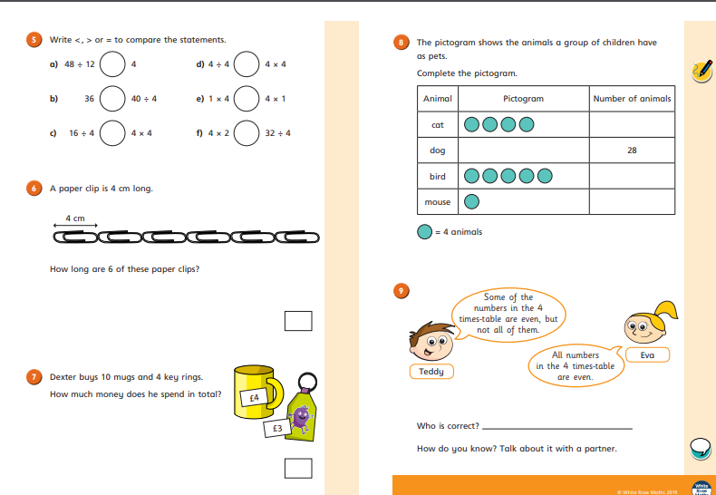

Slide 7
with
Mrs Denny!

Slide 8
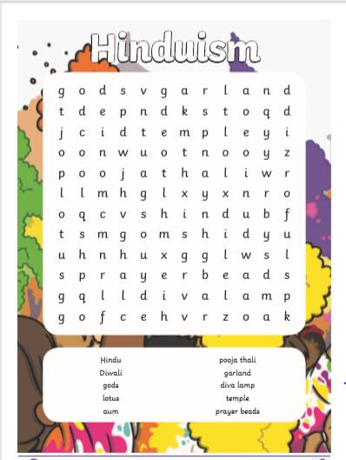

Slide 10
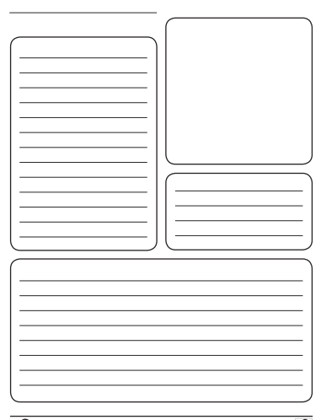
A fact file about Ganesh – in your own words.
Picture of Ganesh
Facts
Facts

Slide 11
New story with Miss Bowler!

