Slide 2
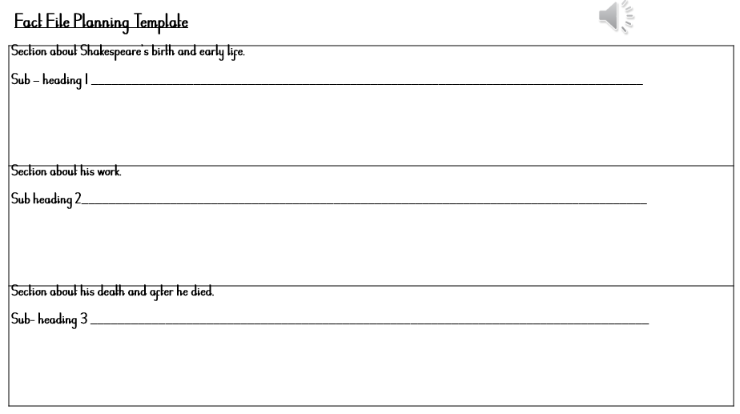

Slide 3
Text 1. Who Am I?
I was born in 1564, in a small town called Stratford-Upon-Avon.
My mother was called Mary and my father was called John and I had two older sisters and three younger brothers.
I got married when I was 18 and I had three children of my own.
I was an English playwright, actor and poet, and I am often thought of as the greatest English writer of all time. My scripts have been translated into more than 100 languages and they continue to be performed as plays around the world to this day. I also introduced nearly 3,000 words to the English language. I died in 1616 aged 52.

Slide 4
Text 2 – The Life of William Shakespeare.
Introduction.
William Shakespeare was an English playwright, poet, and actor, widely regarded as the greatest writer in the English language and the world's greatest dramatist. He is often called England's national poet and the "Bard of Avon".
William’s Early Life.
William Shakespeare was born in 1564 in Stratford-upon-Avon but we don’t know his exact date of birth. His birthday is usually celebrated on the 23rd April. William was born to prosperous parents. His mother, Mary, was the daughter of a local farmer. His father, John, was a glove-maker and wool trader with a large family house. Although William was the third of eight children, he grew up as the oldest. His two older sisters both died very young. Shakespeare married Anne Hathaway – a local farmer’s daughter when William was only 18 years old in 1582. Together they had a daughter called Susanna in 1583 and two more children called Hamnet and Judith who were twins, born in 1585.

Slide 5
Becoming a Famous Playwright.
From about 1590, Shakespeare lived mainly in London and by 1592 was a well-known actor there. He was also a playwright. He went on to write, or co-write, about 40 plays. Shakespeare was also a poet and in 1609 published a book of 154 sonnets. Shakespeare was a businessman too. He was a part-owner of a theatre company called The Lord Chamberlain’s Men and from 1599, he was part-owner of the famous Globe Theatre. For about twenty years, he made money from acting, writing and running a theatre company.
What Happened After William’s Death?
After 1613, Shakespeare spent more time at Stratford. William Shakespeare died on 23rd April 1616. He is buried in Holy Trinity church in Stratford-upon-Avon. Nowadays, William Shakespeare remains very famous for his plays, and many children learn about them in school. His plays are still performed on stages across the whole world and enjoyed by many more than 400 years after his death.

Slide 6
Please send any questions and your completed work to
yeartwo@lingsprimary.org.uk
Have a terrific Thursday!

