Slide 1
Terrific Thursday
21.1.21

Slide 2
Here is a letter from Egeus telling the Duke, Theseus to help him.
Dear Your gracious Duke, I came to you today as I am full of rage against my child, my daughter, Hermia. I gave Demetrius consent to marry my daughter but Lysander does not have my permission to marry her. These men are both wealthy and have a good reputation in Athens but I made the choice for my daughter and she should obey me.
Lysander has cast a spell on my daughter and sends her poems and has swapped tokens of love with my child. He has sung at her window at night time and given her many rings, worthless tokens, flowers and sweets to woo her. He has have stolen my daughter’s heart through deception and turned her attention to him and not me, which is just cruel.
You need to tell her that I give her consent to marry Demetrius, I beg you use the ancient rule of Athens. She is my property, and I will get rid of her if I need to. She either marries Demetrius or Hermia will die.
Gracious - kind
reputation - beliefs/ opinions people have of someone
obey - do as I say
worthless - no use
deception - lies
woo - make someone interested in them
distressed - upset
Now answer the questions - use the text to help you:
What is Egeus's problem?
Who do you think Hermia, the daughter loves? Why do you think that?
Name two things Lysander has done to get Hermia's attention?
What will happen if Hermia does not marry Demetrius?
Please help me make sure she makes the right choice. A very distressed Father, Egeus.

Slide 4
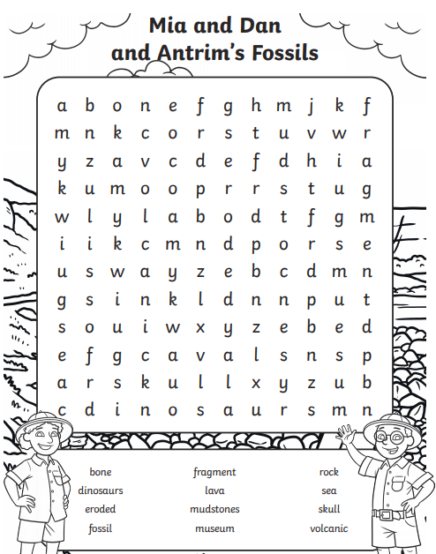

Slide 6
https://vimeo.com/476319270

Slide 8
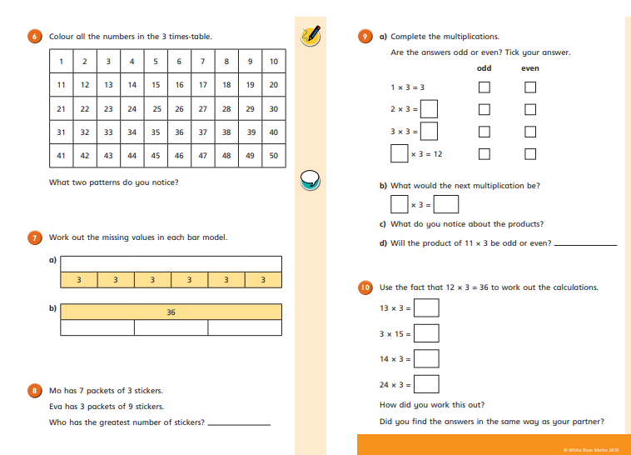

Slide 9
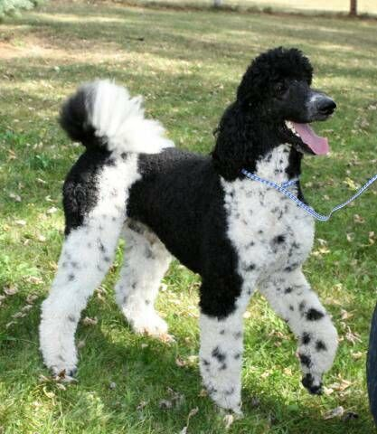
PE AWARDS
A huge shout out to Elliot and Harvey for getting the PE awards last week.
Harvey showed enthusiasm and joy.
Elliot showed enthusiasm and patience with Wilson the dog!!

Slide 10
STAY SAFE ON THE INTERNET!
NEVER GIVE OUT DETAILS.
IF YOU ARE WORRIED TELL YOUR GROWN UP.
PEOPLE MIGHT NOT BE WHO THEY SAY THEY ARE.
GAMES HAVE AGE RESTRICTIONS FOR A REASON.
FaceBook, WhatsApp, Twitter, Instagram, TicToc etc THE YOUNGEST AGE FOR AN ACCOUNT IS 13!! THESE ARE FOR TEENAGERS AND ADULTS!

