Slide 1
TANTALIZING TUESDAY

Slide 2
In the city of Athens, it is known as a place of civilization, law, and order. At the highest point standing proud is the important, solid, marble Parthenon. The spacious area is a place of calm and tranquil. There lies a temple dedicated to the Goddess Athena and consists of 17 columns. The lavish white marble and huge size shows the power and importance in Athens. Just beneath the temple, is the upper city called Acropolis. Here the large, protected, stunning building which again is made from white marble made up of a sanctuary for healing, temples and an open air theatre. You feel at peace here. In the town itself, there is a bustling, crowded and open agroa where you will find markets, meetings and social gatherings taking place. The sights and sounds of this open space makes it a comfortable and refreshing place to be. By the stairs, a decorative and ornate statute glistens in the daytime sun and shows off the wealth and power of this town and another glistening object catches my eye on top of the building. The dragon type statute is golden, hard and heavy, looking like it could still be there in thousands of years to come.
Vocabulary Civilization - where many people live Tranquil – peaceful, restful Lavish – luxury/ grand Sanctuary – religious place Bustling – busy Wealth - rich
1. What place will you find at the top of the mountain? 2. Why is Parthenon so important? 3. Give three descriptions that tell you that Athens is wealthy. 4. Where in Athens would you go if you wanted to meet up with friends? 5. When thinking about the power of the town. Which word has similar meaning: strength, control, importance?

Slide 3
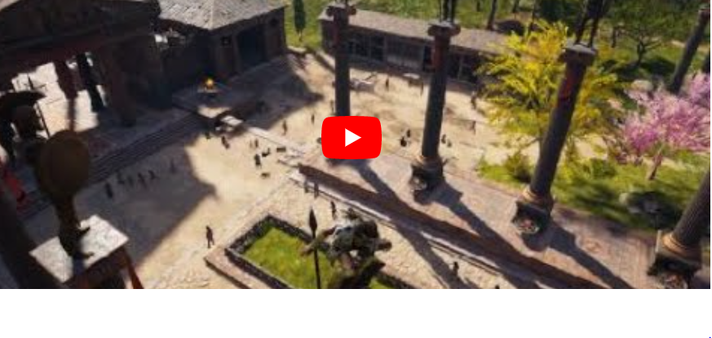
Writing: Use and watch the link and imagine you are the person in the video, taking a guided tour of the Ancient World of Athens. As you watch think about and make notes on what you might smell, touch, hear and see. You could try taste too but this can be more difficult - so give it a go. Listen to the description the person gives to help you.
Once you have finished your guided tour and with your carpet of words from yesterday, write a description of Athens.
You need to include:
names of places you visited
fronted adverbials for 'where'
three adjectives using a comma to describe the noun - remember the magic rule of 3.
Imagine you are there - you have lots of detail and information now so try and write at least a page of description.

Slide 4
https://vimeo.com/475444169

Slide 5
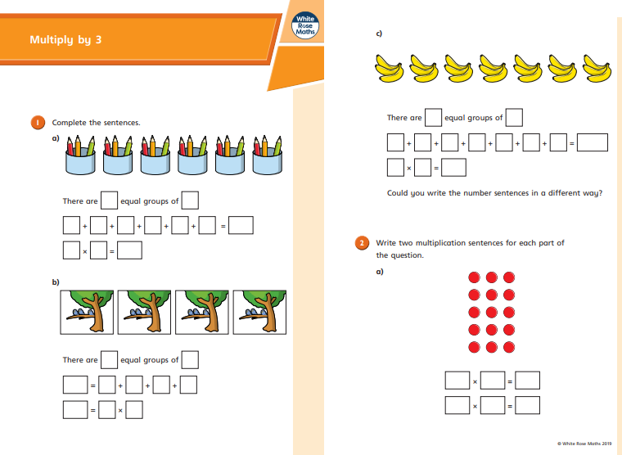
https://resources.whiterosemaths.com/wp-content/uploads/2019/09/Y3-Autumn-Block-3-WO2-Multiply-by-3-2019.pdf

Slide 6
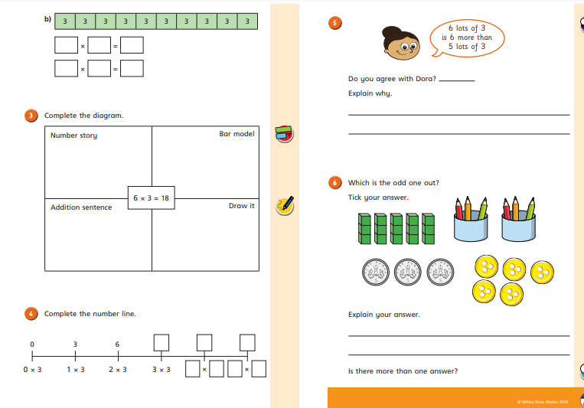

Slide 8
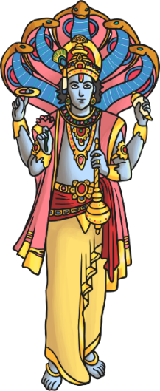
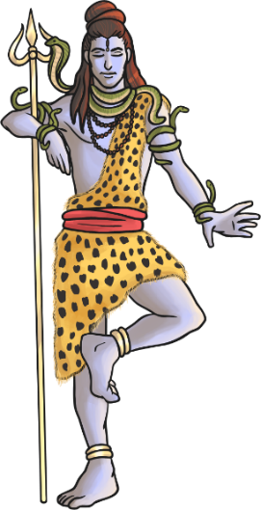
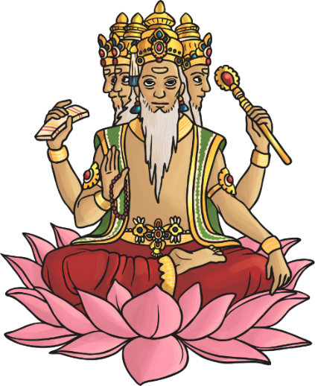
Brahma is God as the creator.
Vishnu is God as preserver
(looks after)
Shiva is the destroyer
Hindus recognise one God, Brahman.
The gods of Hinduism are different expressions of Brahman. The gods above show 3 aspects of Brahman. God creates the world, he looks after everything in the world and he can destroy it if he wants.
Just like each of us is more than one thing: Mrs B is a mother, daughter, sister, teacher, wife, gardener, friend. Each of these parts of us are different depending on the situation.

Slide 9
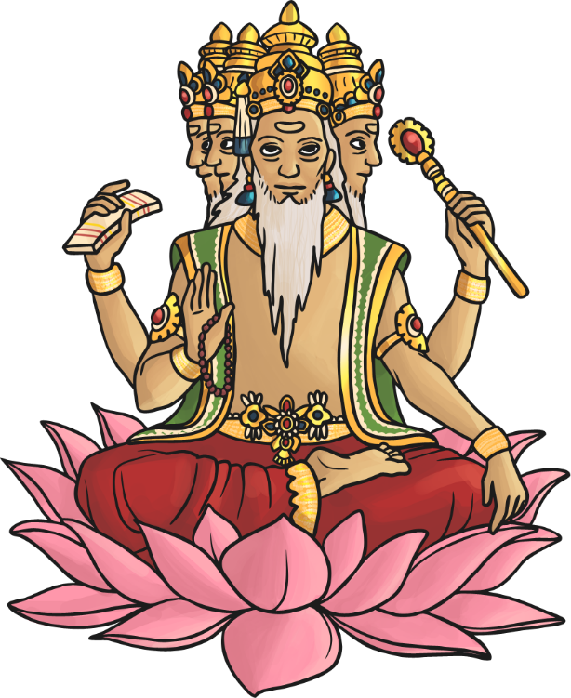
Hindu Deities - Brahma
Brahma is the god (deva) of creation.
He has four arms and four faces, looking in the four directions.
Each of his four heads is believed to be responsible for one of the four Vedas (sacred Hindu texts).
Brahma is not worshipped as much as the other gods, as it is believed his role as creator is over.
His wife is Saraswati – the goddess
of knowledge.

Slide 10
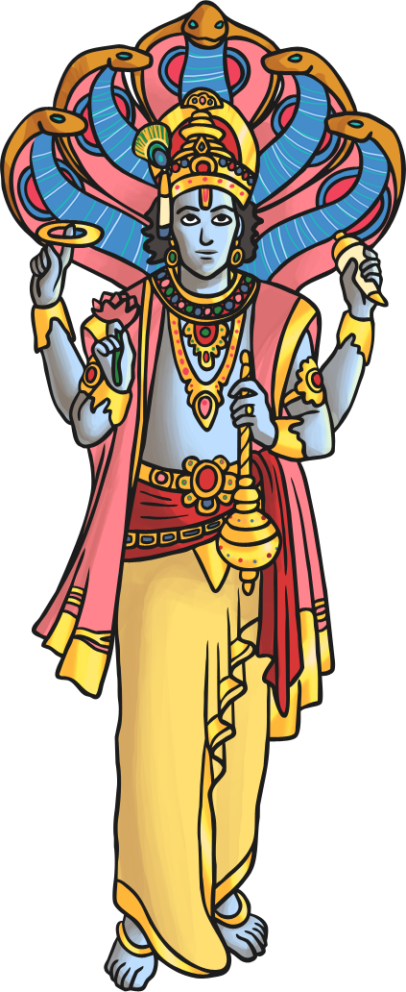
Hindu Deities - Vishnu
Vishnu is the god responsible for preserving and protecting the universe.
His role is to return to Earth during troubled times to restore the balance between good and evil.
His incarnations (human forms of Vishnu) include Rama and Krishna.
His last incarnation is said to be Siddartha Gautama – otherwise known as ‘Buddha’ (the founder of Buddhism).
His wife is Lakshmi.

Slide 11
Hindu Deities - Shiva
Shiva is the god of destruction. His role is to destroy the universe in order to re-create it.
He is seen as the source of both good and evil.
His wife, Shakti, is said to enable him to gain balance.
He is often depicted with . . .
a third eye (representing wisdom and insight);
a cobra necklace (representing destruction and recreation – snakes represent this in the way they shed their old skin for new skin);
vibhuti (three lines drawn across the face to represent his power);
a trident (which represents the three functions of the Trimurti).

Slide 12
Name of Hindu God:
What does the god represent? What is their role?
What do they look like in paintings/ sculptures? What objects/flowers/colours are associated with them?
Write down anything else you found out about this god.

