Slide 1
El título: days The title:
¿ Cuál es la fecha de hoy ?
What day is it today?
miercoles 5 de enero 2021
Wednesday 5th January 2021
Objectivo : To be able to say the days of the week in Spanish

Slide 2
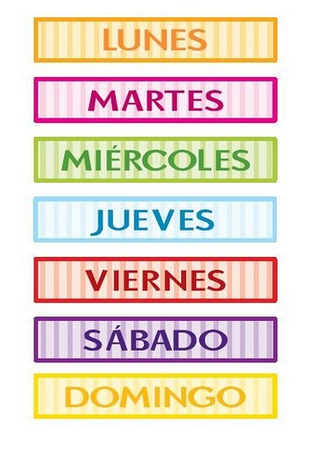
LOS DIAS DE LA SEMANA

Slide 3
LOS DIAS DE LA SEMANA
Notes:
https://www.youtube.com/watch?v=C2DNBnhMpvQ

Slide 4
LOS DIAS DE LA SEMANA
Put them in the correct order.
jueves
sábado
lunes
viernes
miércoles
domingo
martes

Slide 5
Write them down:
Monday
Tuesday
Wednesday
Thursday
Friday
Saturday
Sunday

Slide 7
Friday
Monday
Tuesday
Thursday
Saturday
Wednesday
Sunday

