Slide 2
To use research skills to find out what a Roman Soldier wore.

Slide 3
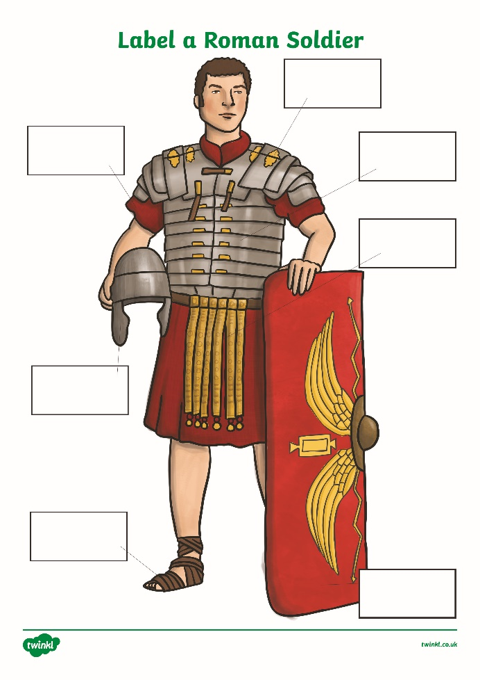
Can you label the different items worn by a Roman Soldier?
Do you know what any of these items were called in Latin?

Slide 4
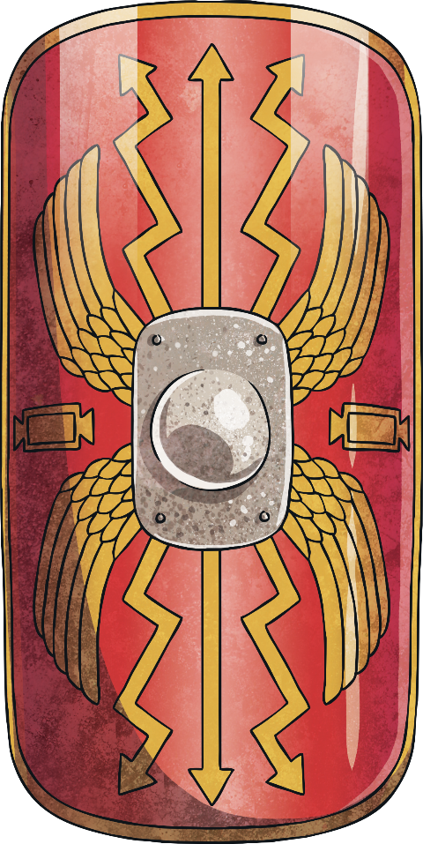
Pick one item and research it in more detail
What was it made from?
How did it work?
What were the advantages?
What were the disadvantages?

Slide 5
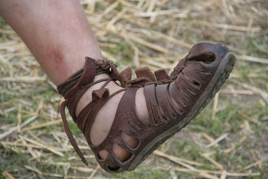
Sandals
What was it made from?
Leather, with metal studs on the bottom.
Advantages
Leather is soft.
Leather is hard wearing – Roman soldiers had many miles to march.
Studs stopped soldiers slipping on mud.
Studs prevented the soles from wearing out.
An extra weapon – they could stamp on their enemies.
How does it work?
Sandal straps tied round the leg so they didn’t fall off.
Studs gripped into soft surfaces.
Disadvantages
Not warm for Britain
Studs would be slippy on wet stone.
Photo courtesy of MatthiasKabel (@flickr.com) - granted under creative commons licence – attribution

Slide 6
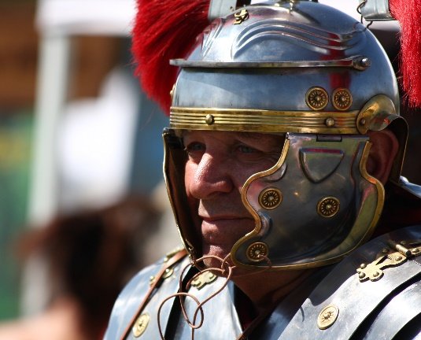
Helmet
What was it made from?
Iron with brass decorations on the main helmet and the cheek plates.
Advantages
The helmets were beaten out of a single piece of metal, therefore providing greater protection.
They were cheap and easy to produce.
Officers were able to demonstrate their importance and be easily followed by wearing crests of horse hair on top of their helmet.
How does it work?
The outer rim protects the forehead and prevents the sword blows from penetrating the helmet. The rear of the helmet has a guard to protect the neck.
Disadvantages
The helmets were very heavy and uncomfortable.
Photo courtesy of Rennett Stowe (@flickr.com) - granted under creative commons licence – attribution

Slide 7
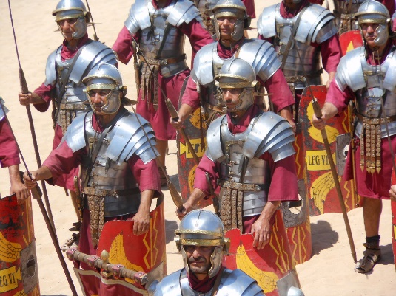
Shoulder Plates
What was it made from?
Soft iron on the inside and mild steel on the outside, which allowed the plates to become hardened against damage without becoming brittle.
Advantages
The overlapping metal strips were fastened with hooks and laces at the front and hinged at the back. Internal vertical leather strips enabled the soldier to bend easily.
How does it work?
The shoulder plates were made of curved, hinged pieces of metal which enabled the soldier to move freely yet remain protected.
Disadvantages
The upper and forearms were unprotected.
Hot and heavy in battle.
Photo courtesy of Michael Coghlan (@flickr.com) - granted under creative commons licence – attribution

Slide 8
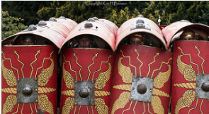
Shield
What was it made from?
The shields were generally made from wood, with additional layers added to create the curve.
The shields were covered in leather and linen then decorated elaborately.
Advantages
The hand grip, on the inside of the shield, was protected by a metal boss which could also be used to push into an enemy and knock them down.
How does it work?
It was semi-circular so that any objects thrown at the soldier would rebound to the other side.
The roman soldiers used the shields to create battle formations.
Disadvantages
They were very heavy and absorbed water during rain fall, making them even heavier.
Photo courtesy of kimbenson45 (@flickr.com) - granted under creative commons licence – attribution

Slide 9
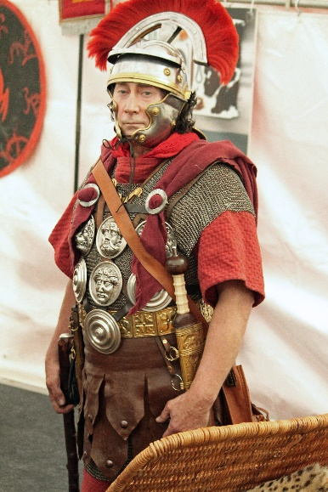
Body Armour
What was it made from?
Multiple, individual iron bands wrapped around the chest and shoulders.
Advantages
Gave good protection and allowed some movement.
The strips of metal could be replaced if they were damaged.
The shoulder plates were hinged to allow movement.
How does it work?
The iron bands were attached together by leather internal strips.
Additional curved metal strips were positioned on the shoulders to provide extra coverage.
Disadvantages
Soldiers needed help to put on the body armour as it was so heavy.
Photo courtesy of Michael Park (@flickr.com) - granted under creative commons licence – attribution

Slide 10
Tunic
What was it made from?
The military tunic was made from wool, cotton or linen, depending on the climate.
Advantages
The tunics were created with great care and made to measure for each individual soldier. The length of the tunic reflected the soldiers rank and authority within the army.
How does it work?
It was a wide, under garment which was worn underneath the body armour to protect the body from the armour and allow freedom of movement in battle.
Disadvantages
Did not offer protection against hostile weather conditions.
Photo courtesy of Michael Park (@flickr.com) - granted under creative commons licence – attribution

Slide 11
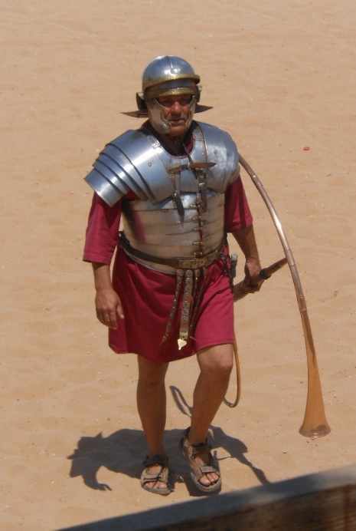
Groin Protection
What was it made from?
Leather strips which were decorated.
Advantages
The belt made a jangling noise when the soldier moved. The noise created by hundreds of soldiers as they marched was believed to have intimidated their enemies.
How does it work?
The groin protection was a belt worn with the tunic. It was decorated with leather strips which provided protection to the groin area.
Disadvantages
The actual protection provided to the groin area was minimal.
Photo courtesy of Michael Coghlan (@flickr.com) - granted under creative commons licence – attribution

