Slide 1
Here are some different images of Puck.

Slide 2
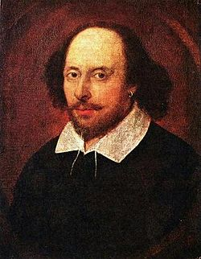
Character Context
In Shakespeare’s day, it was believed that fairies and ‘small beings’ did exist. Whenever something peculiar happened -at home or in the village (such as tools disappearing or doors closing by themselves!)- it was sometimes blamed on fairies or sprites!

Slide 3
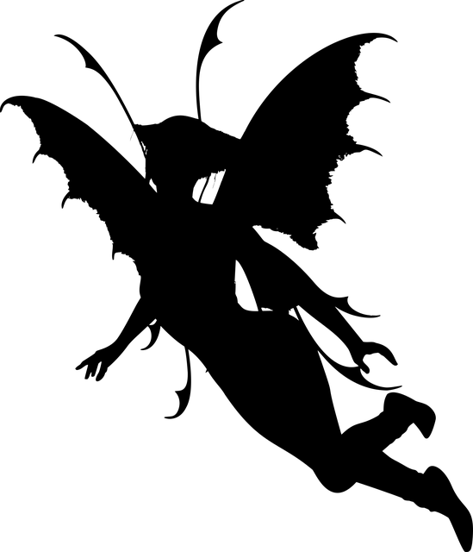
FAIRY FOLKLORE
Traditionally, people believed that:
Fairies mainly spent their time dancing
It was a bad idea to get on the wrong side of a fairy…!

Slide 4
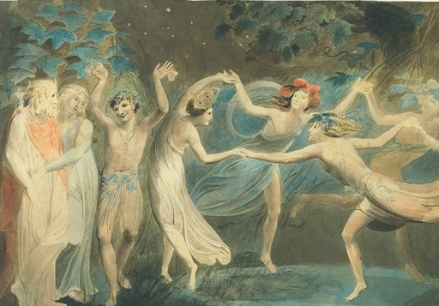
Here’s Oberon & Titania
Here’s Puck
Here’s other fairies
(Painting by a famous poet called William Blake.)

Slide 5
Here’s Oberon & Titania
Here’s Puck
Here’s other fairies
How might Puck be viewed as different to the other fairies?
Why is it important that he ‘stands out?’

Slide 6
Shakespeare describes Puck as:
‘that shrewd and knavish sprite’
Dishonest
Mischievous
Clever
Intelligent
Sharp

Slide 7
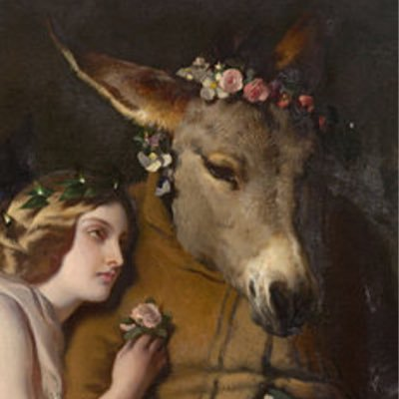
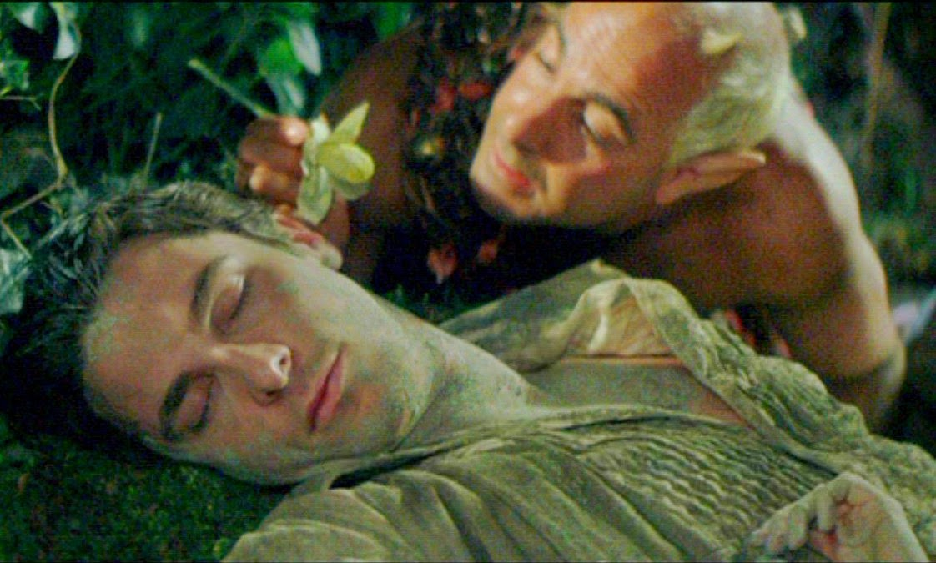
Audiences today might use modern adjectives to describe PUCK. Here’s some:
Troublesome
Hilarious
Mischievous
Entertaining
Smart
Sharp
Witty

Slide 8
Why is it important to have a troublesome/ hilarious/ mischievous/ entertaining/ smart/ sharp/ witty character in the play?
Imagine the play without Puck. What difference would that make?

