Slide 1
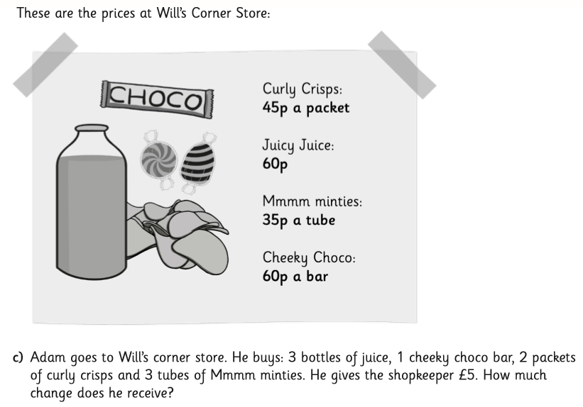
Here’s a maths challenge for you.
Click the button below to hear Miss Lindop read the question and give you some tips and hints that may help you solve it.

