Slide 1
Monday 25.1.21

Slide 2
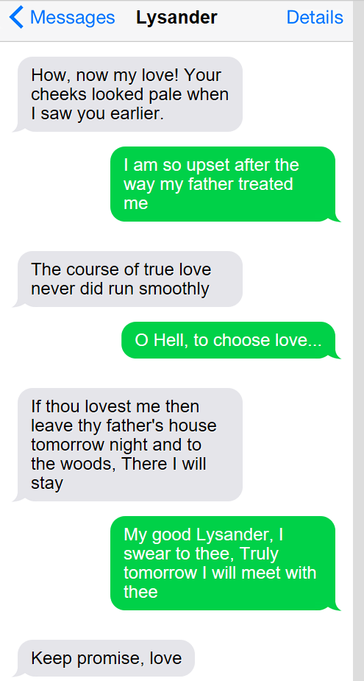
Take a look at these text messages that Lysander has been sending and answer the questions below:
Who is he sending the messages to? How do you know?
What are Lysander and his lover planning to do?
'The course of true love never did run smoothly.' What does Lysander mean?
'Choose love' - Why do they have to choose love? Think about what we did last week and Egeus.
If you have pale cheeks what does that usually mean is wrong with you?

Slide 3
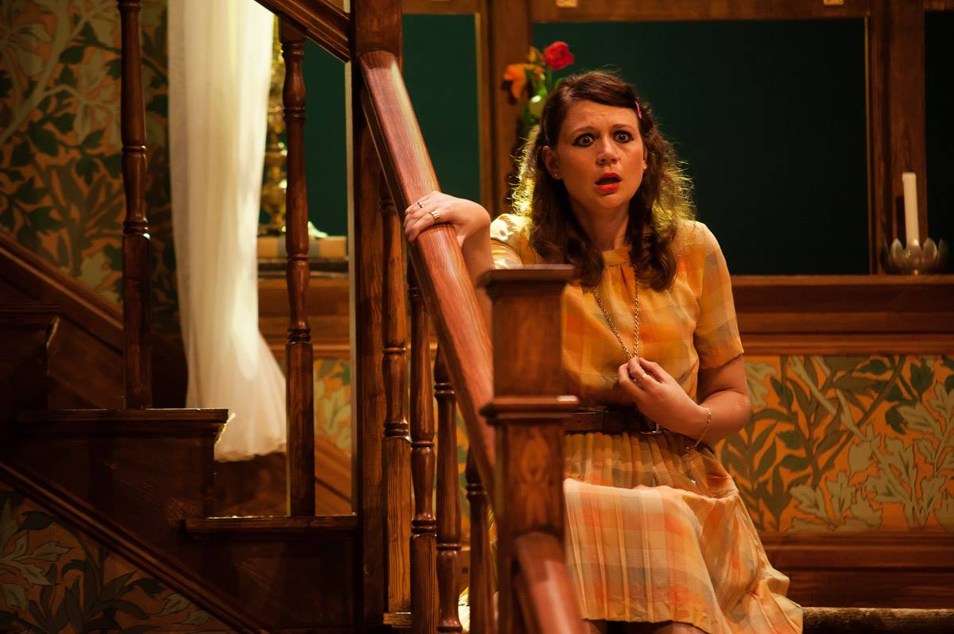
Imagine after every step she took as she walked down those stairs, she thought something. You could draw the stairs and write on each step what she was thinking, or if you have stairs at home you could pretend to be Hermia and recreate the scene writing a thought bubble or footprint for Hermia (first person - I) - you need to do for at least 6 steps/ 6 though bubbles. (Use what Hermia would have been thinking after what her father said to her last week and now what Lysander has said to her).
On one footprint/ thought bubble write a question as if you are Hermia
As you have probably guessed Lysander was messaging Hermia. Now Hermia has heard what her father has said about Lysander. WE want you to explore her thoughts.
On another footprint/ thought bubble write a command/ order - e.g. My father should listen to me! Think of your own.
On another footprint/ thought bubble write a statement - e.g. My father will have me dead. Think of your own.
On another footprint/ thought bubble write an exclamation sentence that starts with what or how e.g. What a mess this is ! Think of your own
You can send pictures or it would be great if you could video yourselves as Hermia walking down stairs saying thoughts or just saying the thoughts. We could add to the blog! We love a bit of drama!

Slide 5
https://vimeo.com/477072164

Slide 6
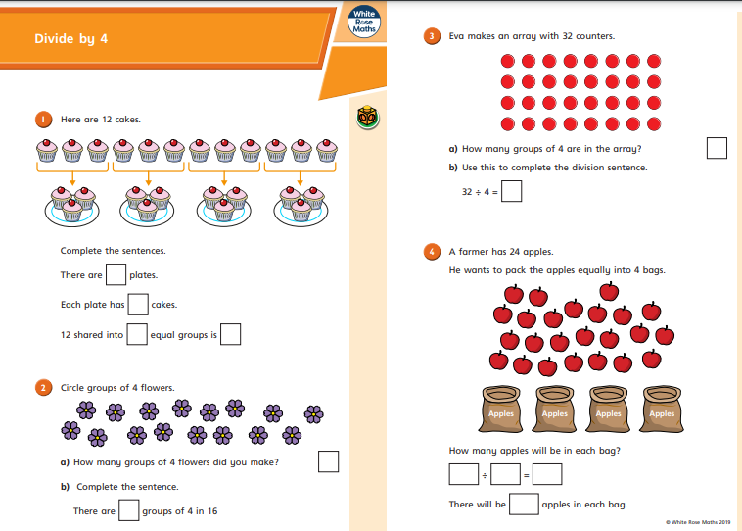
https://resources.whiterosemaths.com/wp-content/uploads/2019/09/Y3-Autumn-Block-3-WO6-Divide-by-4-2019.pdf

Slide 7
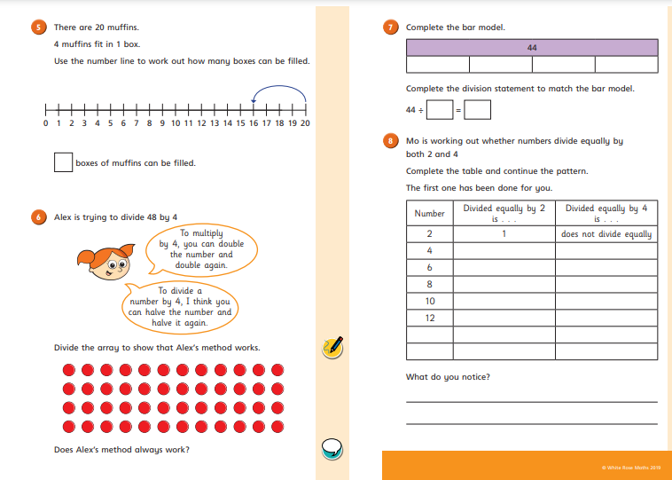

Slide 8
https://www.topmarks.co.uk/maths-games/mental-maths-train

Slide 9
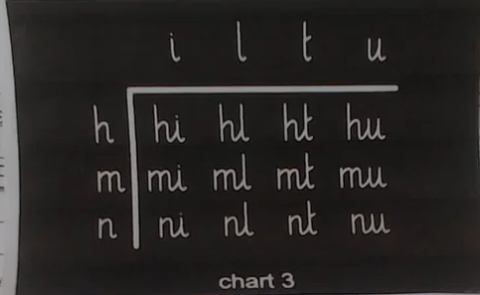

Slide 10
It’s time for you to create their own super-hero avatar, like Jessie’s, Tia’s and Mo’s in the Avelzon game. There are lots of ways they could do this – for example, drawing, painting or collage... .or why not find some spare clothes/items around the house to make their own super-hero costume? Jessie, Tia and Mo’s ‘Power Words’ are ‘Strong’, ‘Fearless’ and ‘Wise’. Ask your child to think of all the positive qualities they would like their super hero to have when being safe and playing games online, and then ask them to choose a Power Word for their own super hero.
Look forward to seeing your creative ideas for a superhero.

Slide 11
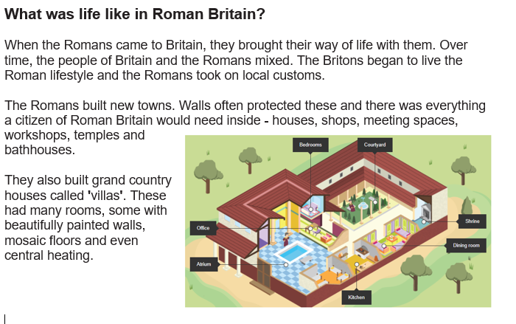
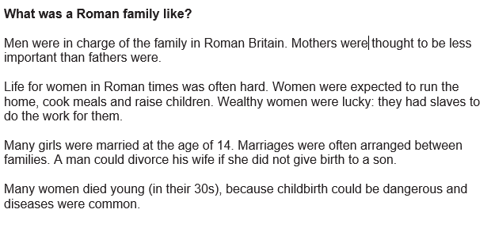

Slide 12
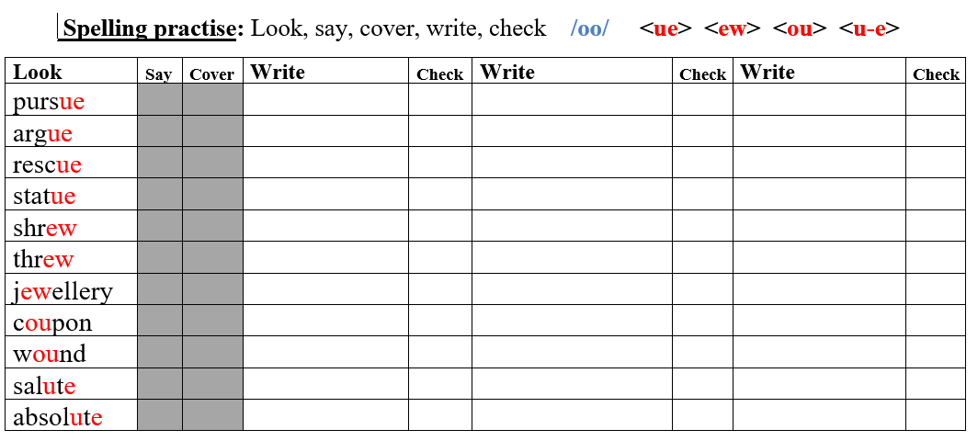

Slide 13
Just for fun and to
help save your
page in the book you’re
reading!

