Slide 1
Magnificent Monday 18.1.21

Slide 2
English/ Reading:
The play/ story of Midsummer Night's Dream moves to Athens in Ancient Greece. If you click the link below, it explores Ancient Greece and if you click on the names/ nouns of places they will give you more information. Take some time to explore Ancient Greece.
https://www.dkfindout.com/uk/history/ancient-greece/athens/
To answer the questions you will need to click on the place or person to find the answer.
What is the name of the statue in Parthenon?
What two places will you find within Acropolis?
If you click on Acropolis, where would you find the god of drama?
if you click on food and clothing and then the red link to What ancient Greeks ate? What animal supplied the cheese and milk?
Click on 'Women' and then the red link to 'Women in Ancient Greece.' What three things did women do in Ancient Greece?

Slide 3
Writing
Using the same link from reading we are going to create a carpet of words like we did in Week 1:
use one colour to write down five nouns/ places you could see - you can click on areas to explore other nouns e.g. Statute, sanctuary
use another colour and the magic rule of three to write down three adjectives for each of nouns - try not to use colours, click on the areas/ nouns to help build descriptions
use another colour to write down a fronted adverbial for where, imagine you are there and not describing where things are in the picture... e.g. Next to the... In the centre, On the hill...
Take a picture of your carpet of words and email them to us. Keep hold of your carpet of words as you will need them for tomorrow.

Slide 4
Blue are the nouns, red are the fronted adverbials for where and green for the three adjectives.

Slide 5
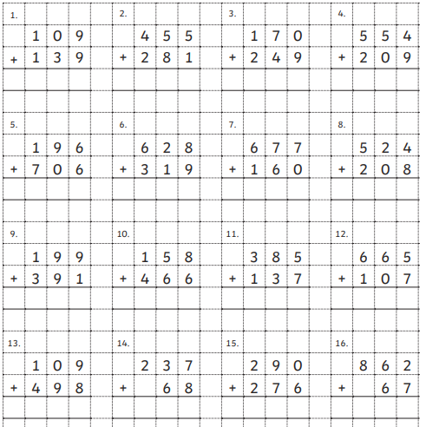

Slide 6
https://vimeo.com/471012878

Slide 7
https://resources.whiterosemaths.com/wp-content/uploads/2019/11/Y2-Spring-Block-1-WO6-Divide-by-10-2019.pdf

Slide 8
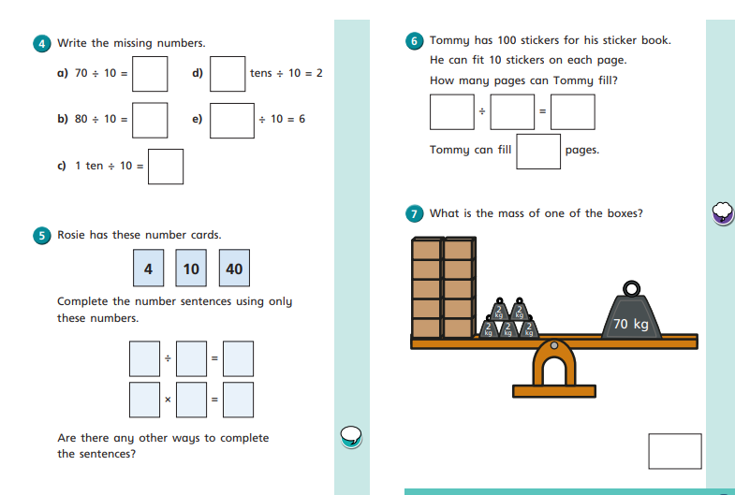

Slide 10
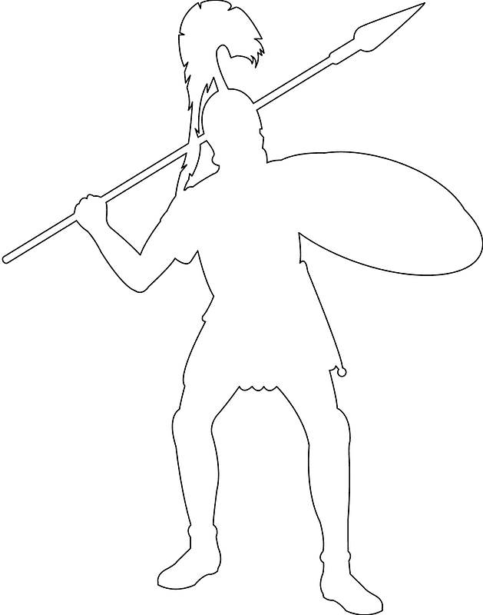
Retrieval
What do you know about the Romans?

Slide 11
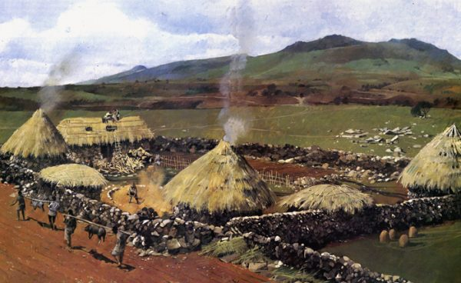
What was Britain like before the Romans invaded?
Before the Romans came to Britain the land was lived in by a people called the Celts.
The Celts were brave and fierce warriors and there was often conflict between the different tribes.
They lived in groups of people called tribes who were each ruled by their own king or queen.
There were no roads, towns or cities.
They lived in round houses made from wood, mud and straw.
The landscape was made up of farms, fields and woods.
https://www.bbc.co.uk/bitesize/clips/zcfygk7

Slide 12
Pick 2 colours. Shade the statements from the Romans in one colour and the statements from the Celts in another.
“Boudicca is selfish for fighting against the Romans. My home has been destroyed.”
“Boudicca is a savage barbarian who needs to be stopped.”
“Boudicca is only trying to protect what is ours.”
“Boudicca is a hero for standing up to the Romans!”
“Boudicca is a brave warrior who will lead us to victory.”
“Boudicca is standing in the way of progress for Britain.”

Slide 13
What was Britain like before the Romans invaded?
What happened to Britain when the Romans invaded?

