Slide 1
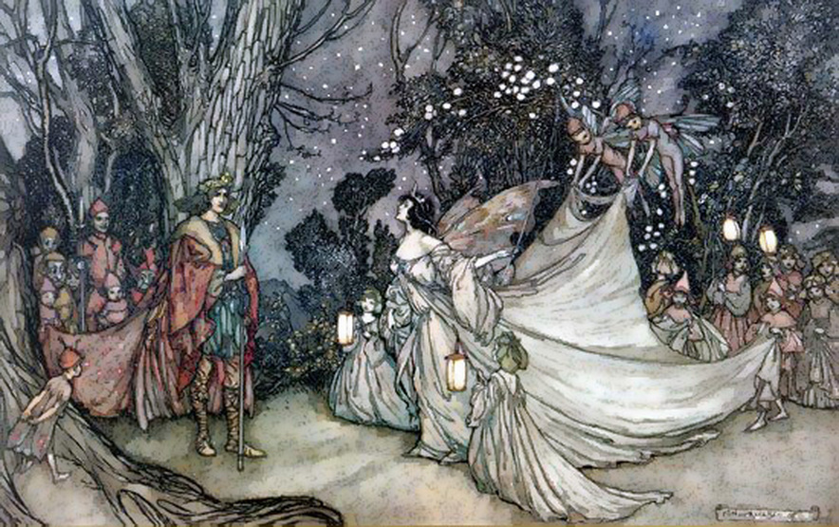
A Midsummer Night’s Dream
Act 4 Lesson 4

Slide 2
Today we would like you to use the vocabulary and phrases from the previous lesson to write your own character description. Here is an example about Puck.
With his yellowish-green spiky hair and his impish cheeky grin, Puck bounds around the woods looking for mischief. You may catch a whiff of his grassy, wood smoke scent as he scurries by, but in the blink of an eye he is gone. His flowing purple robes billow behind him as he moves as silently as a mouse. With skin as soft as fur and as pale as the moon he is hard to spot in the nooks and crannies of the woodland floor. His small, squeaky, melodic voice is carried along on the whispering breeze. Off to find Oberon and obey his every whim. A loyal character but with a mind of his own that can lead to mischief and mayhem for all he encounters.
Now it is your turn. Think about what has been included in the description above and remember, you need to paint the picture in your readers imagination of what your character is like. Good luck!

