Slide 1
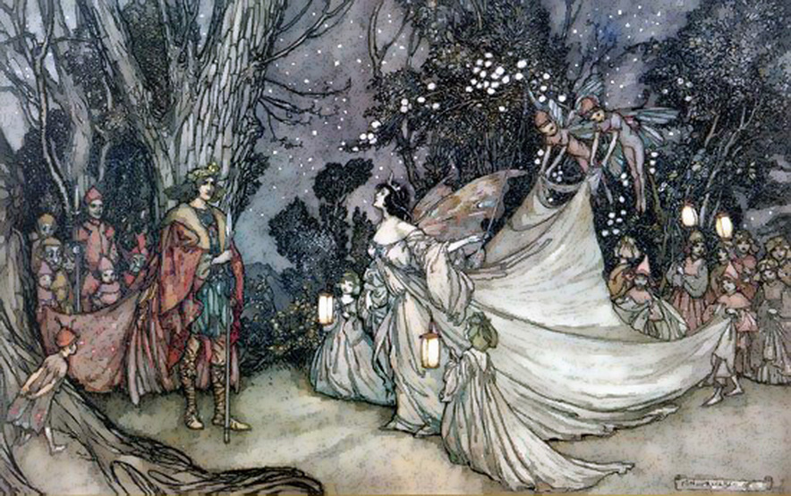
A Midsummer Night’s Dream
Act 4 Lesson 2

Slide 2
In today’s lesson you are going to begin to think about your favourite character. What we would like you to do is to choose one character. Either draw a picture of them or use the image from the slides and place it in the middle of a piece of paper.
The next four slides take you through the process of building up a word and phrase bank for a character. Use this method to complete a word bank for your chosen character. We have done one for you about Puck.
On the last three slides there are images of the main characters for you to use, or you can search safely on the internet for your own.

Slide 3
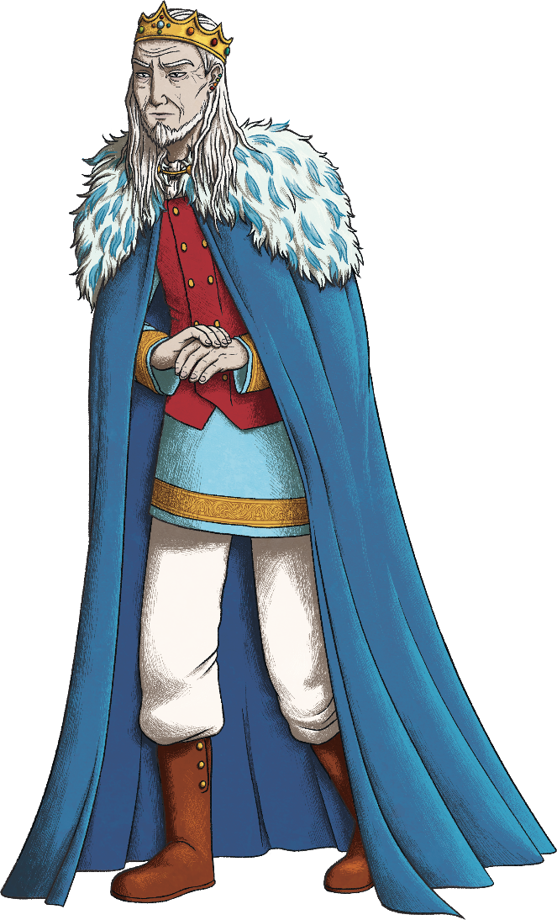
Describing a Character’s Appearance
It is important that a character description allows the reader to picture what that character looks like.
wears crown
long hair
thin face
wears nice robes
wears a cloak
Look at King Enk. What features would you want the reader to picture?
slim

Slide 4
Describing a Character’s Appearance
What adjectives would work well to create a picture of the king?
Think carefully about what is most important for your reader to know.
shoulder-length
gold
wispy
long hair
wears crown
bejewelled
snowy white
heavy
pale
expensive
thin face
wears nice robes
sunken
fine
embroidered
velvet
wears a cloak
blue
stooped
slim
floor-length
slender

Slide 5
Describing a Character Using Your Senses
As well as thinking about what the character looks like, we could consider the other senses.
What would the character sound like? What would they smell like? What would their clothes feel like?
Focus on describing things that will tell the reader something important. What clues can we give that the king is wealthy, powerful and old?
silky voice
soft fur
heavily perfumed
leather boots click clack loudly

Slide 6
Figurative Language
To keep your reader engaged, and to create a comparison which is easy for your reader to understand, why not use figurative language?
The jewels in his crown were stars plucked from the night sky.
hair as white as snow
A simile compares two things using the words ‘like’ or ‘as’.
A metaphor compares two things without using the words ‘like’ or ‘as’. It simply says that one thing is another.
The cloak hung lazily over his shoulders.
Personification describes a non-living object or animal using the features of a human.

Slide 7
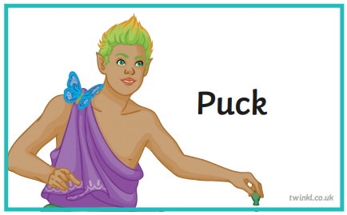
Here I have found some nouns related to Puck.
hair
eyes
ears
robes
hands
mouth
skin

Slide 8
Now I will expand the nouns by using adjectives.
Spiky, yellow-green hair
Green eyes
Sharp, pointy ears
Purple, flowing robes
Soft, small hands
Happy, pink mouth
Pale, golden skin

Slide 9
Spiky, yellow-green hair
Green eyes
Sharp, pointy ears
Smells of fresh cut grass and wood smoke
Soft, purple flowing robes
Purple, flowing robes
Soft, small hands
Giggly, squeaky voice
Pale, golden skin
Silky, pale, golden skin
Happy, pink mouth
Next, I can think about the other senses – what would Puck sound like? What might he smell of? What might his clothes feel like?

Slide 10
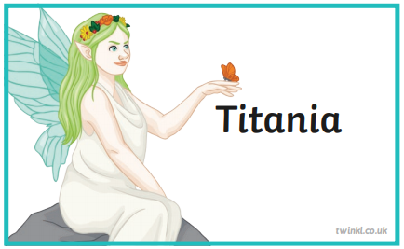
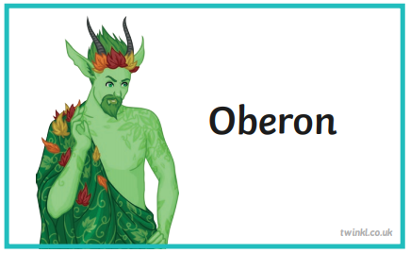

Slide 11
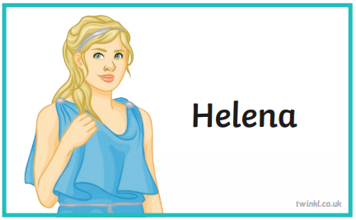
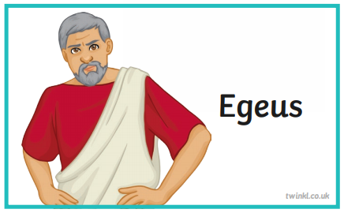

Slide 12
