Slide 1
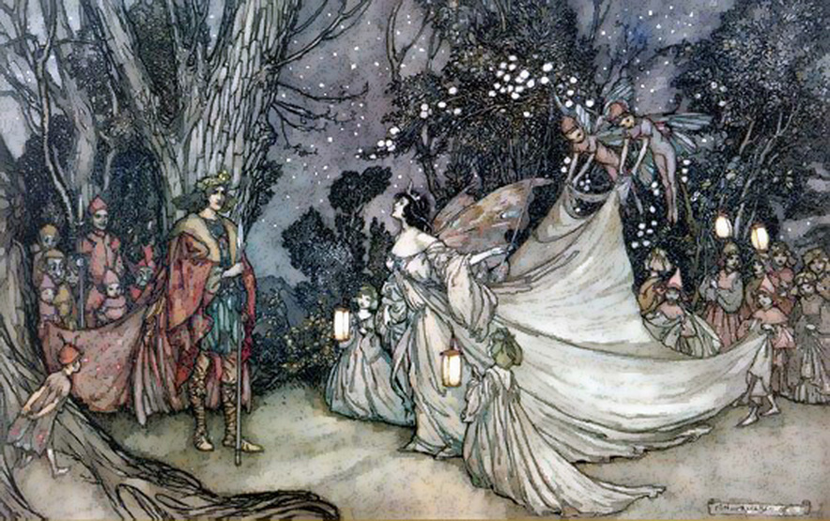
A Midsummer Night’s Dream
Act 4 Lesson 1

Slide 2
The following slides show Act 4 in narrative form (i.e. written as a story).
Task 1: Please read the text through.
Task 2: Carry out the checking by exploring when you have finished reading – you have three to complete.
Task 3: Write a short summary of the key events.

Slide 3
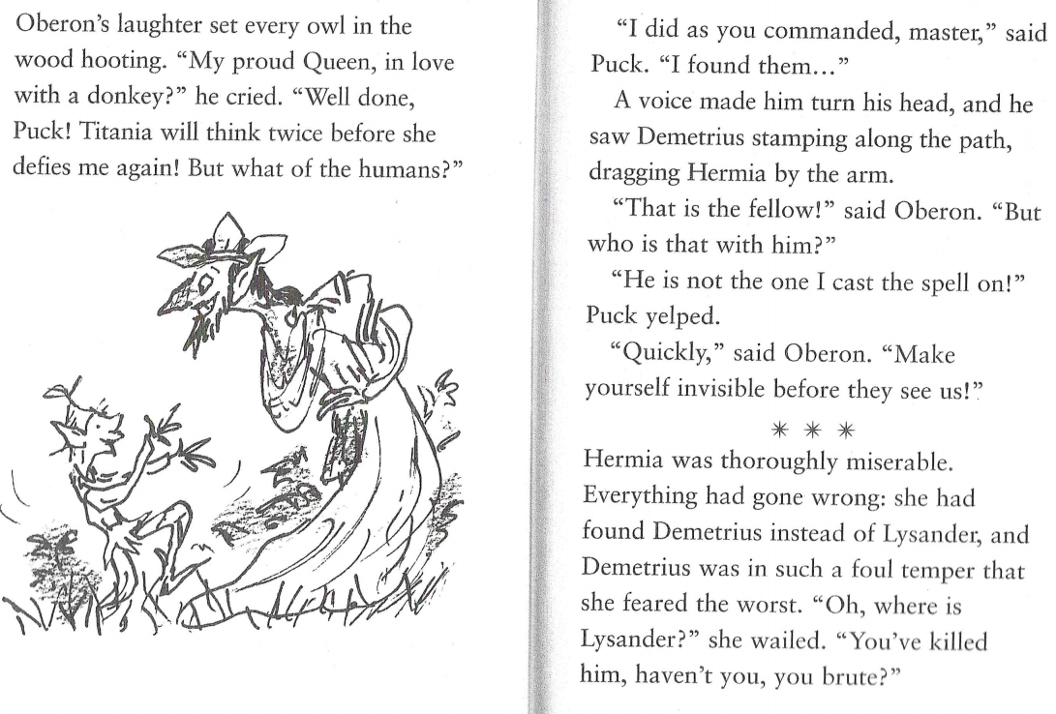

Slide 4
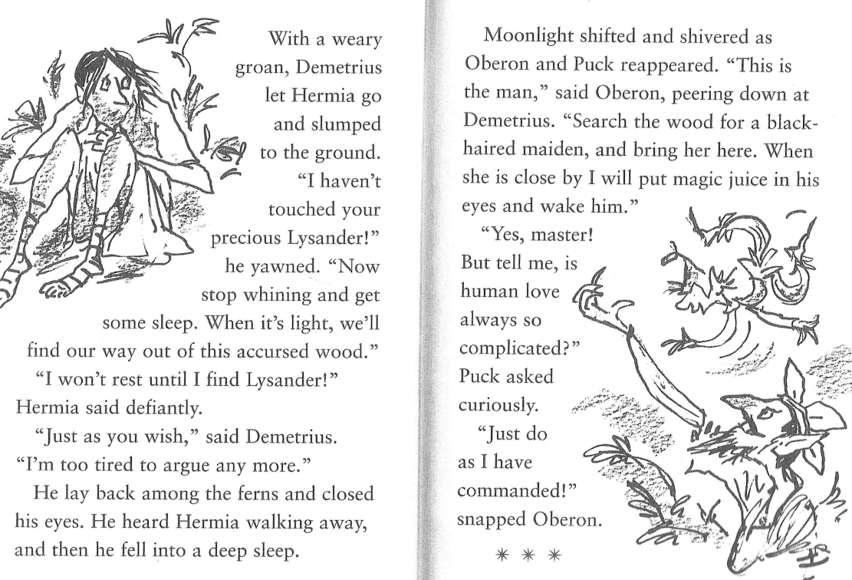

Slide 5
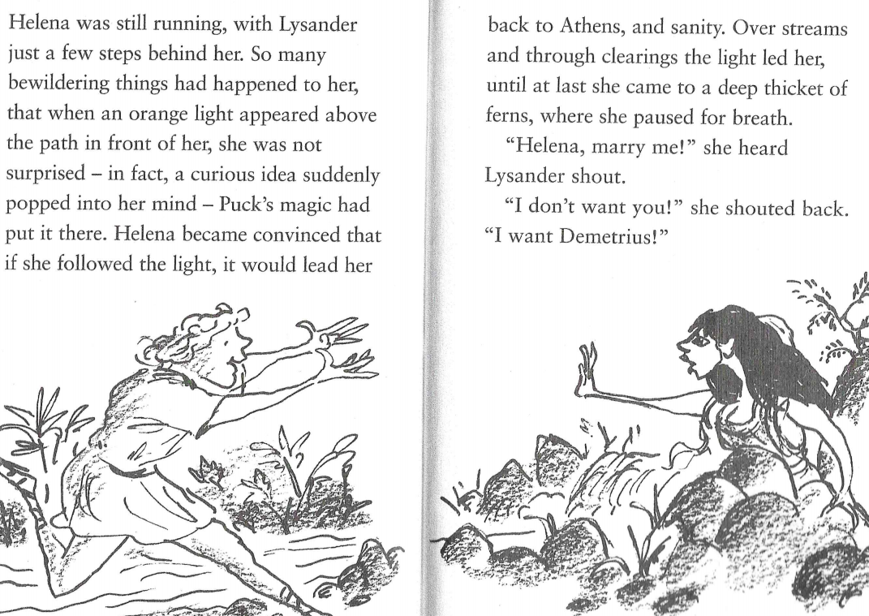

Slide 6
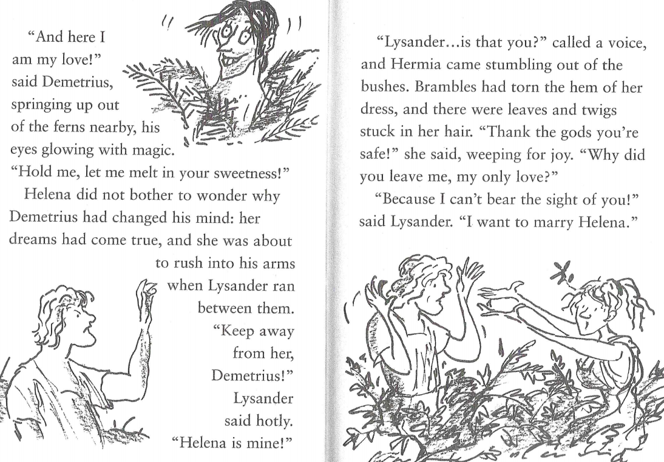

Slide 7
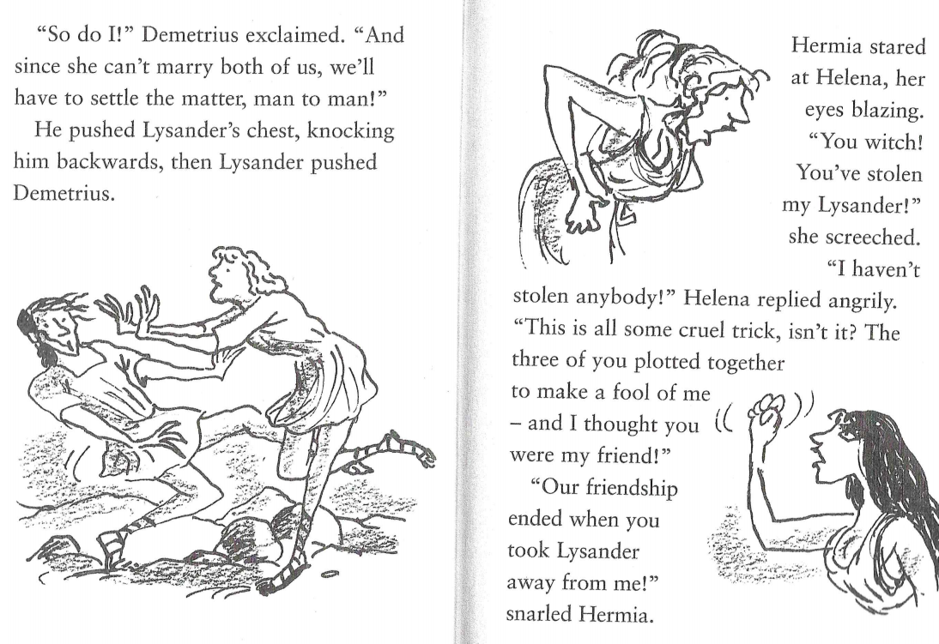

Slide 8
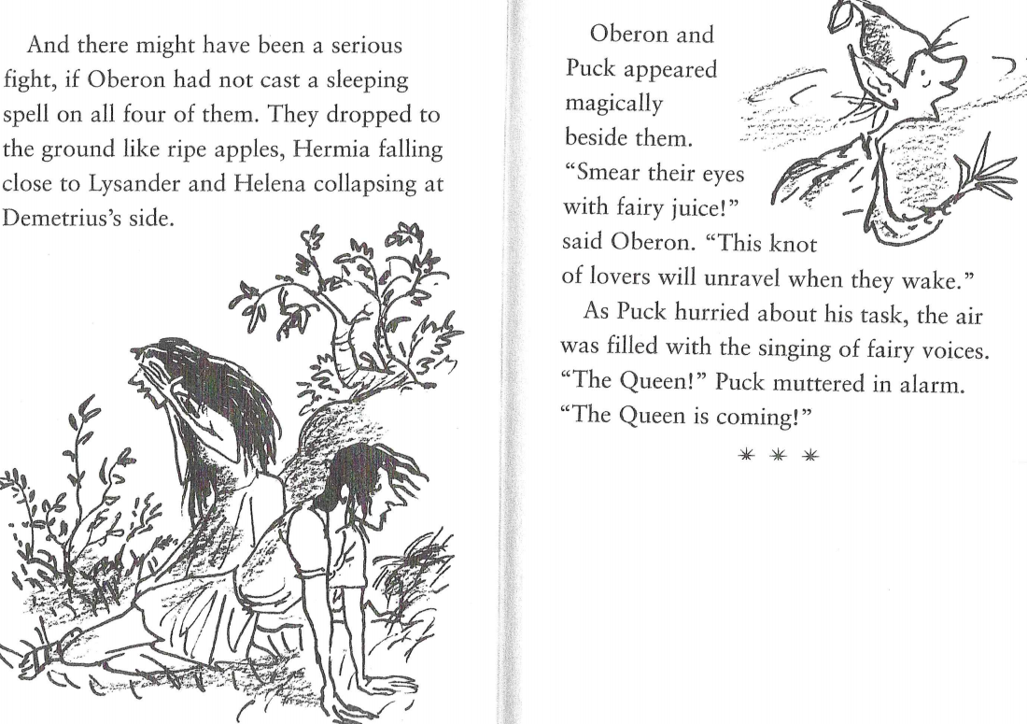

Slide 9
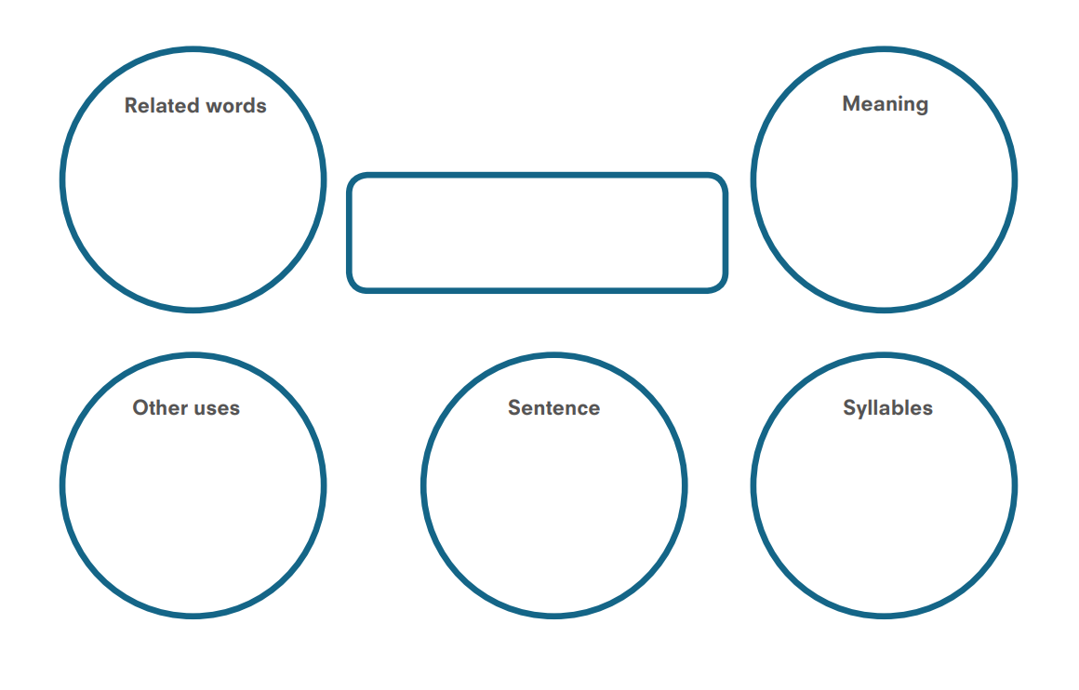
Find three new words from the text to fill in a new checking by exploring.

