Slide 1
Act 3 Lesson 4

Slide 2
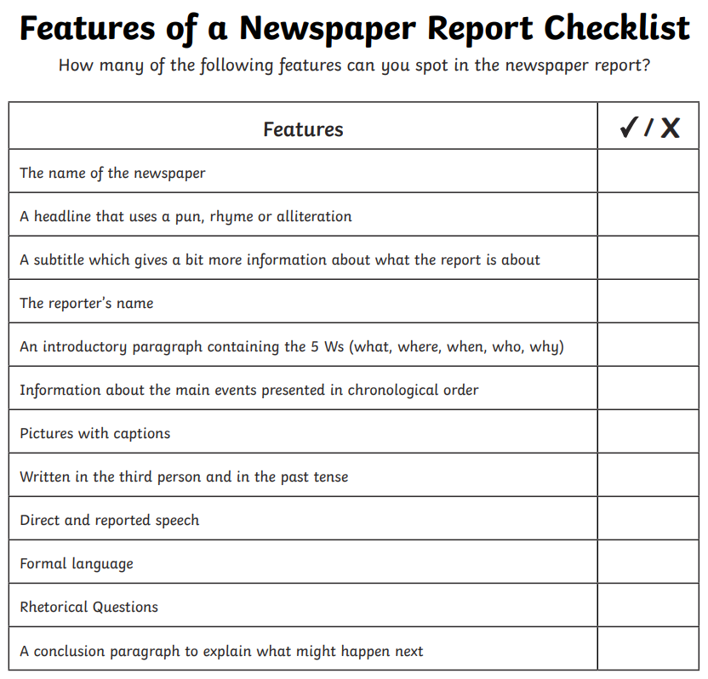
Look again at the newspaper report from the previous lesson.
Using the checklist here can you find examples of each aspect? Write down an example for each of these features.
Did you add any of these features to your list yesterday?

Slide 3
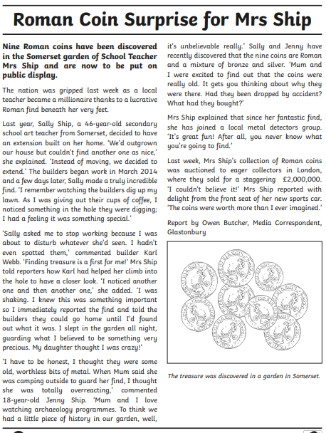

Slide 4
Using the checklist of features, can you start to plan a newspaper report about the strange event from this part of the play.
Use your summary notes to help you. Each feature can be a subheading for you to add your notes to, e.g.
Name of newspaper: The Athenian Times
A headline: Athenian actor makes an ass of himself!
A subtitle: Acting group gets a shock when one of it’s members becomes a donkey.
The reporter’s name: Mrs H Baldry
An introductory paragraph: include the key points from your summary but without too much detail.
Information about the main events: here you can describe the action in chronological order including more detail this time. In this section you might decide to add some speech, as if you have spoken to the people involved to find out what happened.
A conclusion: this is a round up of everything that has taken place. You may decide to add some rhetorical questions here. (If you are not sure what these are don’t worry!)

