Slide 1
Act 3 Lesson 1

Slide 2
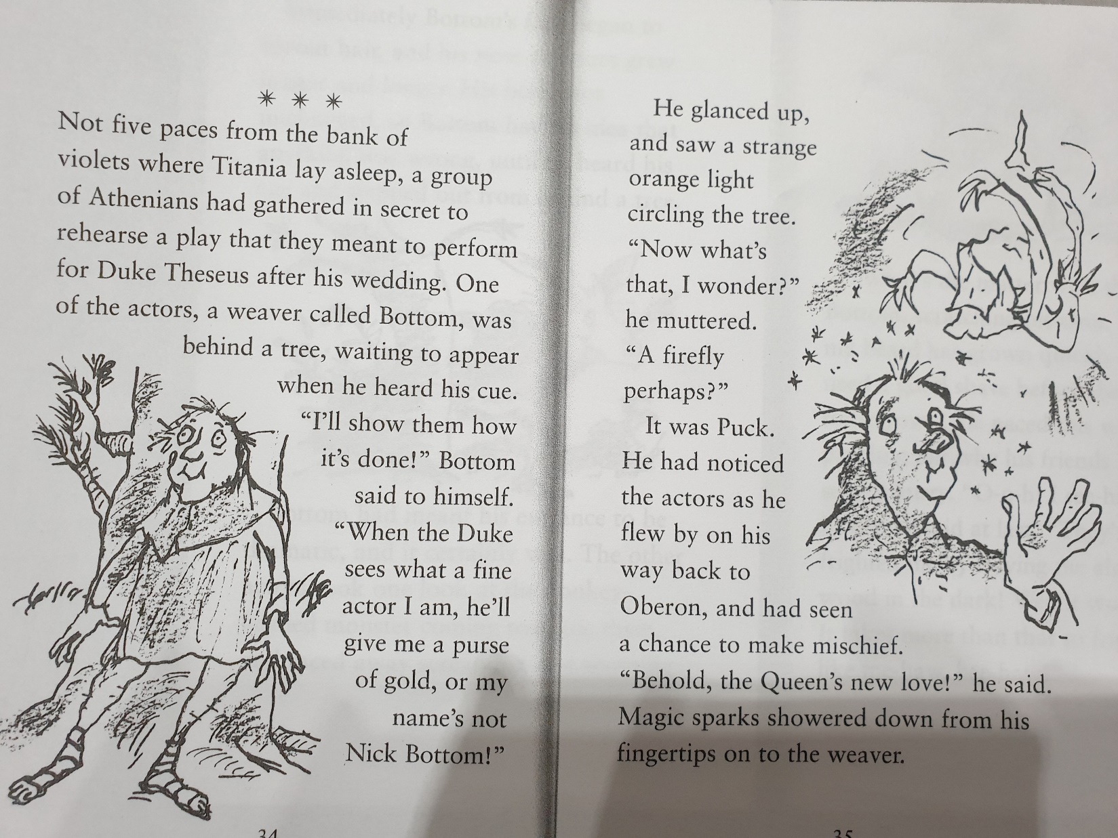
Here is a story version of the next part of the play. Read it carefully to yourself.

Slide 3
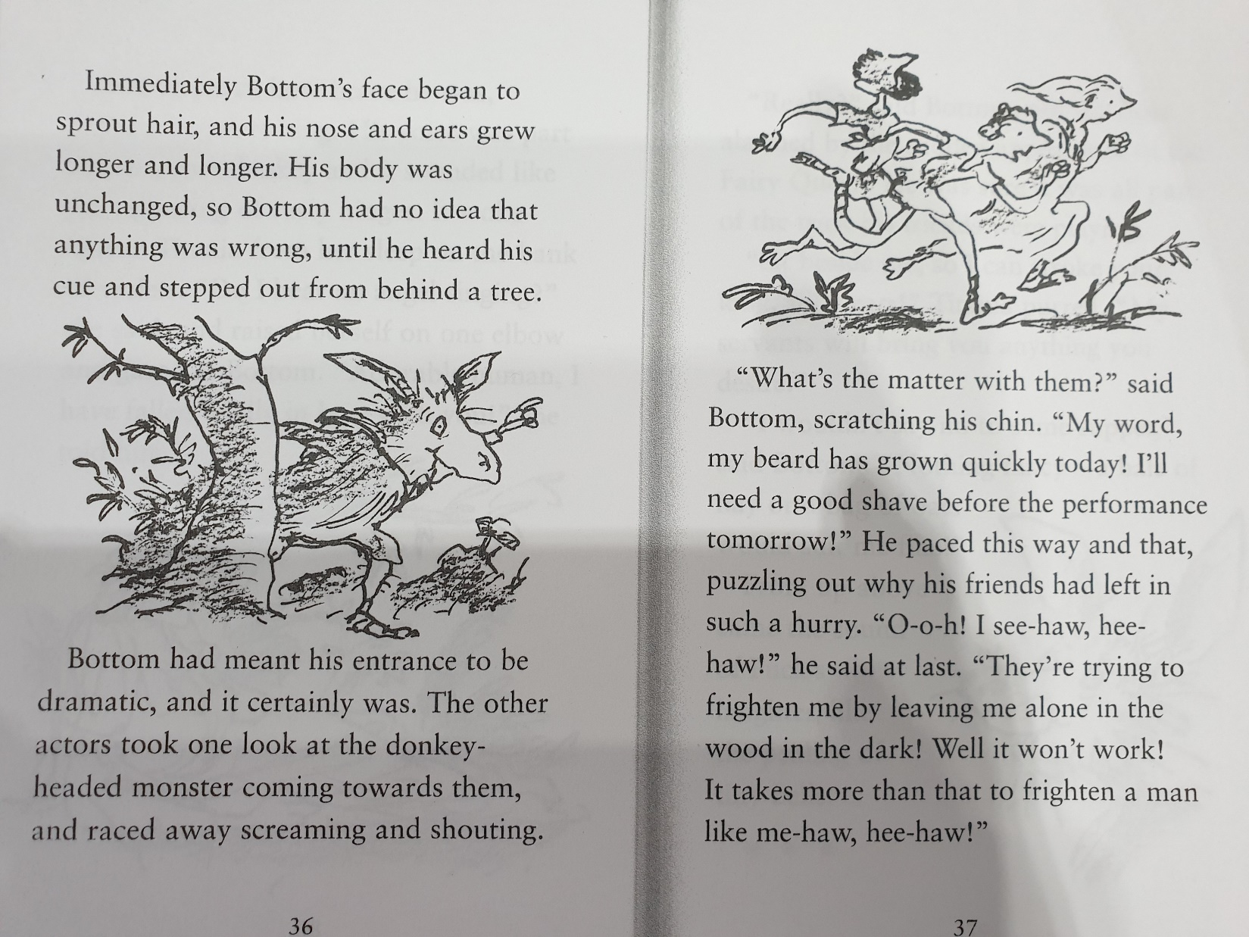

Slide 4
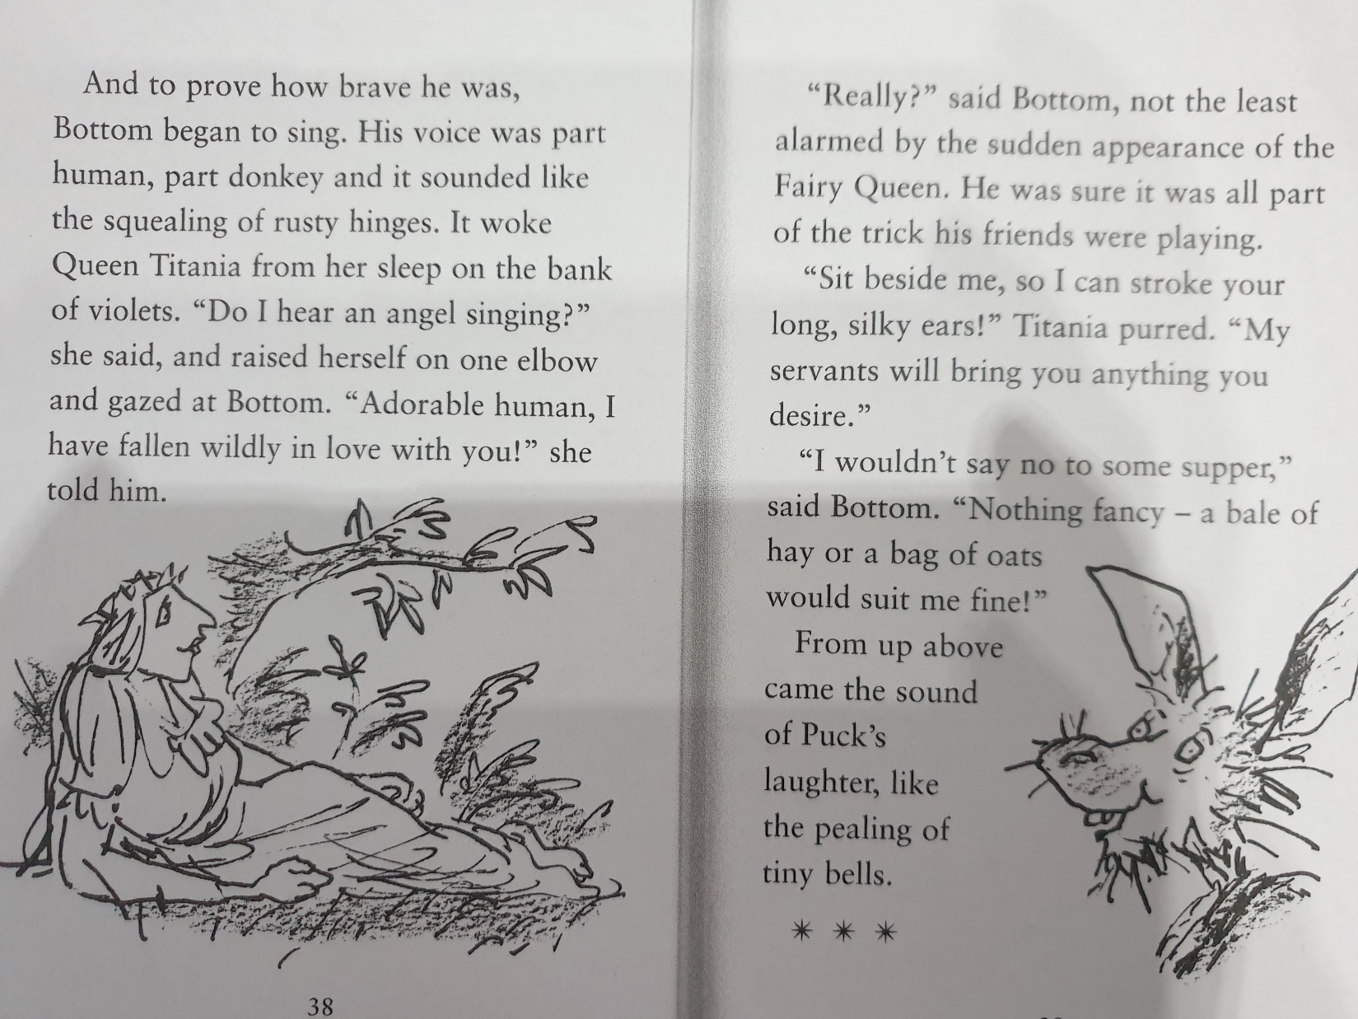

Slide 5
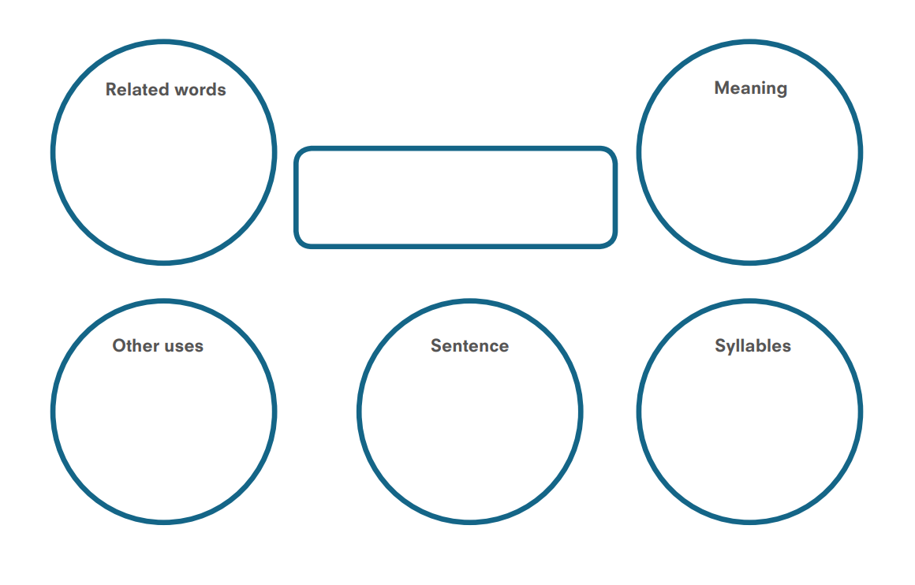
Find three new words from the text to fill in a new checking by exploring.

Slide 6
Have a go at answering these comprehension questions based on the text. Please write your answers in full sentences. Remember to use the words from the question to help you construct your answer.
How far away from the Mechanicals was Titania sleeping?
Why are the Mechanicals meeting in secret?
Who was waiting behind a tree?
What does Bottom hope he will get from Duke Theseus?
Who was watching the men rehearse?
What did Bottom’s face turn into?
How did the other Mechanicals react when they saw him?
What does Bottom think from their reaction?
Why does Bottom think that the other Mechanicals have run away?
Can you write a simile to describe what Bottom’s singing voice was like now.
What does Titania think of Bottom’s singing?
What happens when Titania wakes up?
How can you describe Puck’s character? How do you know he is like this? Give evidence from the text.
Think about your presentation if you are handwriting your work.

