Slide 1
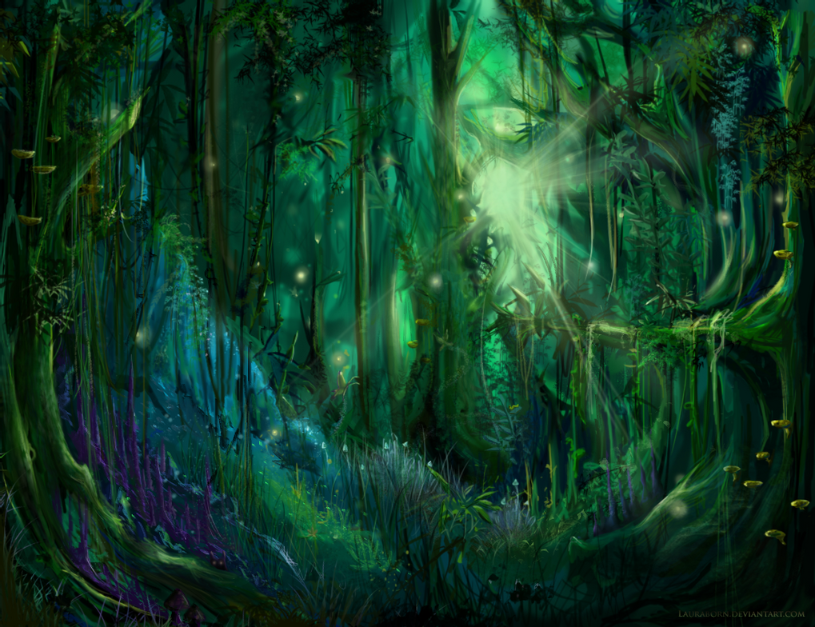
A Midsummer Night’s Dream
Act 2
Lesson 5

Slide 2
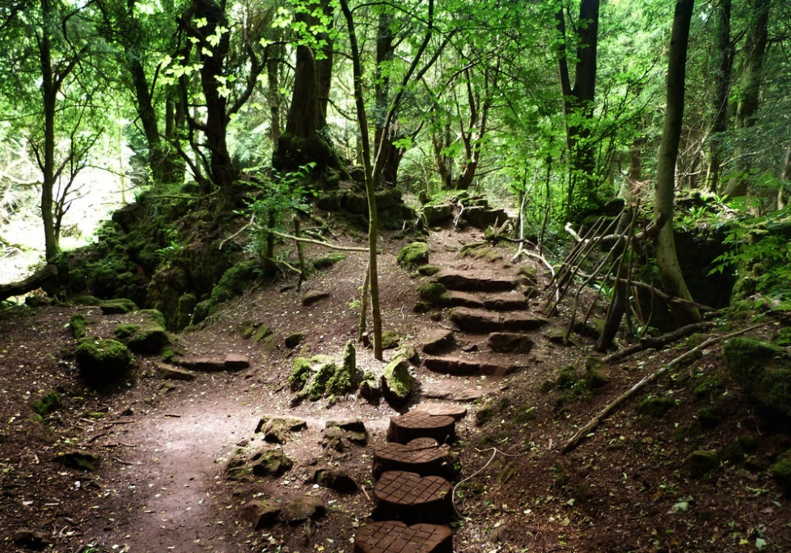
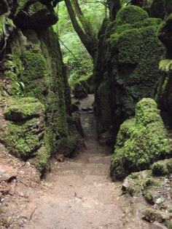
Using the pictures of the woods from the previous session can you write a description of a journey through the wood.
You need to describe what you can see, smell, feel and hear as you travel through the wood. Remember to include how you feel, how does the ground feel beneath your feet? Try to also include similes, alliteration, fronted adverbials.
Try to write three or more paragraphs of description – use your imagination and build a picture in words of what you are experiencing.
You could go for a walk in Lings wood or other local woodland to help you.

