Slide 1
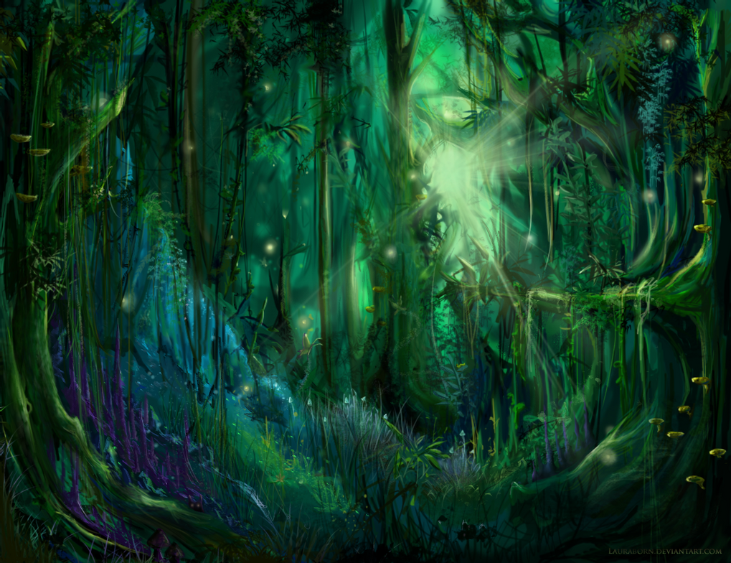
A Midsummer Night’s Dream
Act 2
Lesson 4

Slide 2
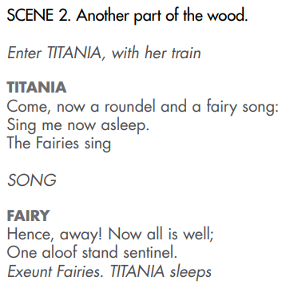
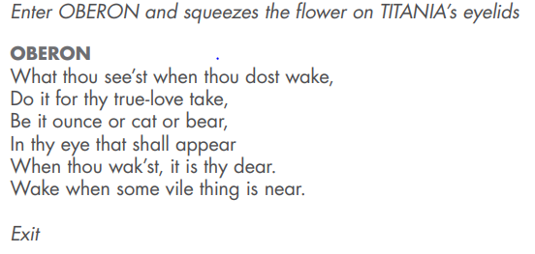

Slide 3
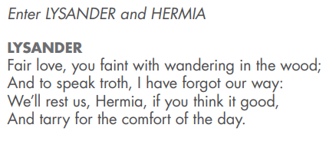
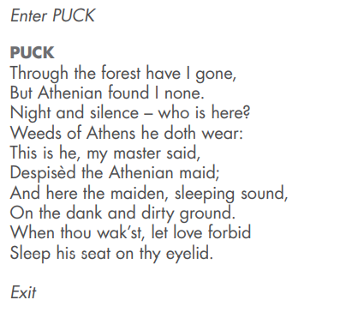
Here Lysander and Hermia decide to rest as they have lost their way.
Puck has been sent by Oberon to find an Athenian lady and the ‘disdainful youth’ but up until now has not found any. He was supposed to find Demetrius and Helena, but instead has found Lysander and Hermia!
Puck puts the nectar of the flower onto Lysander’s eyes instead.

Slide 4
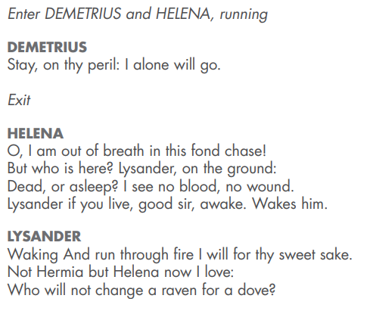
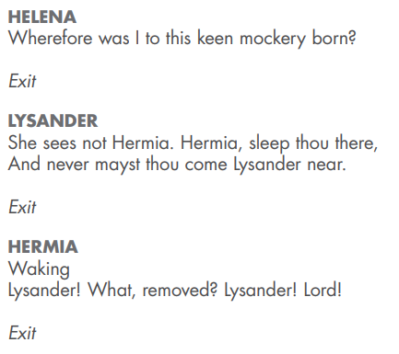
Helena and Demetrius find Lysander and Hermia asleep. Helena disturbs Lysander and with the flower’s nectar on his eyes he sees Helena! He is now in love with her and not Hermia!
Helena thinks he is joking with her. She leaves and he follows her leaving Hermia alone.
When she wakes Lysander is gone.

Slide 5
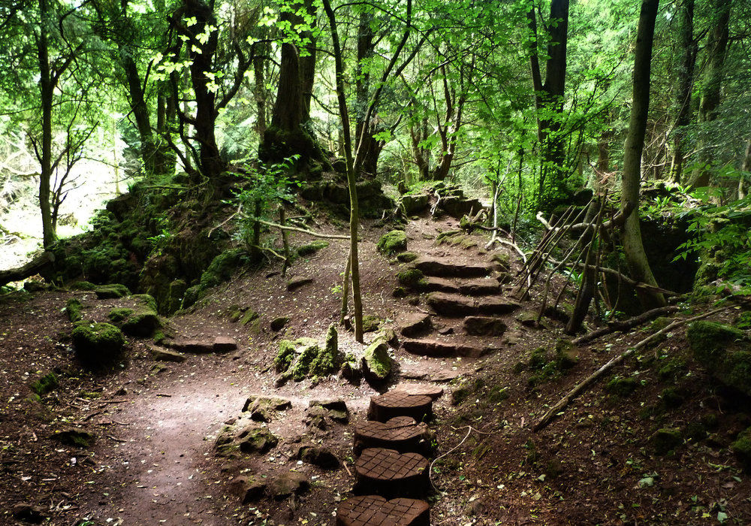
Look at this picture of a wood.
Make a list of nouns you can see in this wood.
Add to your list nouns of things that could be in this wood but that can’t be seen.
Expand your nouns by adding one, two or three adjectives to make it more descriptive and interesting for the reader.

Slide 6
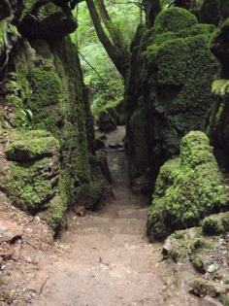
Here is a different part of the wood.
Repeat the previous activity but this time add nouns for feelings and emotions too.
What feelings does this part of the wood inspire in you? How would you feel if you were in this part of the wood. For example, cold, sad, scared.
Don’t forget to expand your nouns with adjectives.

