Slide 1
A Midsummer Night’s Dream
Act 2
Lesson 3

Slide 2
Watch this version of the conversation between Puck and Oberon as performed on stage at the RSC.
Act 2, Scene 1 | A Midsummer Night's Dream - YouTube

Slide 3
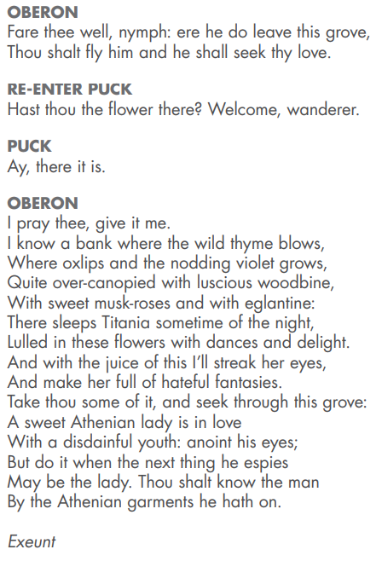
Here, Puck returns with the flower. Oberon tells Puck of the place where Titania sleeps. He will go there and put the nectar of the flower onto her eyelids.
He then tells Puck to find an Athenian lady who is in love with a ‘disdainful youth’ – it is Demetrius and Helena. Puck is told to put some of the nectar on his eyes so that when he wakes he will see Helena and fall in love with her.

Slide 4
Please answer the following questions in full sentences. Either answer in the comments section of the blog or send them via email.
Why do you think Oberon does this to Demetrius?
Does Oberon know their story?
Why do you think he is helping Helena?
What does this make you think about Oberon’s character?
How will Helena feel when she wakes up to discover Demetrius is in love with her all of a sudden?
Will she be suspicious? Explain your answer.
How would you feel if someone you knew changed their mind so quickly? Explain your answer.

