Slide 1
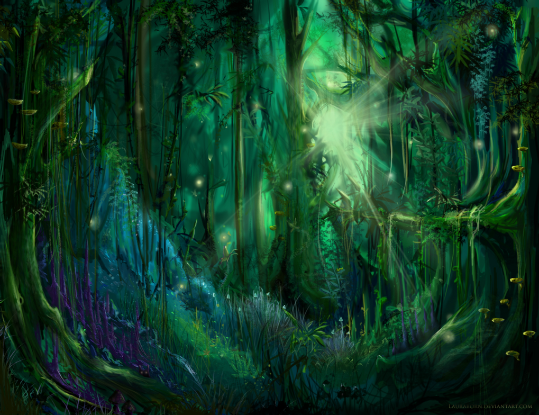
A Midsummer Night’s Dream
Act 2
Lesson 2

Slide 2
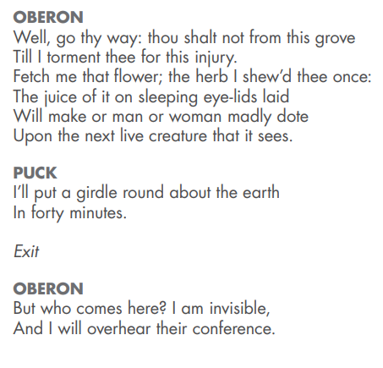
Oberon is still angry with Titania and is going to seek his revenge on her. He knows of a flower whose nectar, when dropped onto someone's sleeping eyes, can cause them to fall in love with the next living thing they see.
Puck tells Oberon that he will go around the world as quickly as possible to find it. He leaves.
Oberon hears someone approaching and hides in order to overhear the conversation.

Slide 3
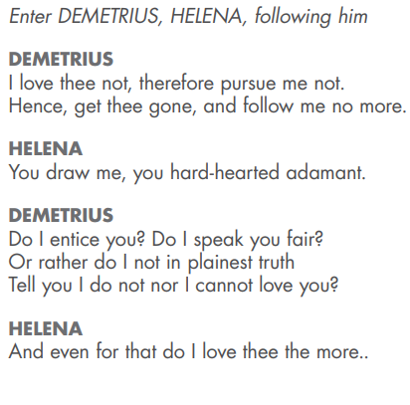
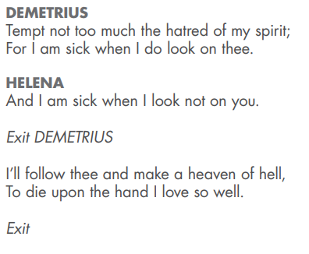
In this scene Helena is following Demetrius and he is getting annoyed with her. Even when he is being mean to her she loves him still.
He asks her if she thinks he is being nice to her, or saying that she is beautiful and makes it clear that he can not love her.

Slide 4
Your task today is to write a letter to Demetrius from Helena. You need to write in 1st person as Helena and tell him exactly how you feel.
Tell him about Lysander and Hermia’s plan to run away.
Explain her feelings for Demetrius.
Tell him what a lovely person she is.
She loves him dearly, even though he treats her meanly – how does that make her feel?
She had a relationship with Demetrius before Egeus chose him to marry Hermia – how would that make her feel?
What is she hoping for the future?

