Slide 1
A Midsummer Night’s Dream
Act 2
Lesson 1

Slide 2
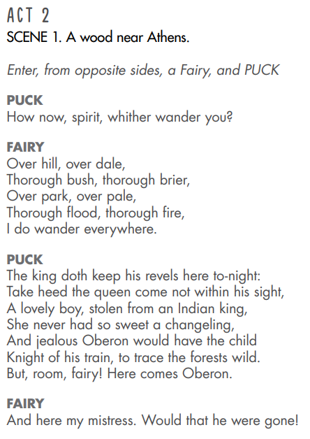
In this scene we meet two fairies living in the woods near Athens. Puck asks the other fairy where he has been and he tells him he has been here, there and everywhere.
Puck then tells the other fairy to be careful as Oberon and Titania are arguing over a ‘changeling’ or little boy that Titania has stolen from a king. Oberon wants to make the child a knight for his entourage and she doesn’t!
Oberon is the king of the fairies and Titania is his queen.

Slide 3
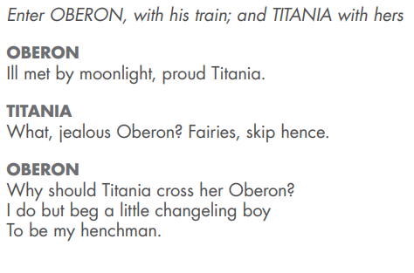
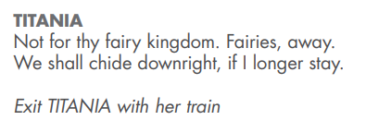
Oberon and Titania enter the scene followed by their trains (groups of fairies). Titania orders the fairies away. She asks him if he is jealous of the little boy as he is taking away her attention from Oberon. He says he wants the boy for himself.
Titania says no and again tells the other fairies to go away with her or she will get angry and there will be an argument.

Slide 4
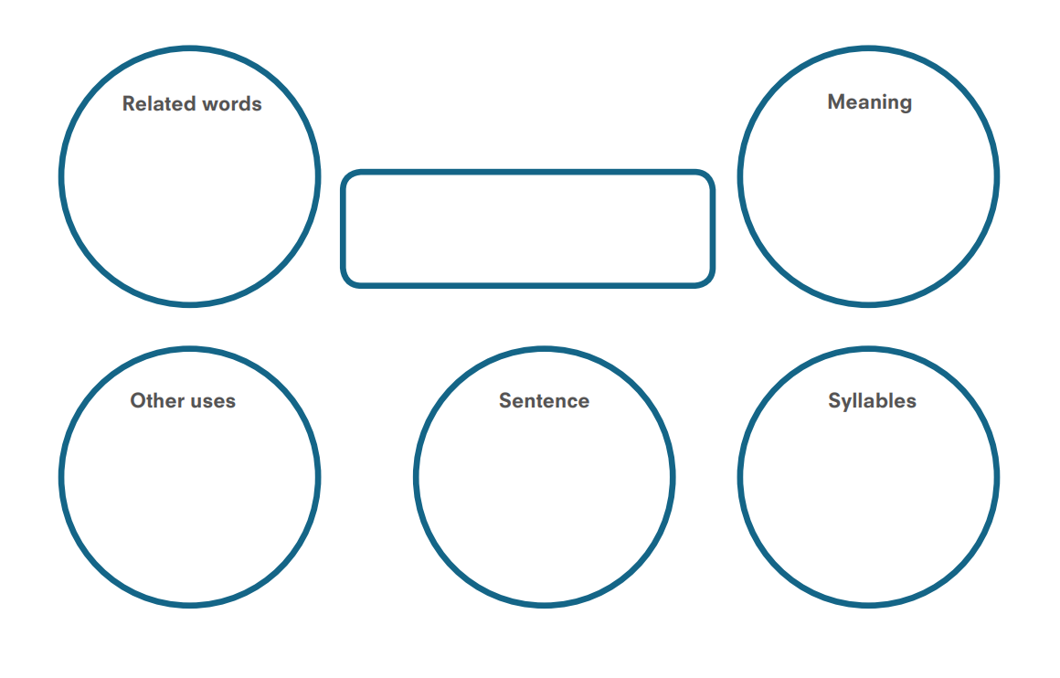
Find two or three words from the texts to investigate. Do a separate sheet for each word. You don’t have to print it out, you can just copy the boxes/circles onto paper.

