Slide 1
IT’S FRIDAY!!
22.1.21

Slide 2
Reading

Slide 3
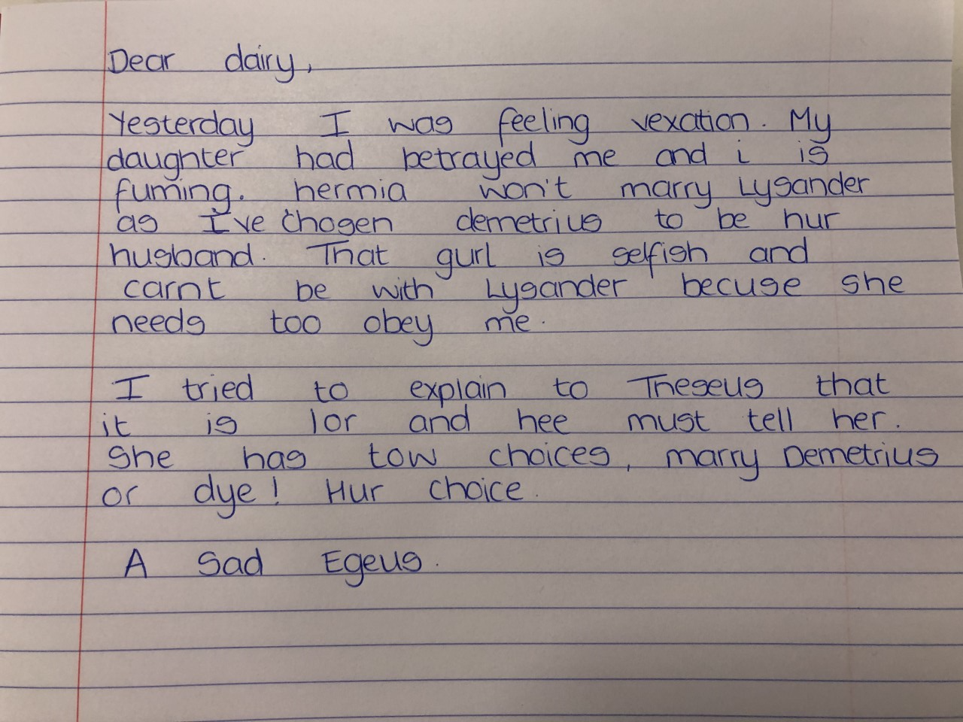
Writing
Mrs Denny has written Egeus's diary. Unfortunately she has made many mistakes - her spelling is terrible she has missed apostrophes, she has not written in the right tense and some of her work just does not make sense. She could have used some better words to describe feelings. Can we help her?
Please edit her work like we do in class and write out what Mrs Denny's diary should look like!

Slide 5
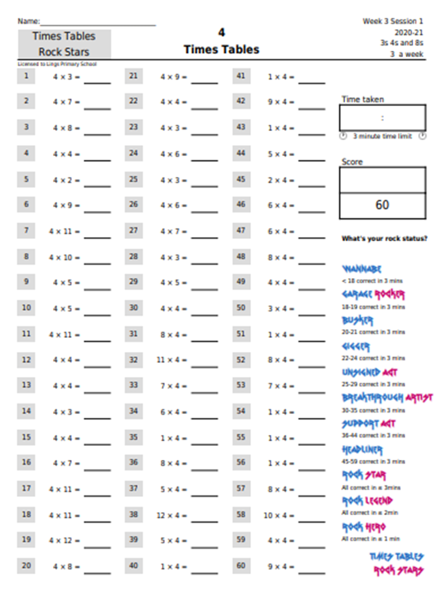
Use the link to download TTR worksheet on the 4x table.

Slide 6
https://vimeo.com/476320465

Slide 7
https://resources.whiterosemaths.com/wp-content/uploads/2019/09/Y3-Autumn-Block-3-WO5-Multiply-by-4-2019.pdf

Slide 8
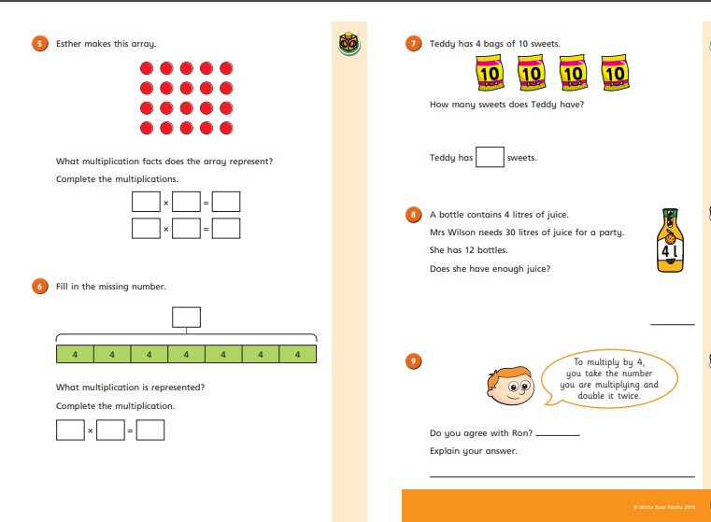

Slide 9
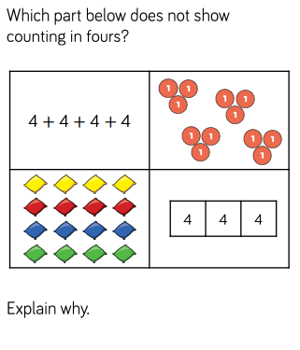

Slide 10
Phonics with Mrs Denny
Don’t forget to complete the speed read - see the blog! Hope you are enjoying these sessions.

Slide 11
Recipes
Fun Friday Cooking Challenge!
We need your recipes! Mrs Denny is a talented cook but Mrs B is talented at burning food!
We need easy recipes for Mrs B, and anyone else, to try and make.
Send recipes and photos of your creations to our year 3 email address.
Let’s have some cooking fun!
Pictures on Monday!!

Slide 12
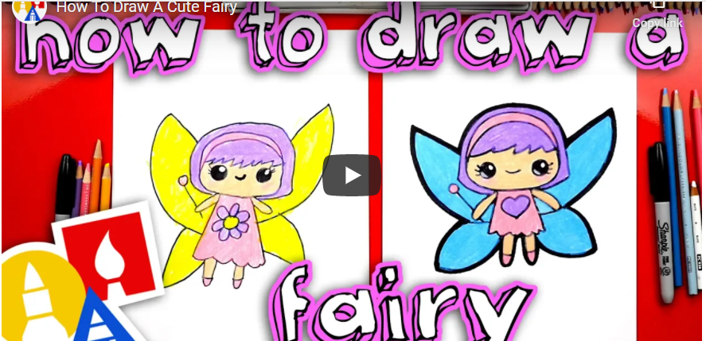
Challenge your family to a drawing competition!!!

Slide 13
