Slide 1
How to write an email

Slide 2
Open Microsoft edge or any web page you use at home (chrome, safari etc.)

Slide 3
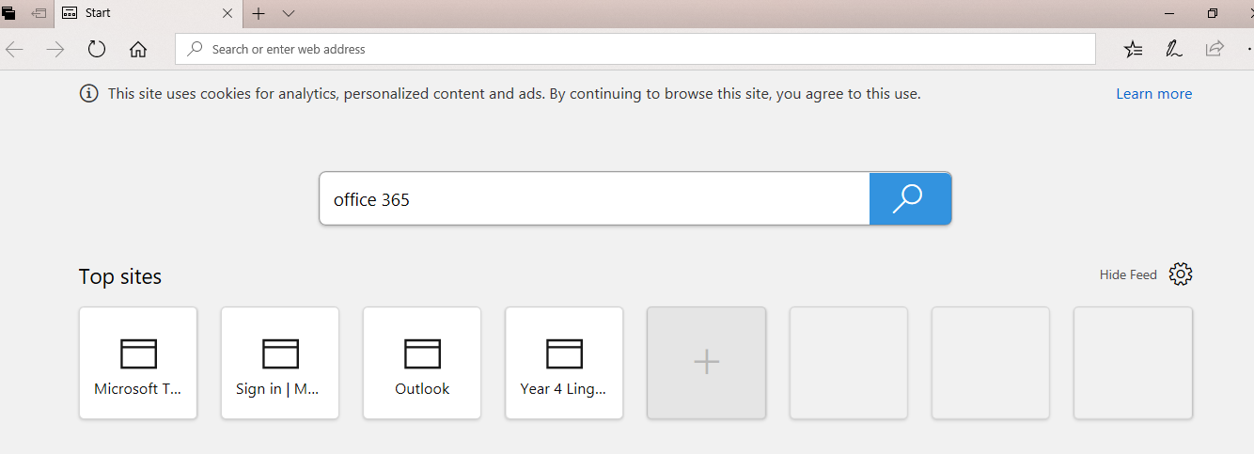
Search for office 365

Slide 4
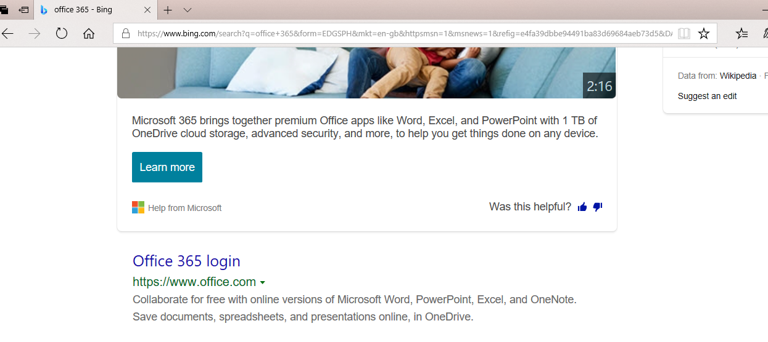
Find office 365 login link

Slide 5
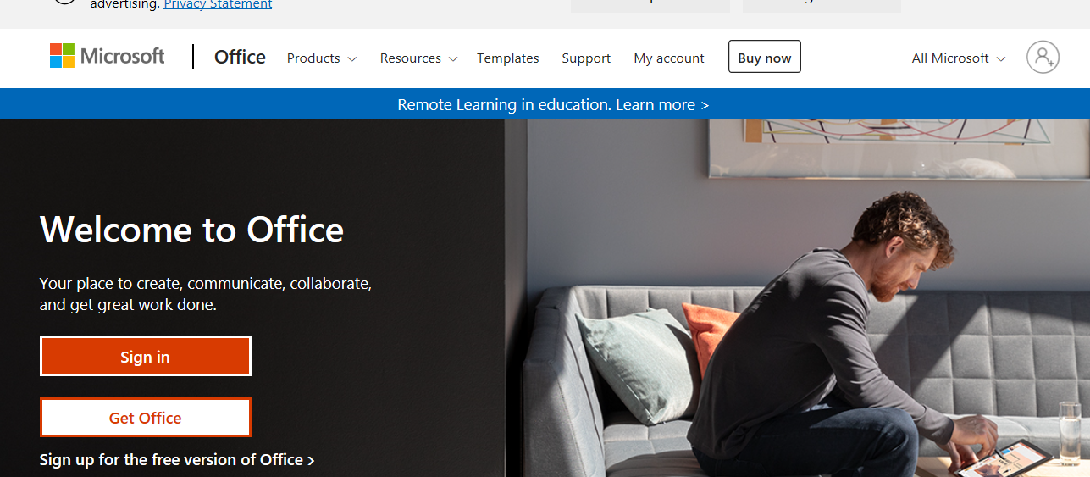

Slide 6
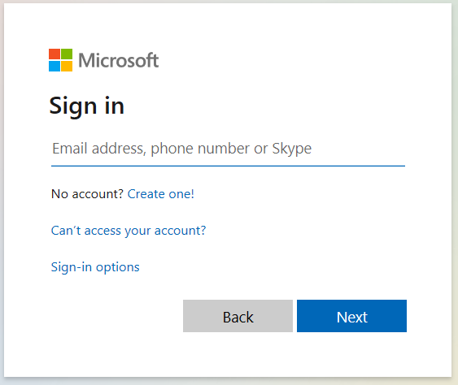
Put in your school email and password-
Firstname.lastname@lingsprimary.org.uk
Year4LPS

Slide 7
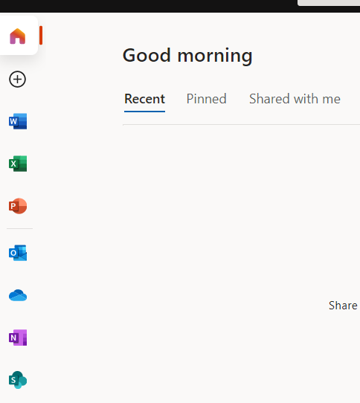
Click on the outlook button

Slide 8
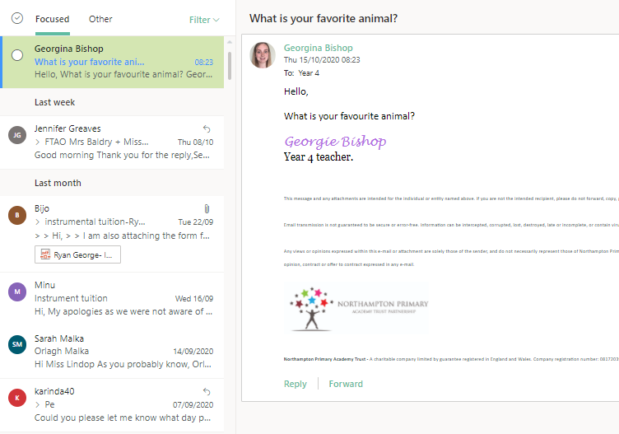
Click on the new email.
Click on the reply button

Slide 9
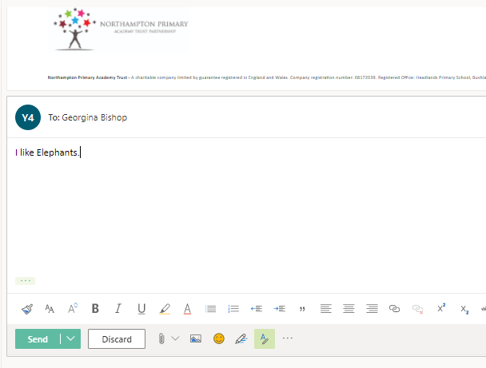
Type your email and press send

