Slide 1
Friday 29.1.21

Slide 2
Read these strips carefully and then put these events in order from first to last in which they happened.

Slide 3
Time to be creative!
You are going to retell the part of the play, up to where we have been the last couple of weeks, which is in Athens. The reading part of the session will help you to understand the events we have explored in this part of the play.
We would like you to create a storyboard, a comic strip, a mini puppet show (make your own characters use your paper chain people, teddies, a video of you showing this part of the story using others in your house to play the other characters, or you own creative ideas to retell this part of the play.
It needs to show these 8 events you ordered in the story.
Use the strips to help, make sure there is talking/ speech bubbles to show what people say and try any use some of the language we have heard in your video, puppet show, storyboard or comic strip. We are seeing many Year 3 children using the language from the play which shows they have a deep understanding of the play - Midsummer Night's Dream.
We can't wait to see your work!!!!!

Slide 4
https://vimeo.com/480763110

Slide 5
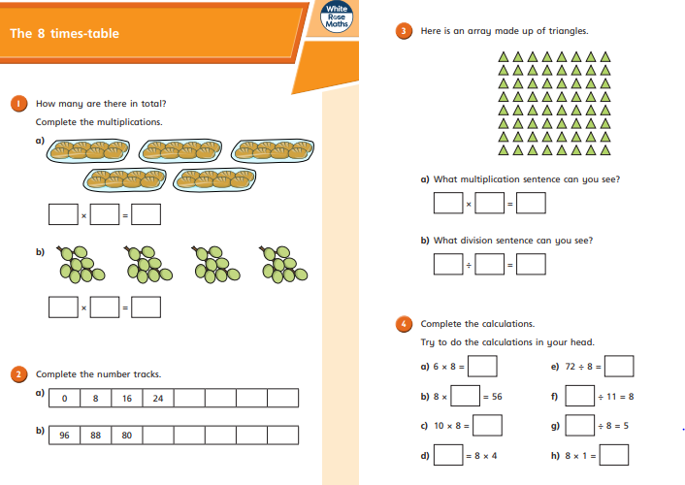
https://resources.whiterosemaths.com/wp-content/uploads/2019/09/Y3-Autumn-Block-3-WO10-The-8-times-table-2019-1.pdf

Slide 6
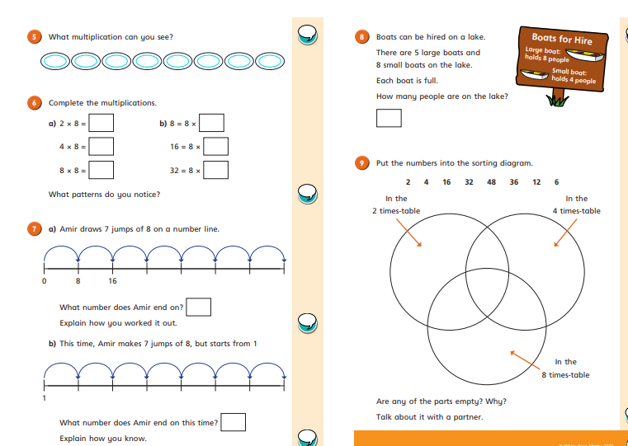

Slide 8
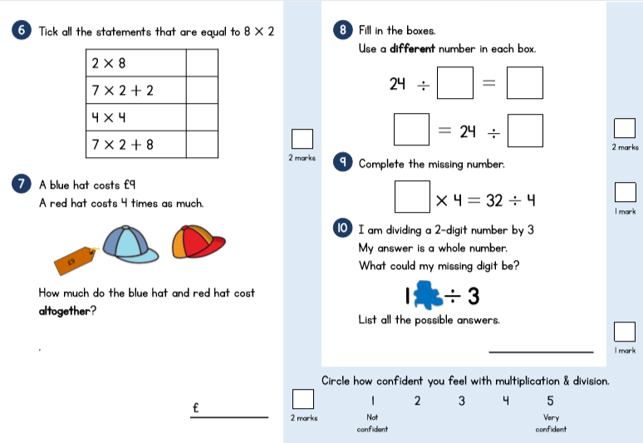

Slide 10
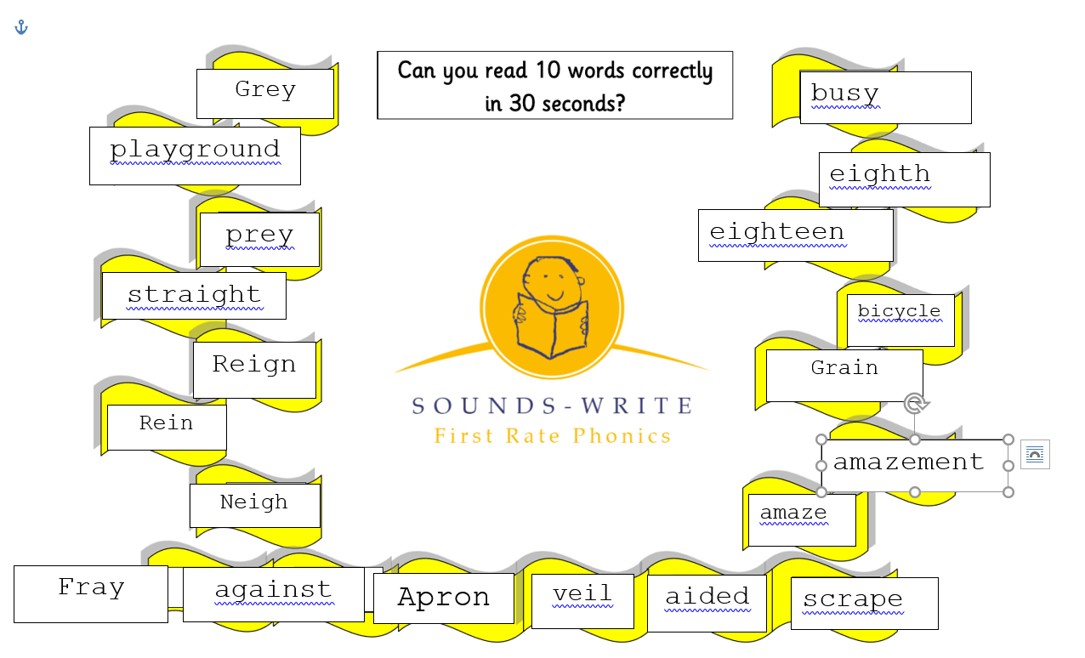

Slide 11
https://beinternetawesome.withgoogle.com/en_us/interland

Slide 12
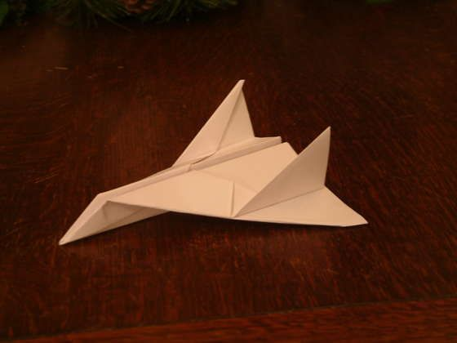
Friday Family Fun: lovely pictures on the blog of FOOD!!
Let’s go fly a … paper aeroplane.

Slide 13
With Miss Bowler!

