Slide 1
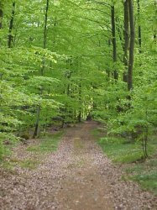
A clamorous owl that nightly hoots
starlight spangled sheen
Weaving spiders
fiery glow worms’ eyes
A snake with enamelled skin
the woodbine the sweet honeysuckle gently entwist
a bank where the wild thyme blows
oxlips and the nodding violet grows
quite over-canopied with luscious woodbine
apricocks and dewberries
purple grapes, green figs, and mulberries
starlight spangled sheen
Weaving spiders
fiery glow worms’ eyes

