Slide 1
Fantastic Friday

Slide 2
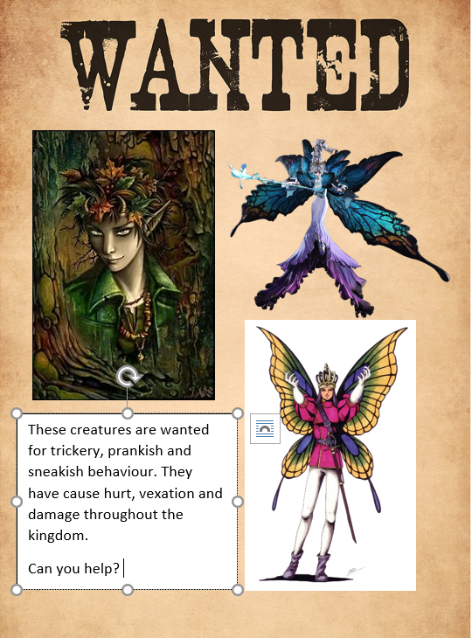
Why would these fairies be wanted? Can you explain what they have done? Think about the story.
What is another word for vexation?
Which character do you think is Puck from looking at the picture? Why do you think that? (use clues from the picture to help explain you answer)
If you could choose another word for creatures what would it be?
What damage has Titania caused? (think back to the words from the video in yesterday's blog)

Slide 3
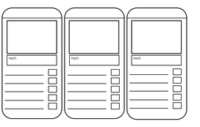
Can you create a top trump cards for Titania, Oberon and Puck. In the facts section, write as much as you know about them and describe what they are like?
Decide on these areas and rank them from 1 to 10. 10 being the strongest and 1 being the weakest.
Power
Magic
Health
Cheekiness
Popularity
Please draw what you think Oberon, Titania and Puck look like in your top trump cards.

Slide 4
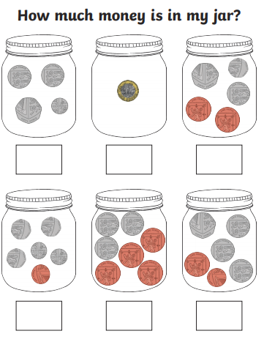

Slide 5
https://vimeo.com/471012335

Slide 6
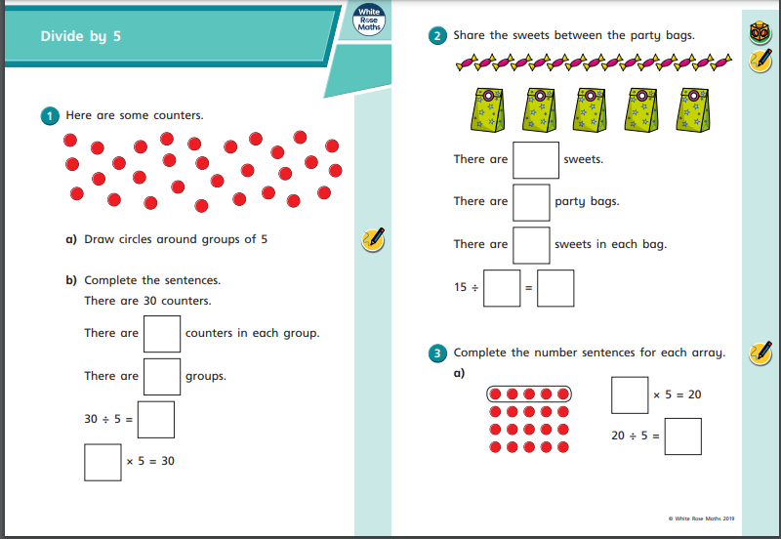

Slide 7
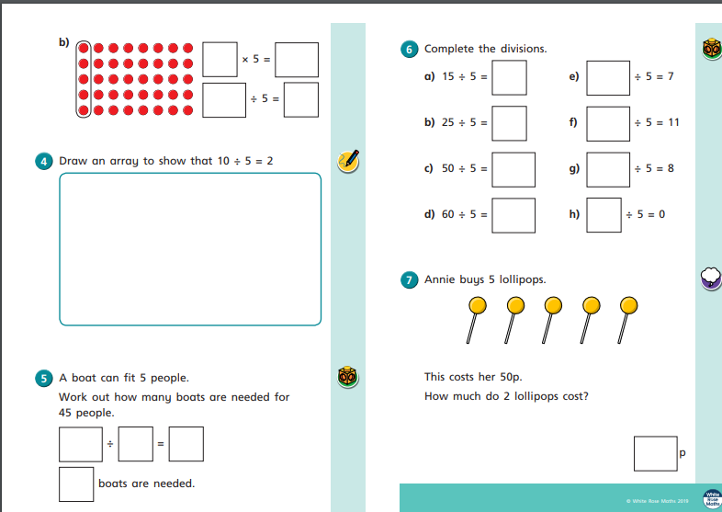

Slide 8
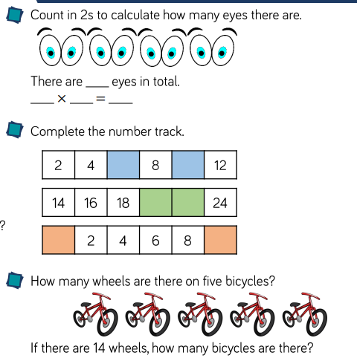
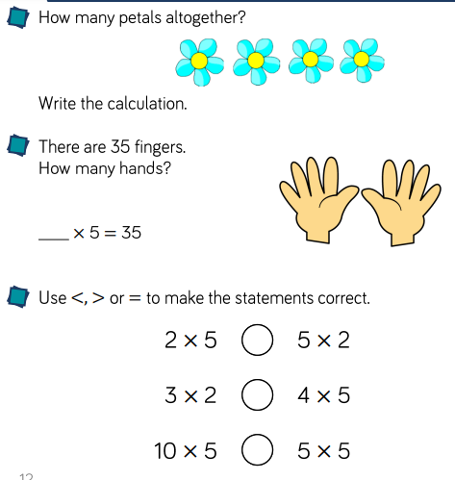

Slide 9
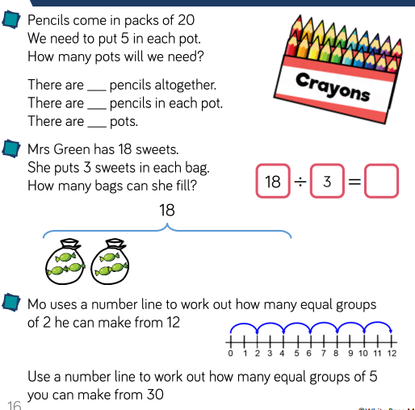

Slide 10
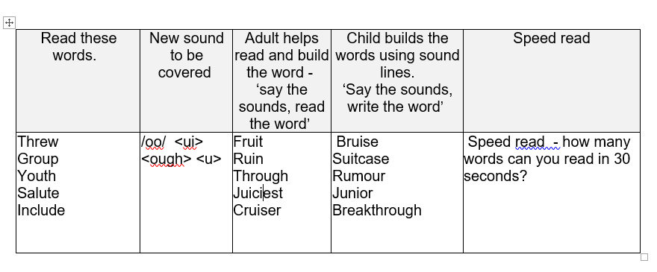

Slide 11
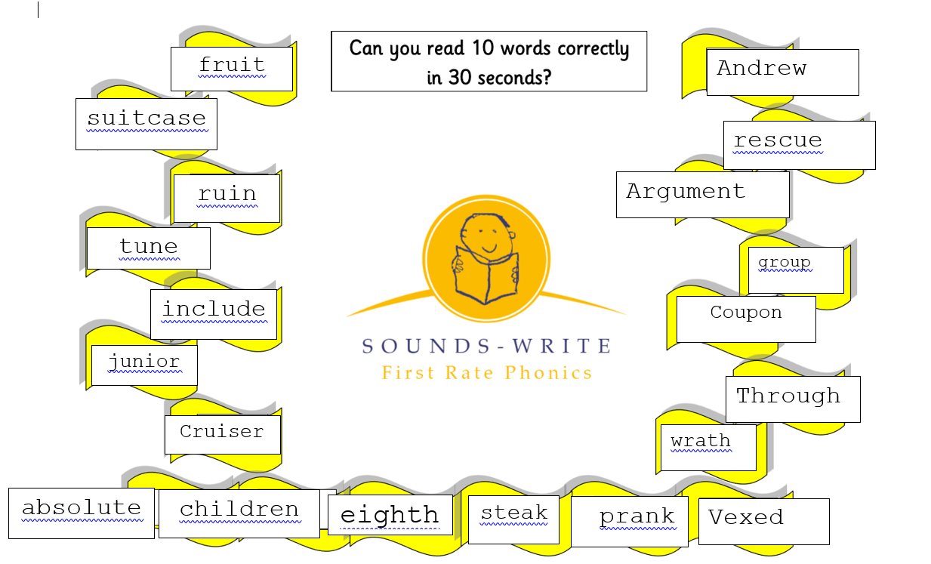

Slide 12
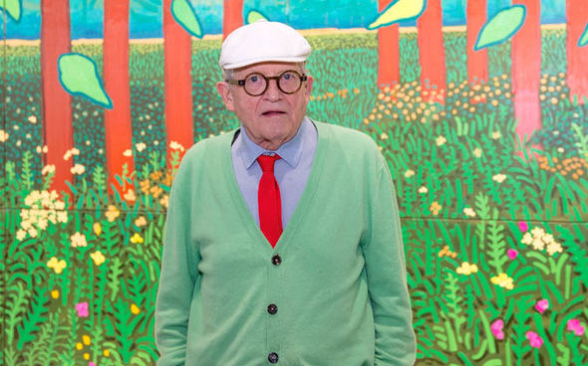
ART: REMEMBER TO STAY SAFE ON THE INTERNET
Today you are going to find out about the famous artist David Hockney.
Use the link below to discover some facts (you might have to copy and paste into the address part).
Make a fact file about him.
https://www.tate.org.uk/kids/explore/who-is/who-david-hockney
EG
Name: David Hockney.
Born: 1937, Bradford.
Involved in pop art
What can you find out
about this talented man?

Slide 13
The following pictures were painted by David Hockney. Study them carefully:
Do you like the picture? Why?
What can you see?
What colours are used?
What patterns are used?
Are any pictures similar?
Which one is your favourite? Why?

Slide 14
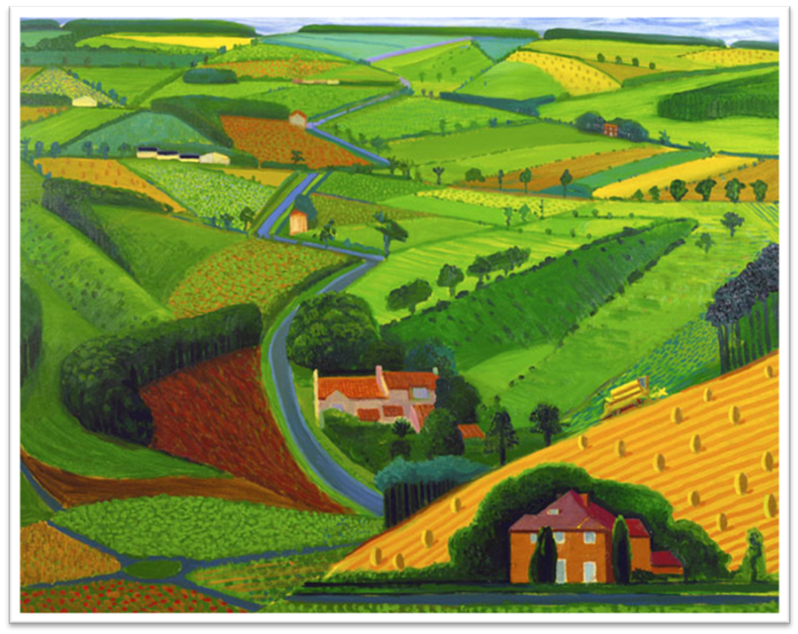
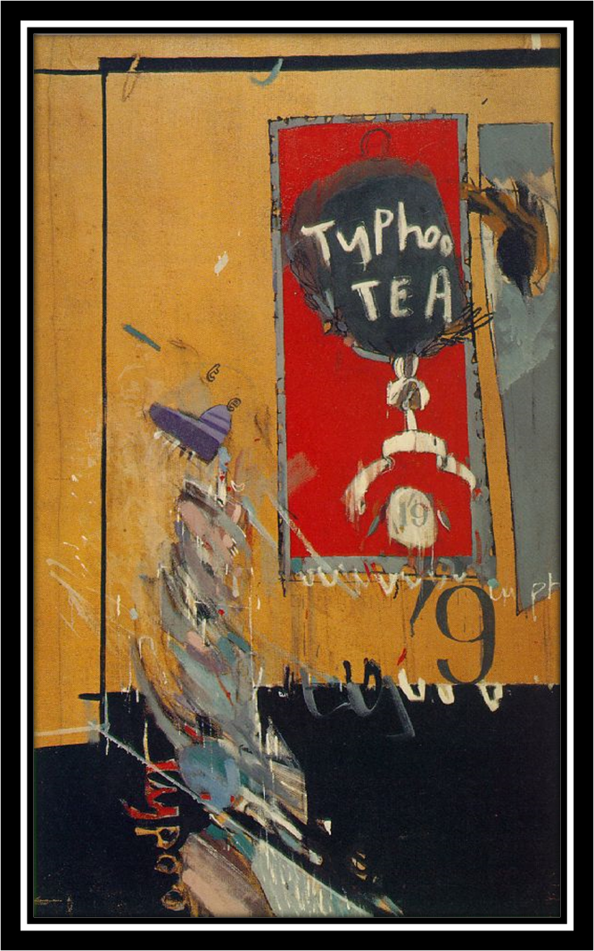
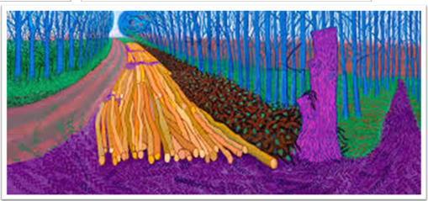
The Road Across the Wolds
1997
The Second Tea Painting 1961 Oil on canvas 61 x 36 in (155 x 91 cm) Private collection
Winter Timber
2009

