Slide 1
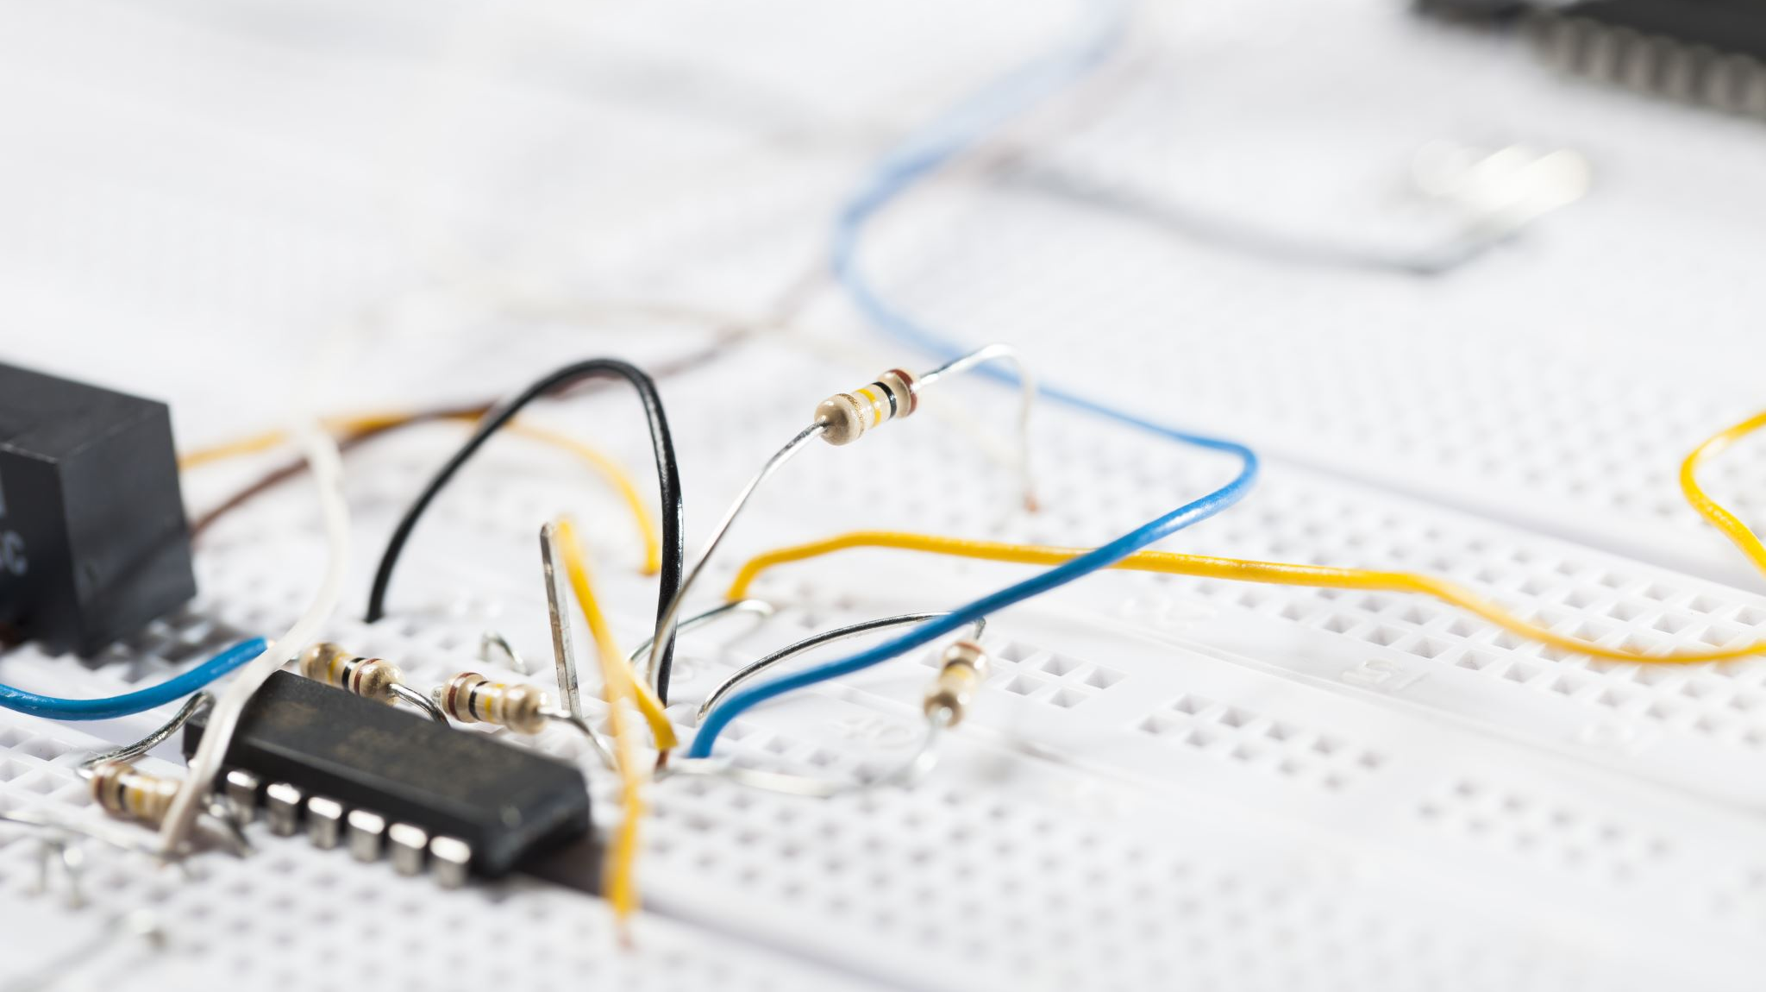
Circuits

Slide 2
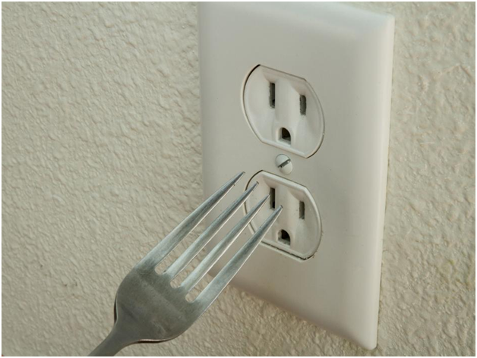
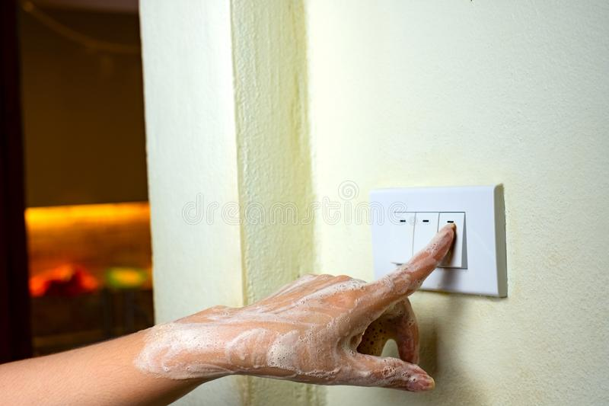
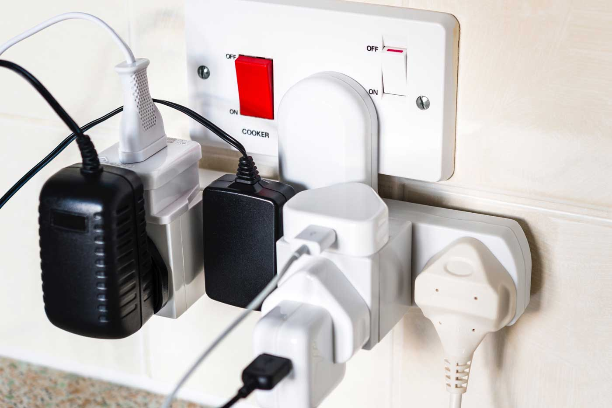
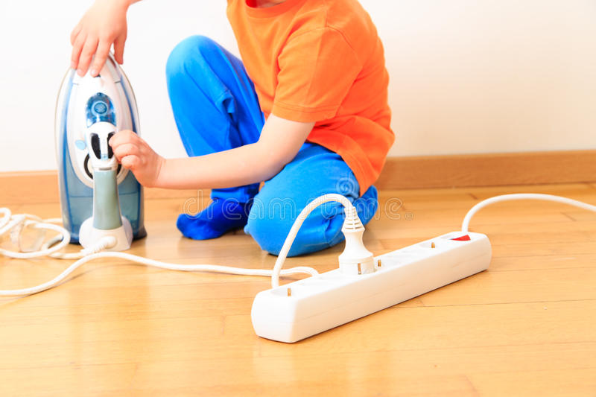
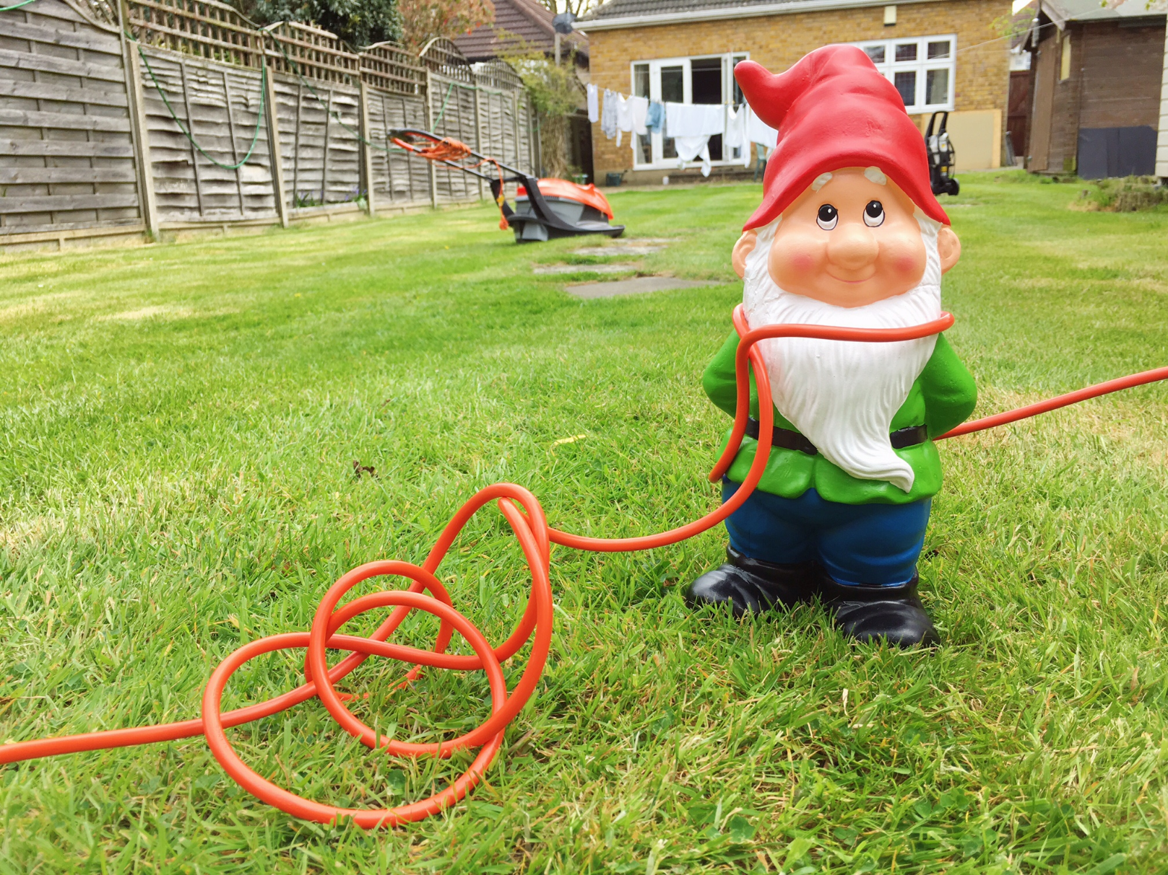
Spot the hazards…

Slide 3
Vocabulary you will need today
circuit – the path around which electricity flows.
current – scientific word for the flow or movement of electricity.
component - the parts of electric circuit (e.g. bulb, wire, buzzer)
cell – changes chemical energy into electrical energy.
battery – one or more cells working together.

Slide 4
Click on the link to watch the video
https://www.bbc.co.uk/bitesize/clips/zq3fb9q

Slide 5
Have a go at explaining this circuit.

Slide 7
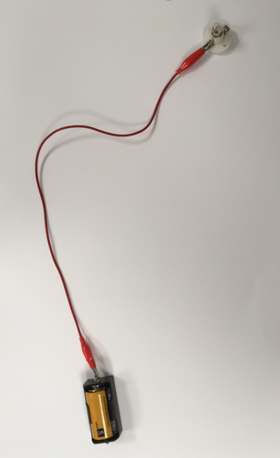
Discussion
Will this circuit work?
Why/why not?

Slide 8
Which of these circuits will work and why?

