Slide 1
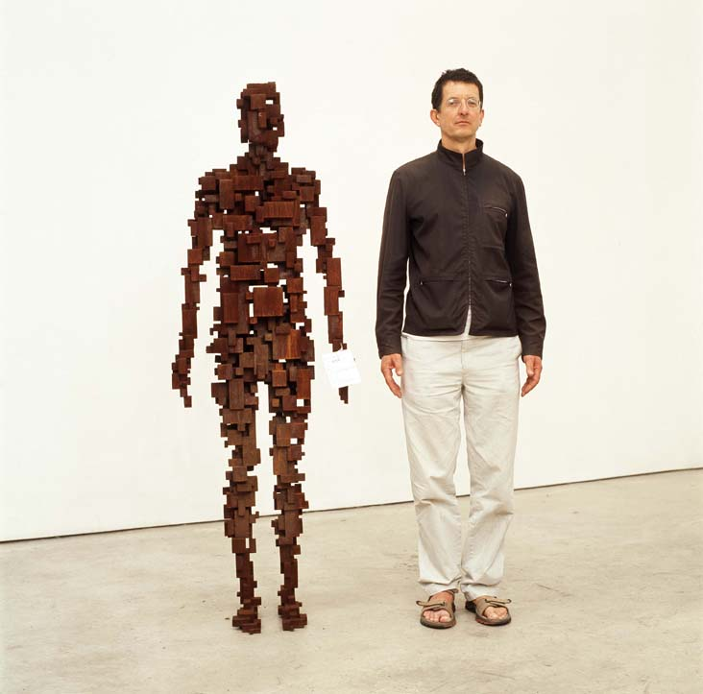
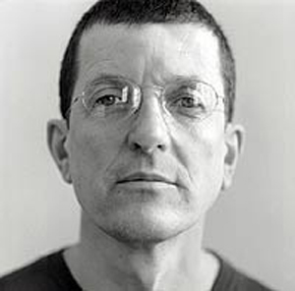
Sculptures by Antony Gormley

Slide 2
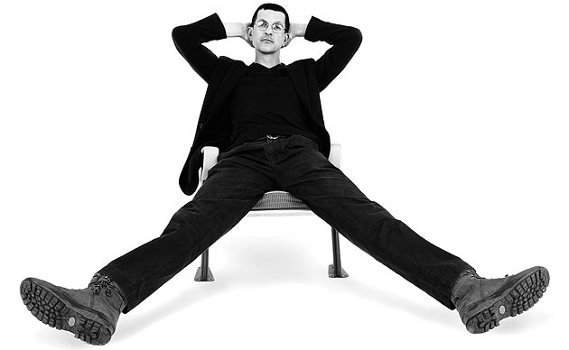
Who is Antony Gormley?
Antony Gormley is a famous sculptor,
who is still alive today.
He was born in London in 1950.

Slide 3
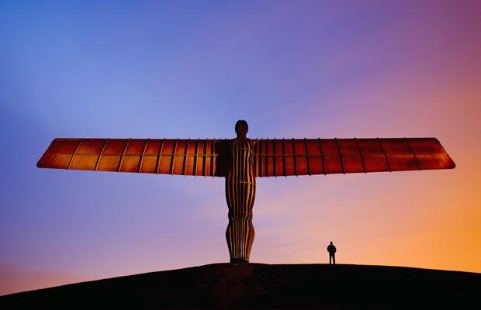
Antony Gormley is probably most famous for creating ‘The Angel of the North’, a sculpture that stands by the side of a busy road called the A1 in Gateshead.

Slide 4
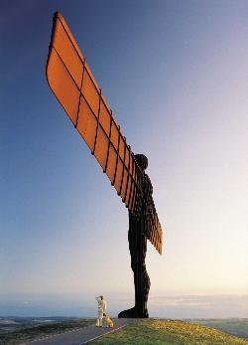
The Angel of the North was built by Antony Gormley in 1998. The Angel is as tall as 4 double decker buses on top of each other and it’s wings are as wide as a jumbo jet!
It is one of the most viewed pieces of art in the world, seen by around 33 million people every year. Have any of you ever seen the Angel of the North?

Slide 5
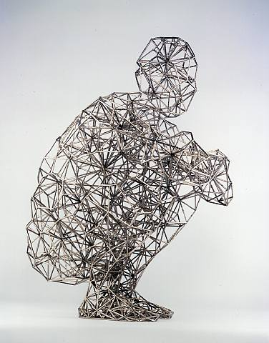
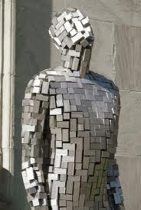
Antony Gormley makes sculptures out of many different materials, including metal, clay and wire. Here are some examples of his work.

Slide 6
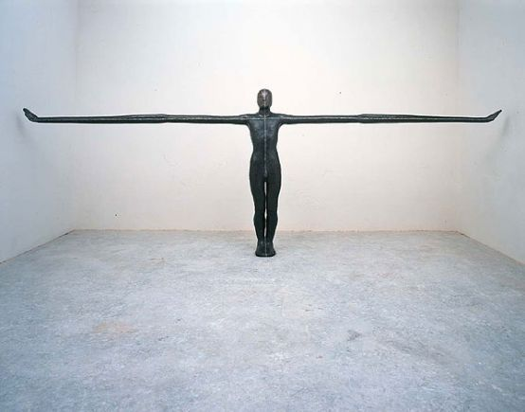

Slide 7
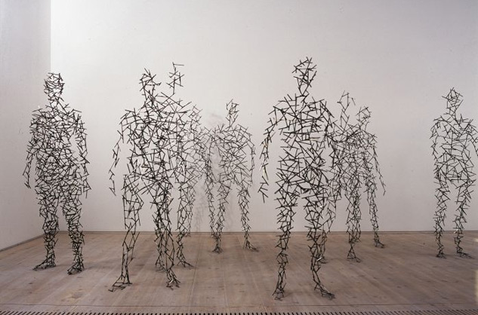

Slide 8
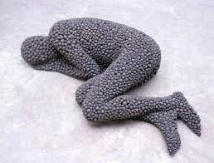
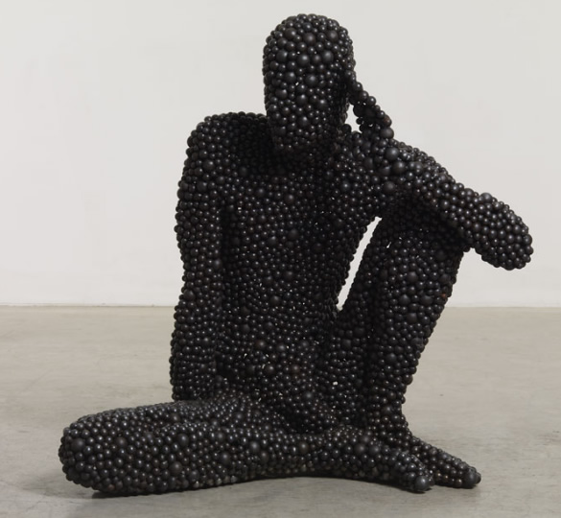
What do you notice about all of these sculptures? What does Antony Gormley like to make sculptures of?

Slide 9
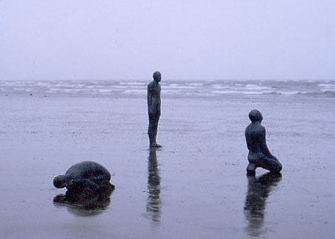
Antony Gormley is well known for his sculptures of people. He arranges the figures in many different ways and in many different settings.

Slide 10
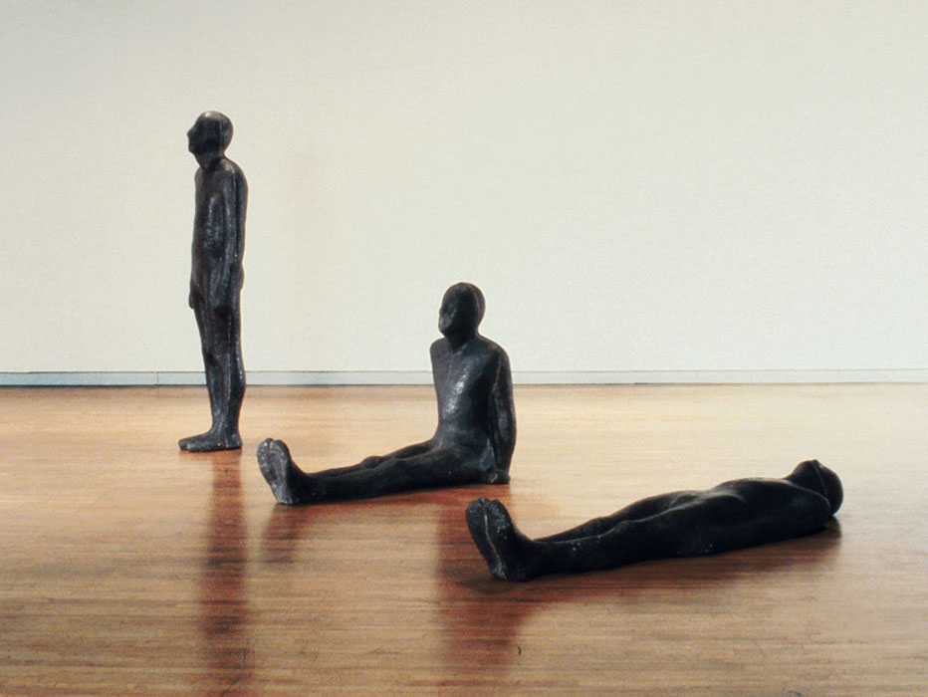
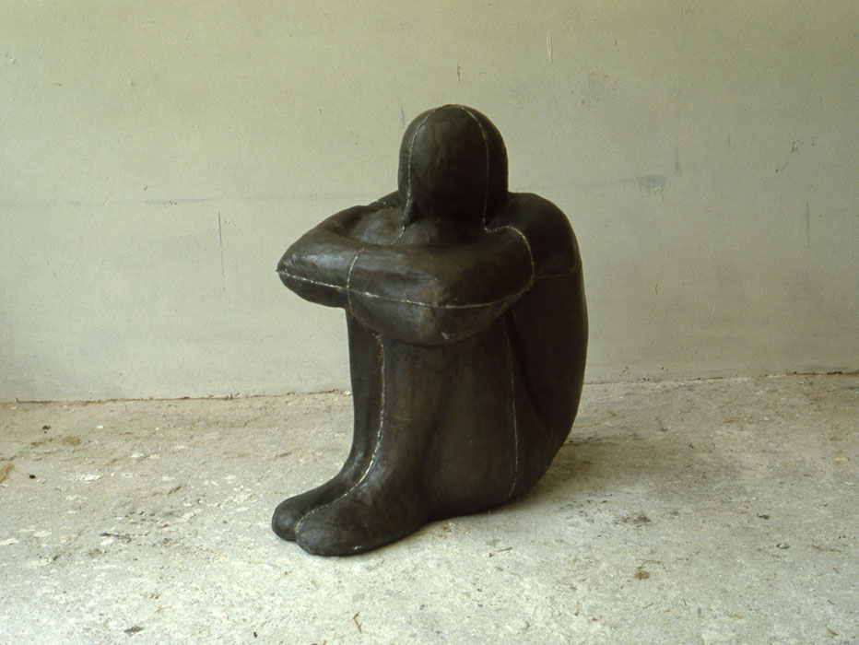
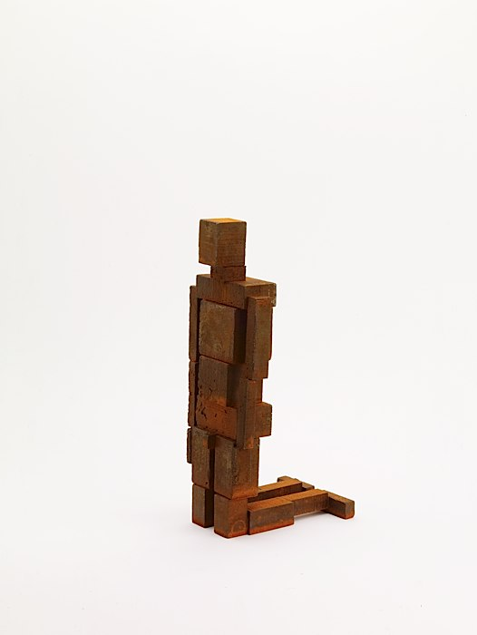
The figures are made into many different positions, for example standing, kneeling, sitting or lying down.

Slide 11
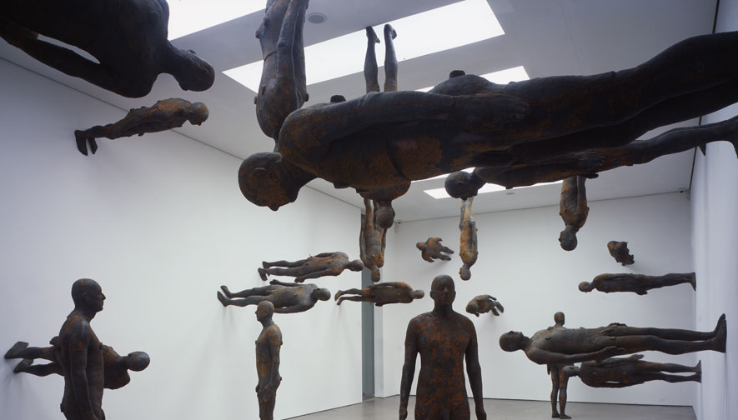
The figures are not always displayed on the floor!

Slide 12
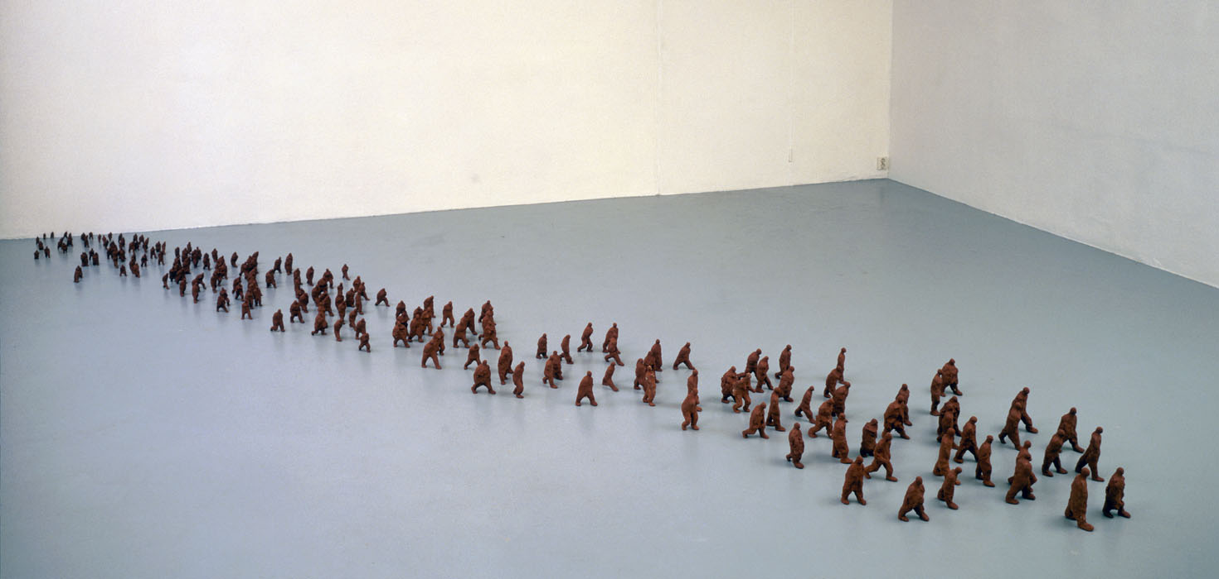
Antony Gormley has also made many works of art using thousands of tiny clay figures.
Day, 1991

Slide 13
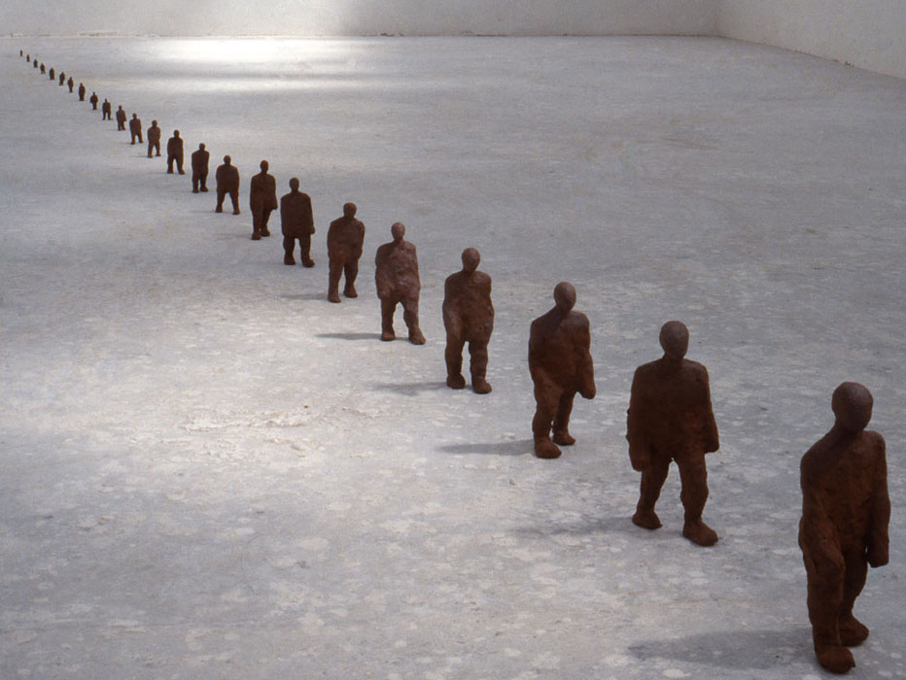

Slide 14
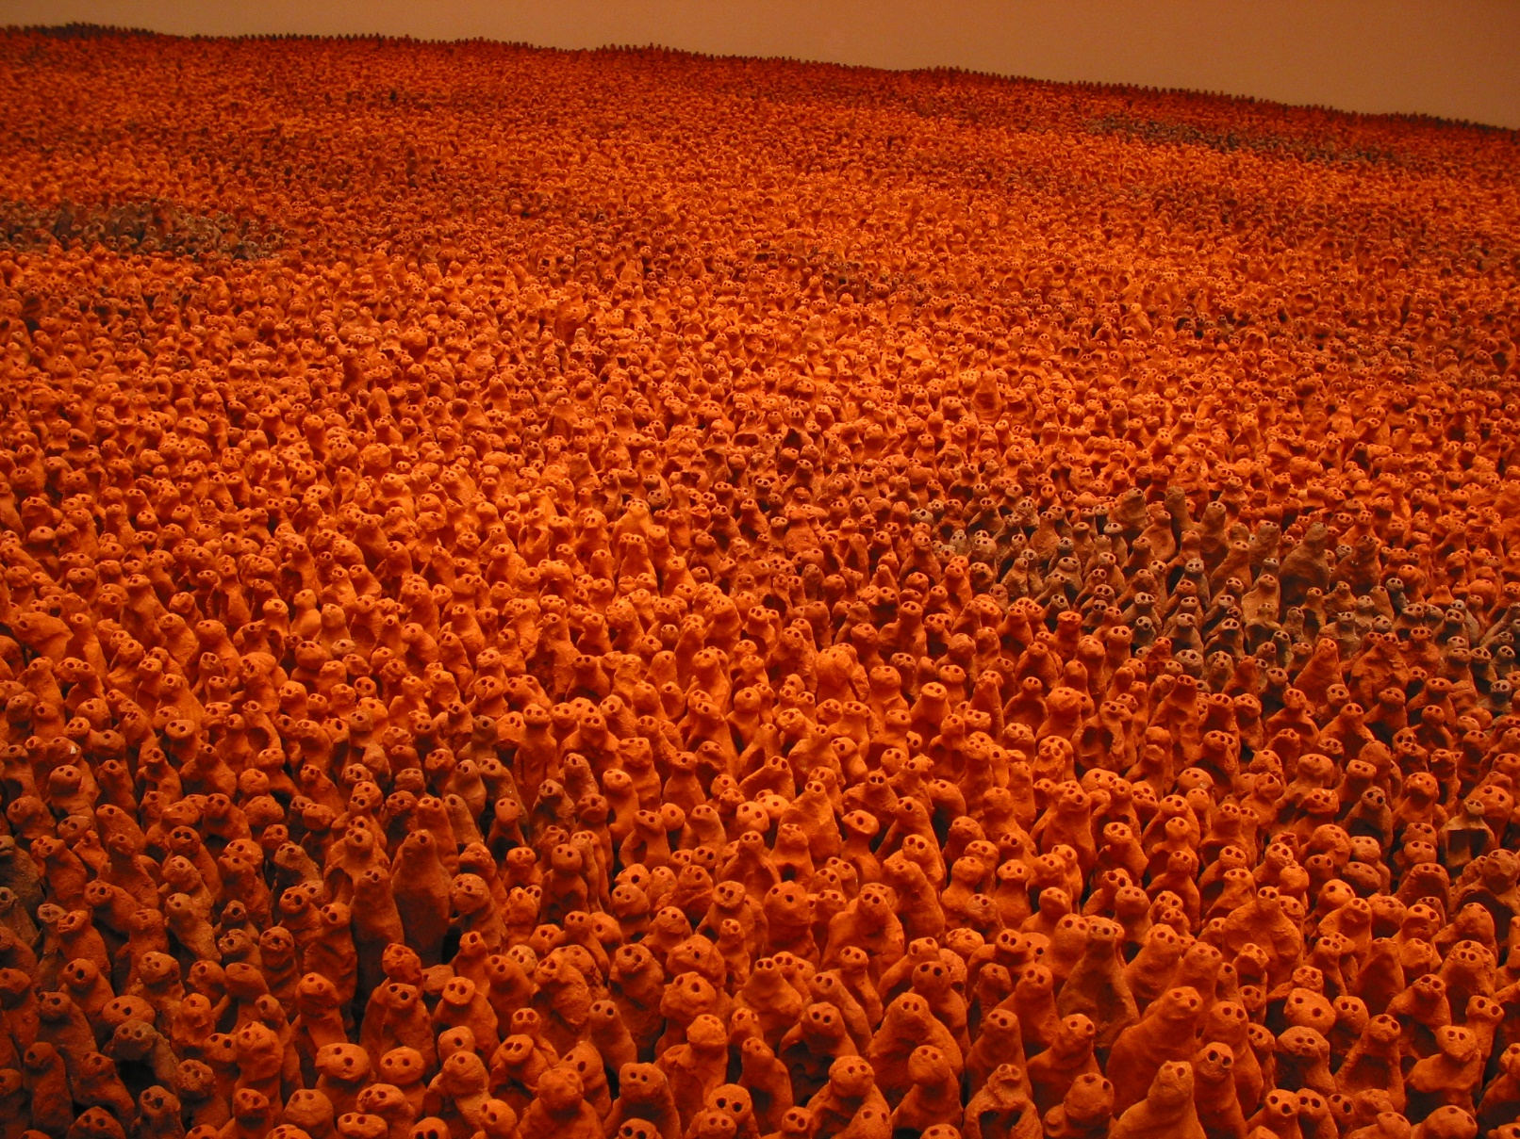
When the figures are set up in a museum, they can often fill the whole room and usually look like they are all walking in one direction.

Slide 15
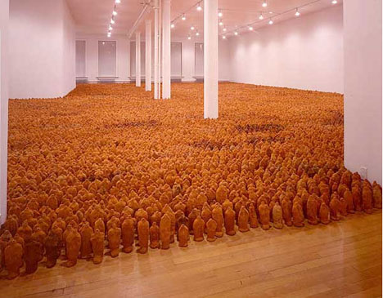
It can take many many hours and lots of people to set up an Antony Gormley piece of art like this one.

Slide 16
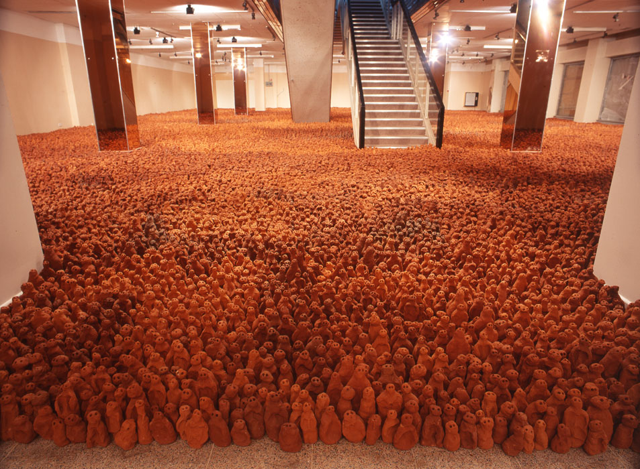
The clay figures were not all made by Antony Gormley himself. This collection were made by about 60 men, women and children aged between 6 and over 60.

Slide 17
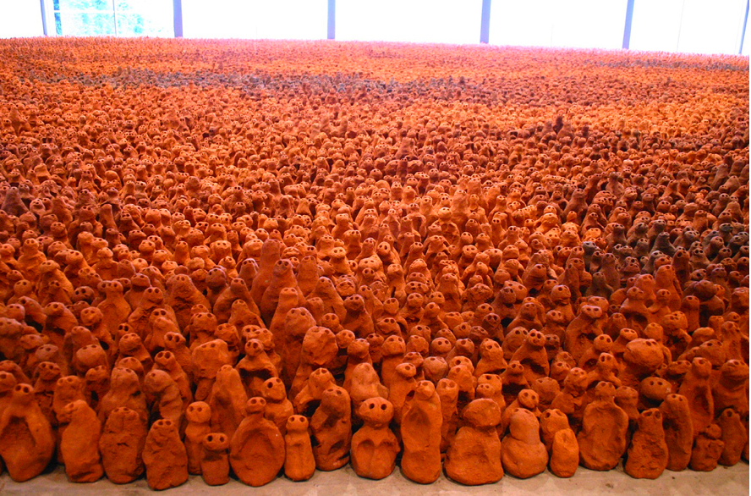
The people who made the figures were given a simple set of instructions. Each figure should be hand-sized and easy to hold. The eyes were to be deep and the head was to be the correct size for the body. The figures range in size from 8cm to 26cm tall.

Slide 18
