Slide 1
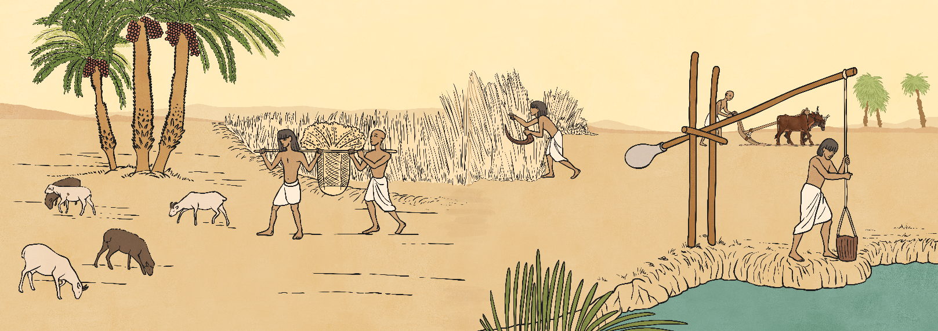
Ancient Egypt
Over 90% of Egypt is covered by desert, which was often referred to as the Red Land and was not easily habitable. The River Nile was a major influence on the daily lives of the people. In ancient times, most of the population occupied the area on the banks of the river, the Kemet or Black Land, named after the dark silt that remained when the flood waters receded. This was where the farmers grew their crops.

Slide 2
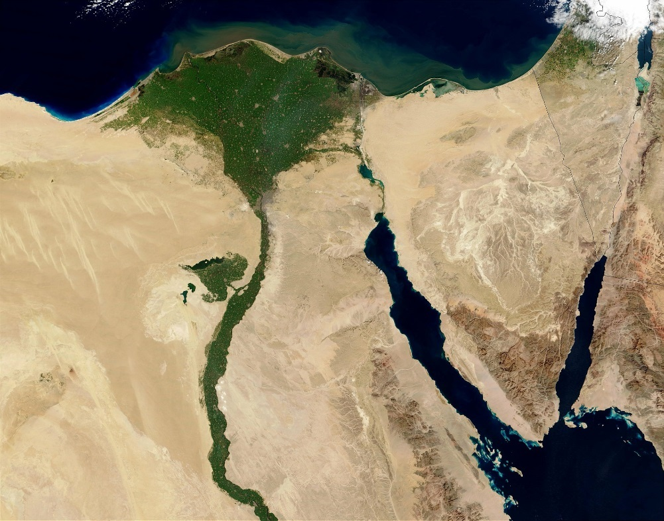
Ancient Egypt Mapping
Today we are going to learn more about the country of Egypt by looking closely at maps of the country and identifying some of the most important landmarks - the cities of Cairo and Luxor, The River Nile, The Valley of the Kings and the Valley of the Queens.

Slide 3
Map of Egypt Labelling Activity
On the blank map of Egypt you have been given, and using the world maps to help you, draw and label The River Nile running north through the country to the Mediterranean Sea.
Label two of the major cities: Cairo, in the north, and Luxor, in the south.
Label The Valley of the Kings, where for nearly 500 years, tombs were constructed for the Pharaohs and Nobles. The Valley of the Kings lies on the West Bank of the Nile.
Finally, label the Valley of the Queens, where the wives of the Pharaohs, as well as princes, princesses and other members of the nobility, were buried. In ancient times this valley was known as Ta-Set-Neferu, “the place of beauty”, and it is also located on the West Bank, near the Valley of the Kings.

Slide 4
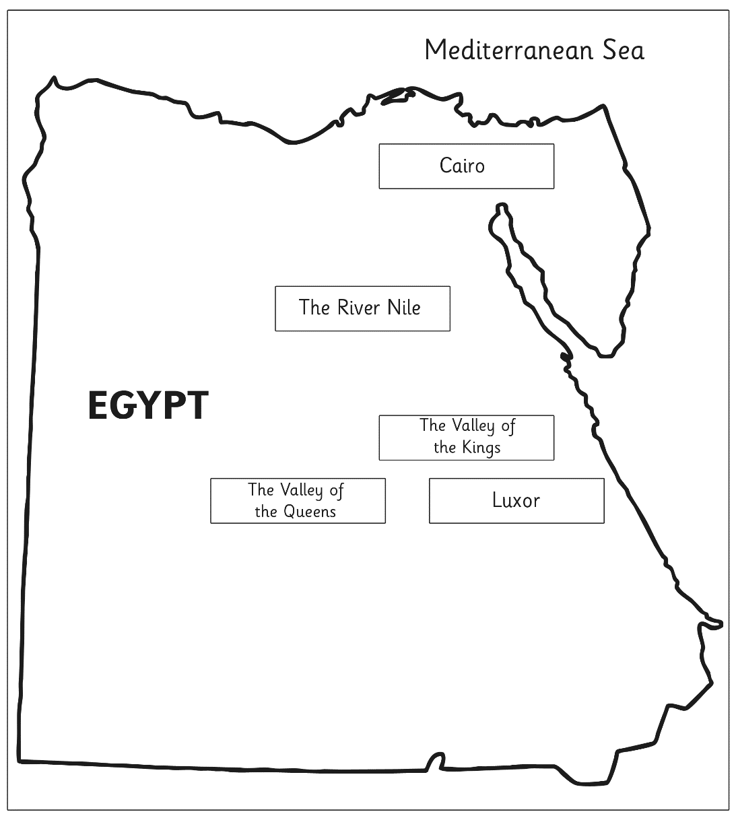
Map of Egypt Labelling Activity

