Slide 1
A Midsummer Night’s Dream
Act 1 Lesson 1.

Slide 2
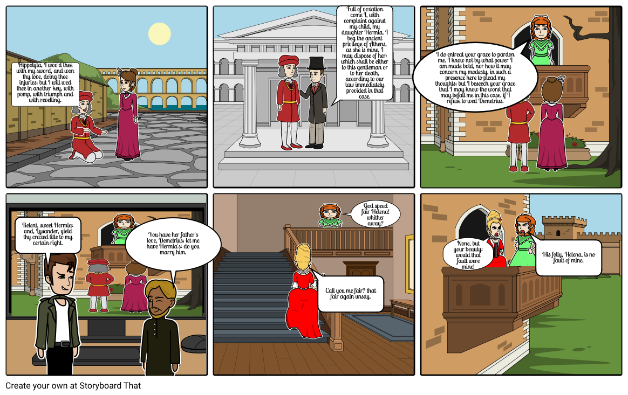
Click on the speaker icon to listen to Mrs Baldry reading the first part of the scene.

Slide 3
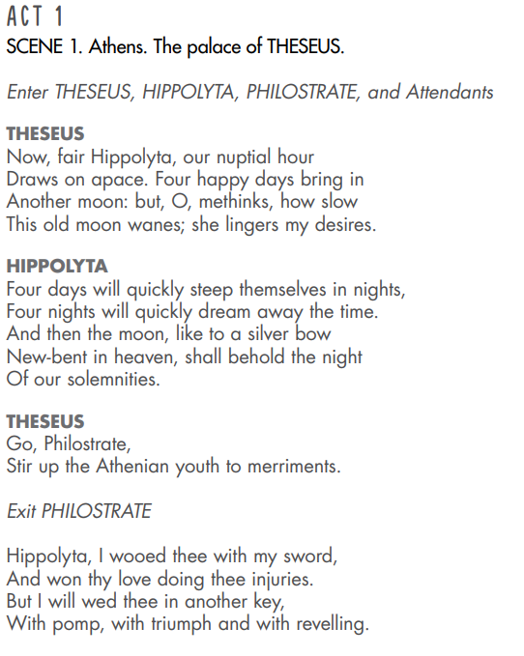
Listen again this time following the text.
Are there any words you don’t understand?
Here, Theseus and Hippolyta are talking about their wedding which will take place in four days time. They are talking about how slow time seems to be going and how excited they are. Theseus wants everyone to be as excited as they are and wants a good celebration.

Slide 4
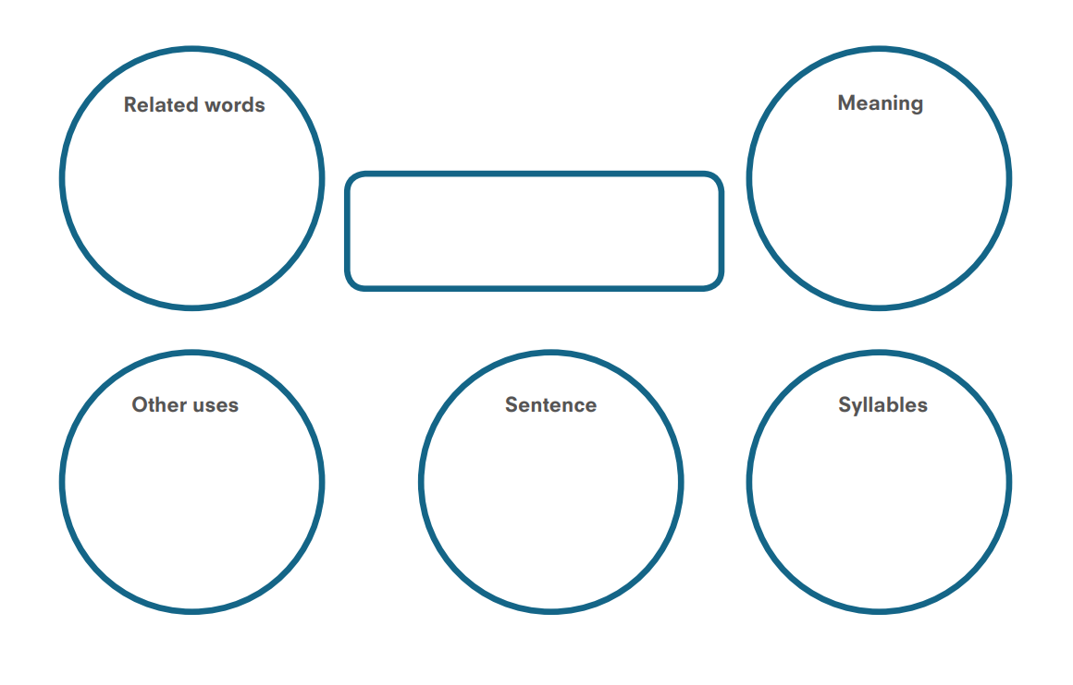
Choose two or three words from the text on the previous slide. Use this checking by exploring sheet to investigate the words. For example:
Betrothal, bridal, marriage, matrimony
A wedding
nuptial
Theseus and Hippolyta were preparing for their nuptials.
This is a tricky one – sometimes your word may not be used in other contexts.
Nup-tial
2 syllables
You can use an online dictionary to help you.

Slide 5
Now you have a go with your two or three words. Do a separate sheet for each word. You don’t have to print it out, you can just copy the boxes/circles onto paper.

