Slide 1
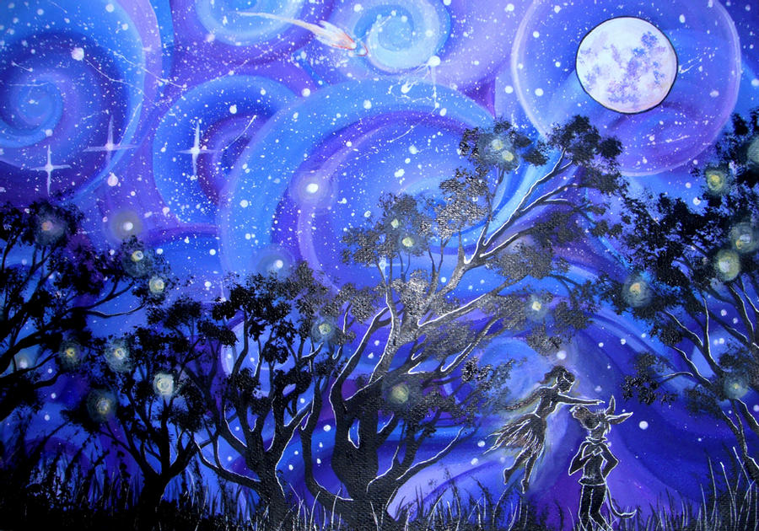
Act 1 Scene 2
Lesson 5

Slide 2
The Mechanicals are rehearsing the play ‘Pyramus and Thisbe’ to present to Theseus and Hippolyta on their wedding day.
Your task is to produce a poster advertising the play. Here are some examples of posters to give you an idea. You need to include the title of the play, where it is taking place (you can make this up), who the actors are that will appear in it and a brief description of the story. (There is a brief description of the story on the next slide.)

Slide 3
This is the brief story of the play the Mechanicals are rehearsing.
Pyramus and Thisbe are in love but their families hate each other. They whisper to each other through a crack in the wall that separates their houses. They eventually grow tired of this and decide to run away to get married.
They decide to meet under a mulberry tree but when Thisbe arrives she sees a lion with blood around its mouth. Thisbe screams and runs away leaving her shawl behind. Pyramus arrives later and finds the lion ripping apart the shawl.
Pyramus thinks Thisbe has been eaten by the lion and stabs himself with his sword. Thisbe later returns and finds Pyramus is dead and so stabs herself with his sword too.

